Slide 1
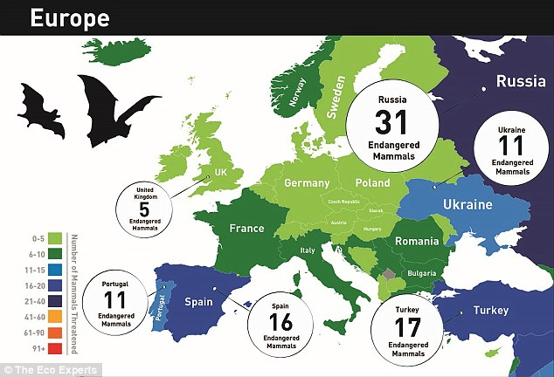
ENDANGERED ANIMALS
In Greece and Europe.

Slide 2
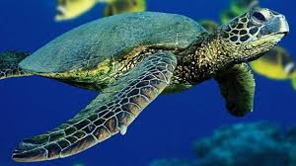
Caretta-Caretta
Caretta caretta, also called commonly the loggerhead, is a species of oceanic turtle distributed throughout the world. The average loggerhead measures around 90 cm in carapace length when fully grown. The adult loggerhead sea turtle weighs approximately 135 kg, with the largest specimens weighing in at more than 450 kg. The skin ranges from yellow to brown in color, and the shell is typically reddish brown.

Slide 3
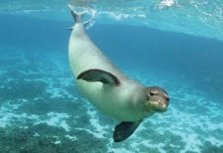
Monachus-Monachus
Monachus monachus is a monk seal belonging to the family Phocidae. As of 2015, it is estimated that fewer than 700 individuals survive in three or four isolated subpopulations in the Mediterranean, (especially) in the Aegean Sea, the archipelago of Madeira and the Cabo Blanco area in the northeastern Atlantic Ocean. It is believed to be the world's rarest pinniped species.

Slide 4
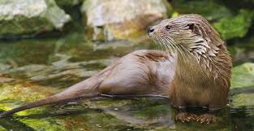
Lutra-Lutra
Lutra lutra, is a semiaquatic mammal native to Eurasia. The most widely distributed member of the otter subfamily of the weasel family, it is found in the waterways and coasts of Europe, many parts of Asia, and parts of northern Africa. The Eurasian otter has a diet mainly of fish, and is strongly territorial. It is endangered in parts of its range, but recovering in others.

Slide 5
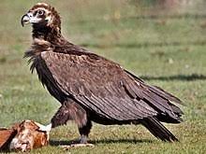
Aegypius monachus
Aegypius monachus is a large raptorial bird that is distributed through much of Eurasia. It is also known as the black vulture, monk vulture, or Eurasian black vulture. It is a member of the family Accipitridae, which also includes many other diurnal raptors such as kites, buzzards and harriers. It is one of the two largest Old World vultures, attaining a maximum size of 14 kg, 1.2 m long and 3.1 m across the wings.

Slide 6
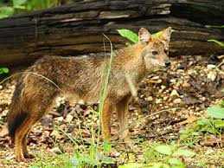
Canis aureus
Canis aureus is a wolf-like canid that is native to Southeast Europe, Southwest Asia, South Asia, and regions of Southeast Asia. Compared with the Arabian wolf, which is the smallest of the gray wolves, the jackal is smaller and possesses shorter legs, a shorter tail, a more elongated torso, a less-prominent forehead, and a narrower and more pointed muzzle.

Slide 7
THE END
Mike Frazoglou

