Slide 1
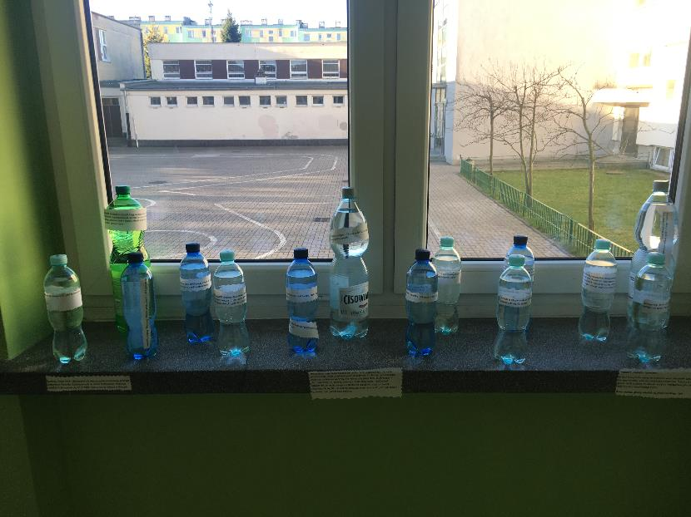
Światowy Dzień Wody
World Water Day

Slide 2
Opiekun (tutor teacher) Agnieszka Borek
Uczestnicy (participants):
Uczniowie z koła przyrodniczego oraz Erasmus +

Slide 3
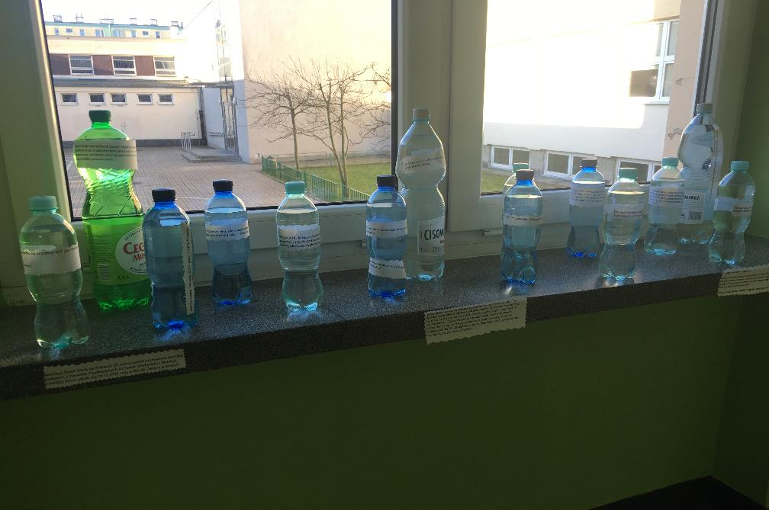
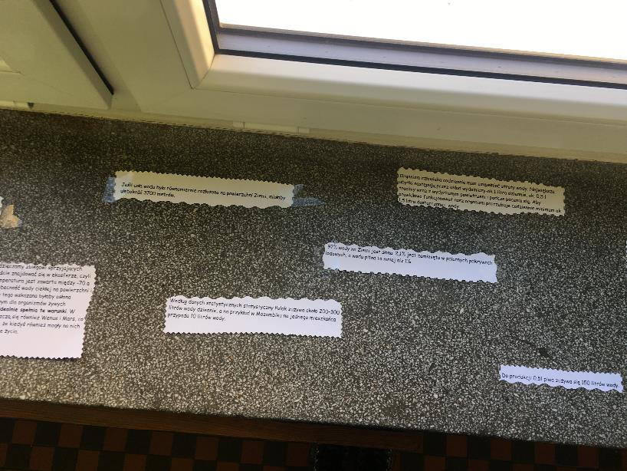
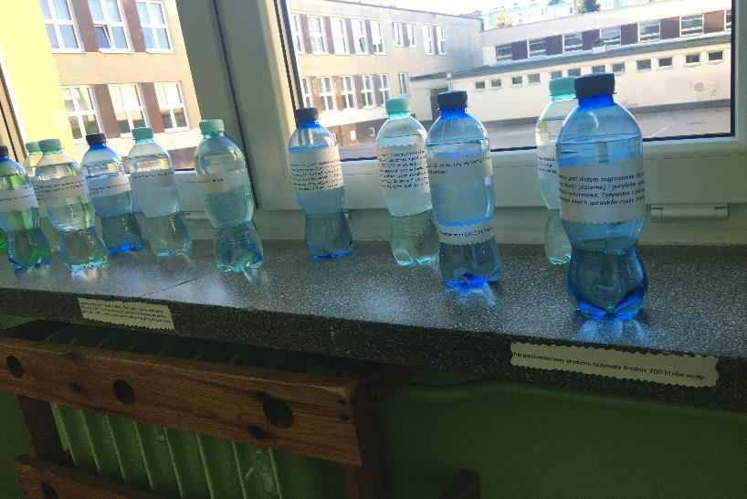

Slide 4
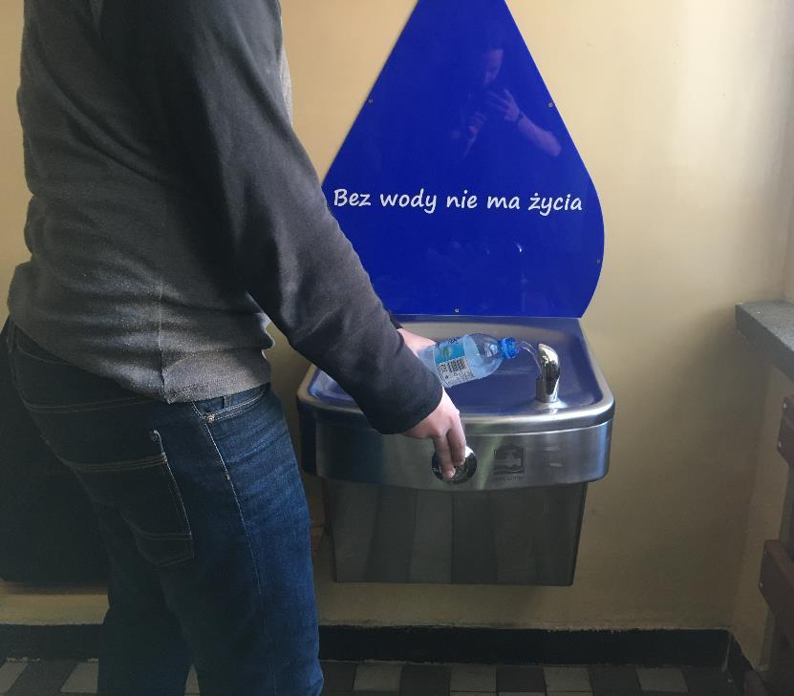
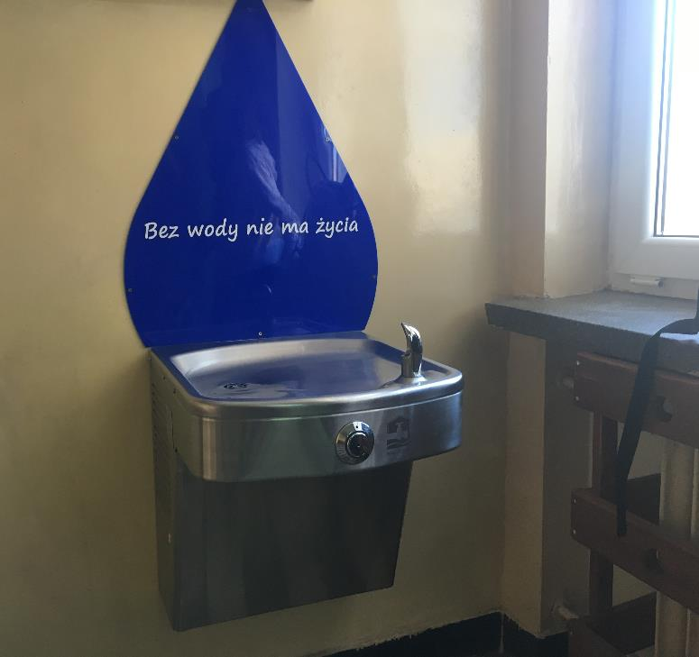

Slide 5
There is no life without water
Everyone drinks about 1 square metre of water a year.
You need 65 litres of water for cheese to fulfill a sandwich ☺
Human body mainly consists of water
You need 150 l of water to produce 0,5 l of beer
You use 200 l of water for a 5 min shower

Slide 6
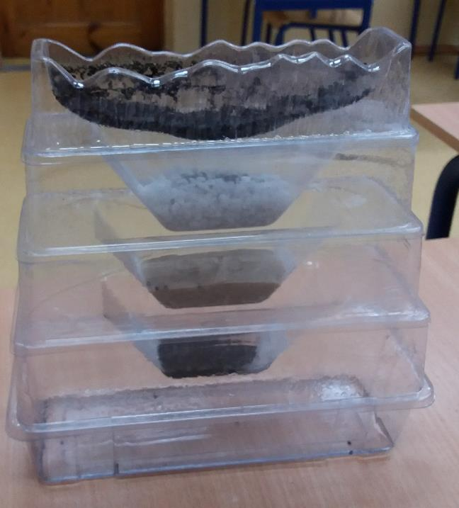
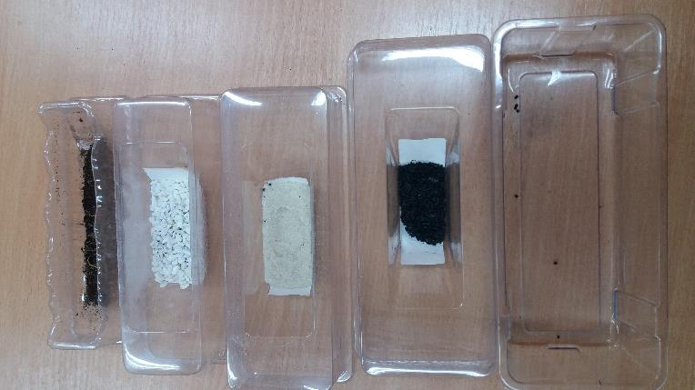
Oczyszczanie wody – water filtration

Slide 7
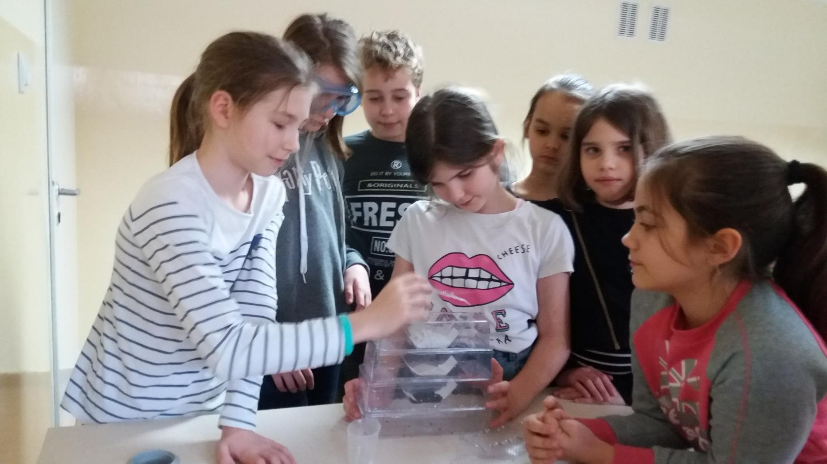

Slide 8
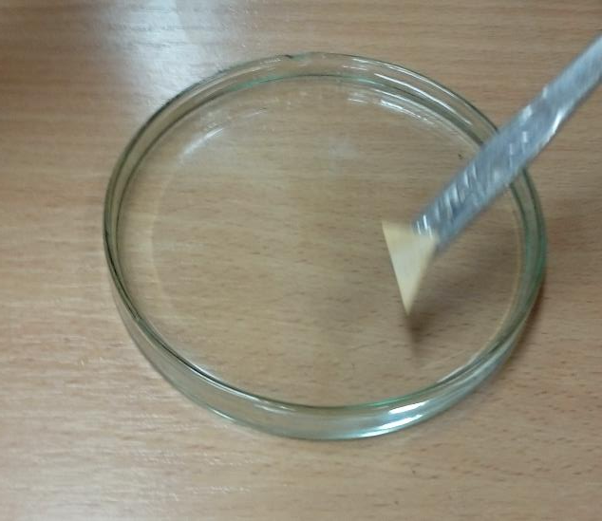
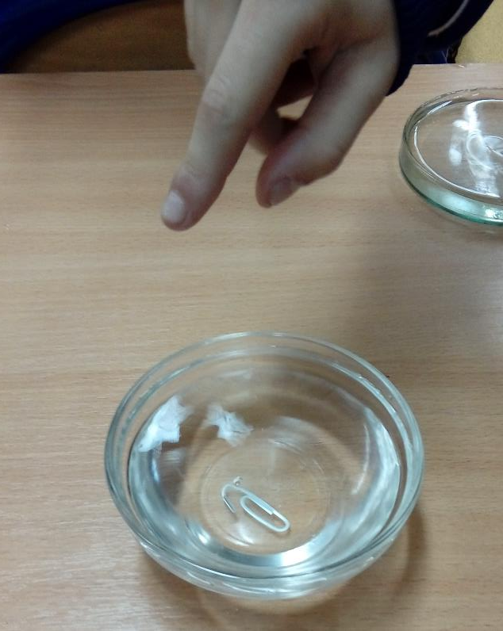
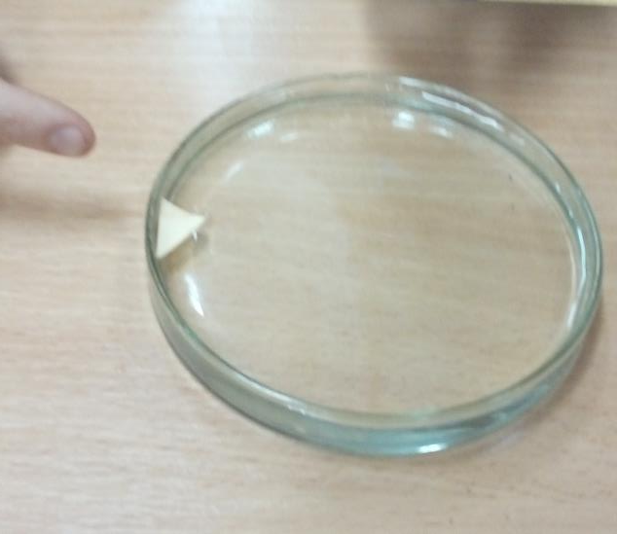
Experiments with water

Slide 9
