Slide 1
World Clean up Day
October, 2018

Slide 2
The team of the project Erasmus+„Stop Climate Change- Together Europe Achieves More“ joint to the action of the World Cleanup Day in Meteliai regional park on October 10

Slide 3
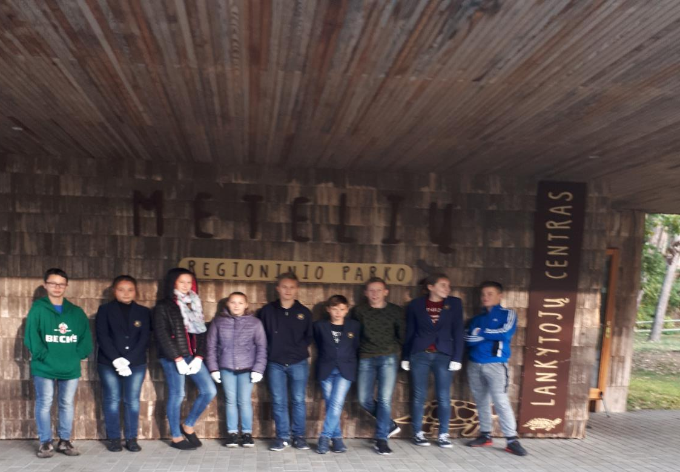
METELIAI REGIONAL PARK

Slide 4
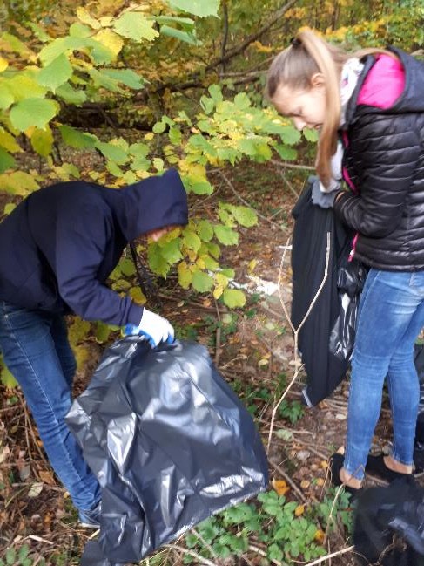
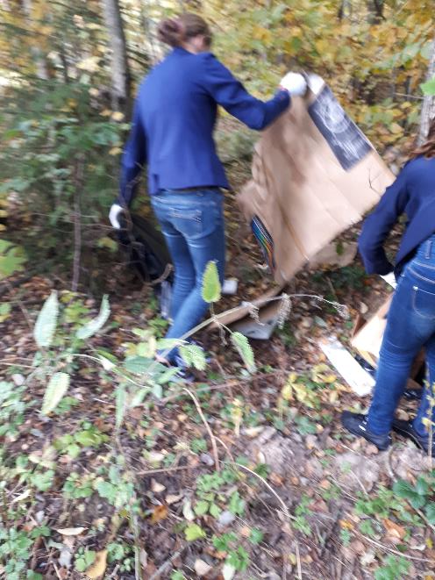
Students carefully picked up different litter: plastic, plastic bottles, papers, glass.

Slide 5
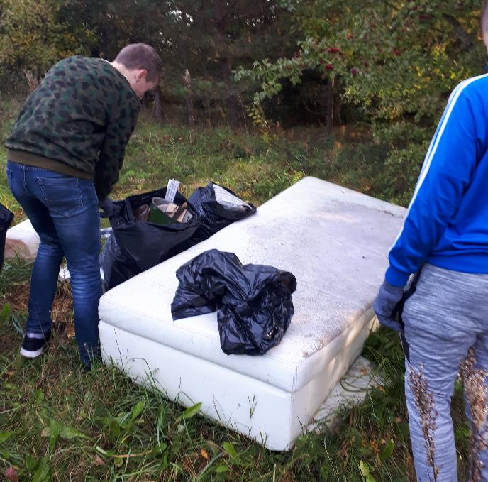
They found even a sofa near the forest.

