Slide 1
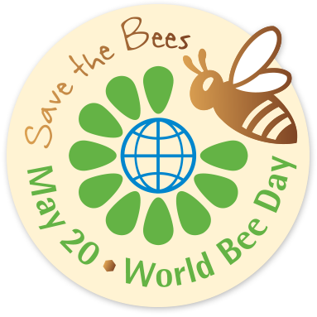
World bee day
Erasmus+ project: Stop Climate Change: Together Europe achieves more The Netherlands

Slide 2
The importance of bees
For a world without hunger: - Every third spoonful of food depends on pollination - Bee products are a rich source of indispensable nutrients.
For sustainable farming and jobs: - Effective pollination increases the amount of agricultural produce, as well as the diversity of our fields and our plates - It provides jobs for millions of people and is an important source of income for farmers.
For preserving the environment: - Pollinators ensure biodiversity and have positive effects on the entire ecosystem; they also signal the health of local ecosystems.

Slide 3
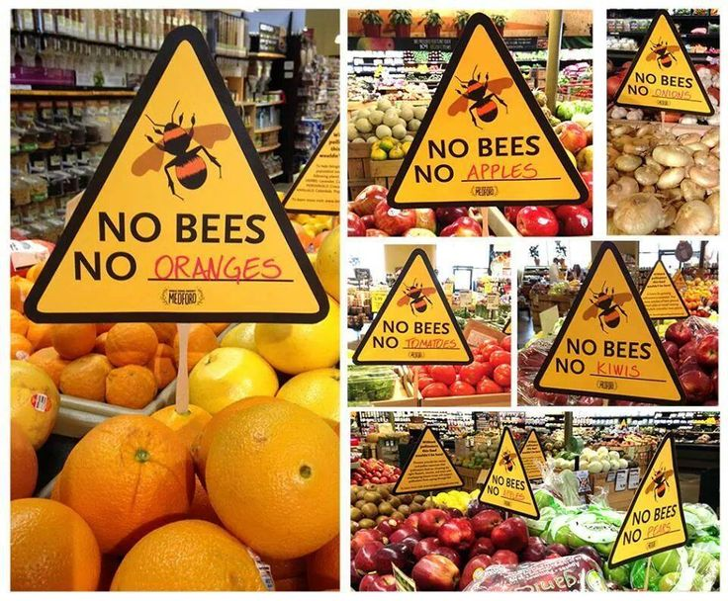
Why world bee day
On the 20th of may it is world bee day. Bees and other pollinators are endangered and need to be protected. They are endangered because of: - Diseases, such as varrosis, nosemosis and viruses - Lack of food due to intensive farming (monoculture, frequent mowing of meadows - Use of pesticides - New pests, which spread around the world more quickly due to globalization - Urbanisation, which is shrinking agricultural spaces - Climate change, which is our subject during the erasmusproject.

Slide 4
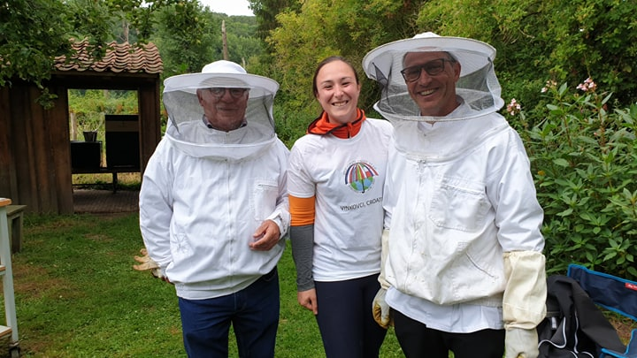
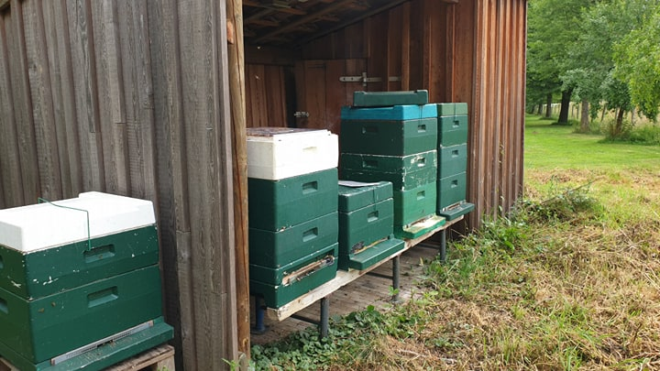
Visit to local beekeepers
We went to local beekeepers on world bee day to learn more about bees and the importance of bees. They also showed us how the bees live and how they make honey.

Slide 5
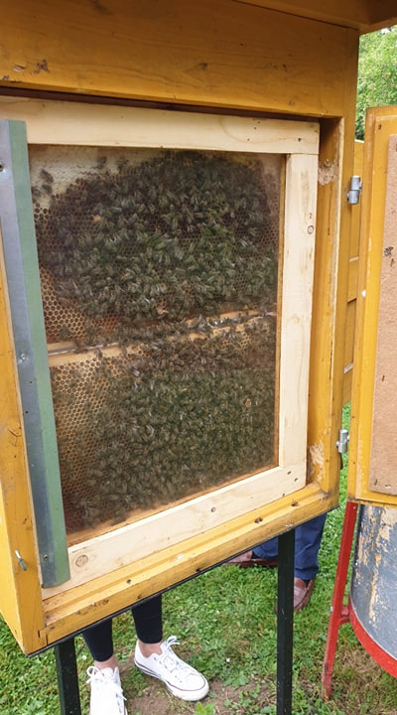
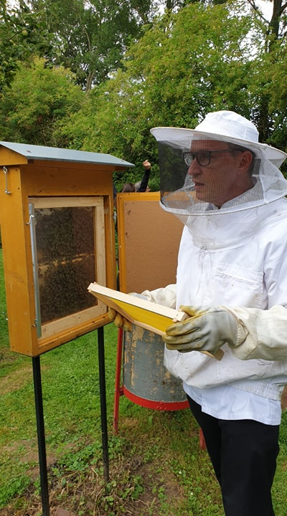

Slide 6
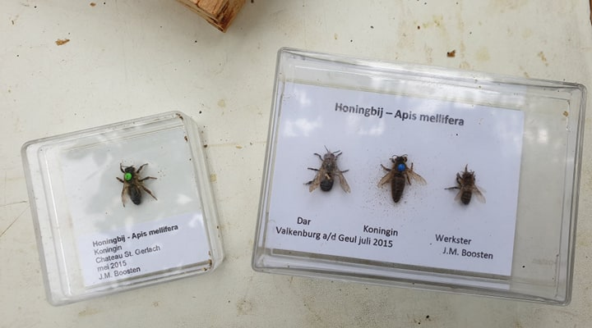

Slide 7
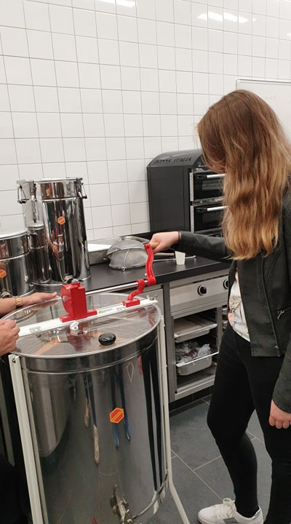
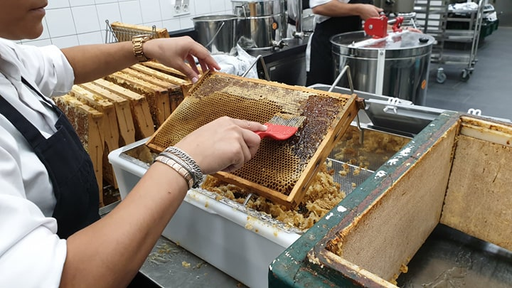

Slide 8
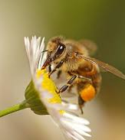
What can you do?
Every individual can contribute to the preservation of bees and other pollinators:
- Plant nectar-bearing flowers for decorative purposes on balconies, terraces, and gardens.
- Buy honey and other hive products from your nearest local beekeeper.
- Raise awareness among children and adolescents on the importance of bees and express your support for beekeepers.
- Set up a pollinator farm on your balcony, terrace, or garden; you can either make it yourself or buy at any home furnishings store.
- Preserve old meadows – which feature a more diverse array of flowers – and sow nectar-bearing plants.
- Cut grass on meadows only after the nectar-bearing plants have finished blooming.
- Offer suitable farming locations for the temporary or permanent settlement of bees so that they have suitable pasture. They will pollinate our plants, which will thereby bear more fruit.
- Use pesticides that do not harm bees, and spray them in windless weather, either early in the morning or late at night, when bees withdraw from blossoms.
- Mulch blooming plants in orchards and vineyards before spraying them with pesticides so that they do not attract bees after being sprayed.

