Slide 1
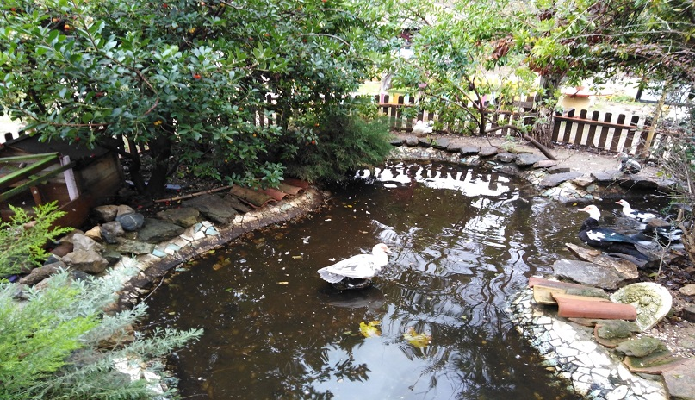
WILD LIFE INTERNATIONAL DAY 3/3/2020

Slide 2
Teacher and students working on Erasmus Project “Stop climate Change” visited …

Slide 3
… an environmental park of Keratea, a region in Attiki …

Slide 4
… where they learned about wild life and climate change.

Slide 5
World Wildlife Day is an opportunity to celebrate the many beautiful and varied forms of wild fauna and flora and to raise awareness of the multitude of benefits that conservation provides to people.

Slide 6
At the same time, the Day reminds us of the urgent need to step up the fight against wildlife crime and human induced reduction of species, which have wide-ranging economic, environmental and social impacts.

Slide 7
Students attended a lecture and took part in interactive games.

