Slide 1
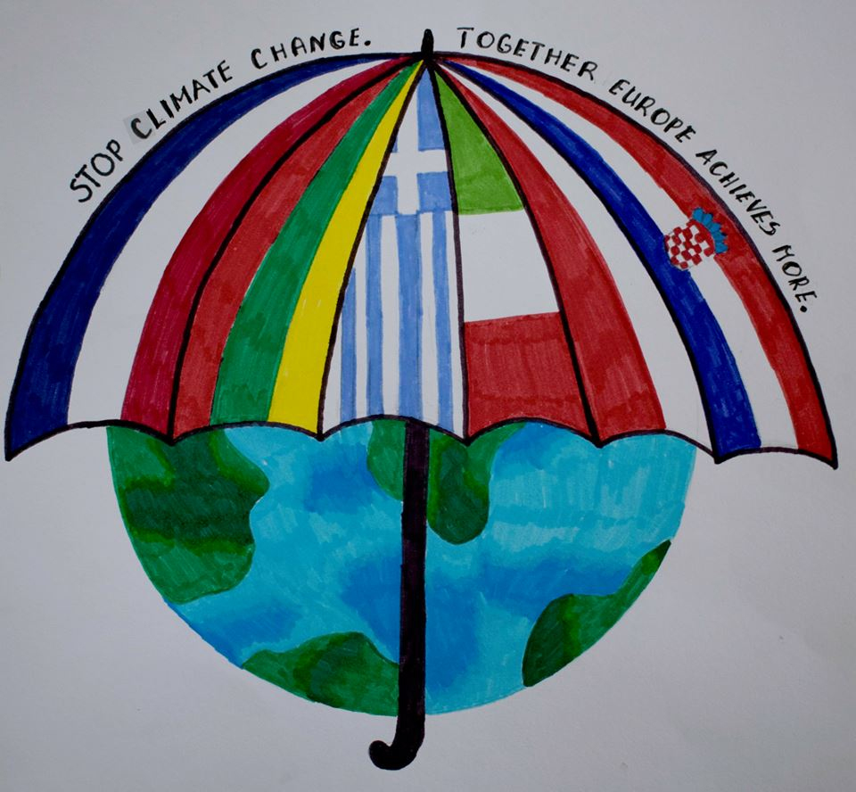
Weather & Climate
Roermond Holland 2019

Slide 2
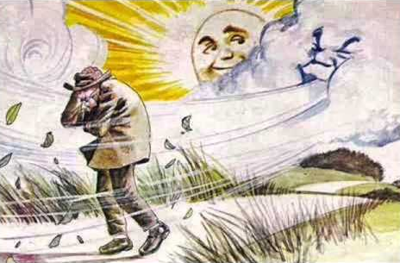
Aesop's Tale about the Sun and Wind

Slide 3
How the Weather Affects us
Our habits, our dressing, our travels, even how we feel.
Correspond the feelings (Anxiety, restraint, joy, depress, discomfort)
to the following weather conditions:

Slide 4
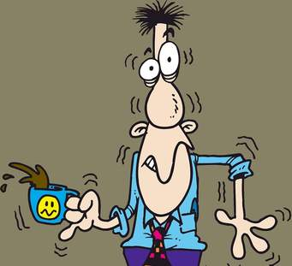
It has a lot of Heat!

Slide 5
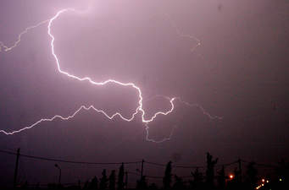
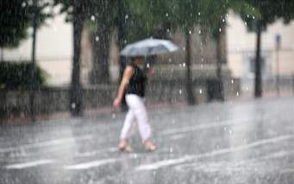
A strong storm breaks out…

Slide 6
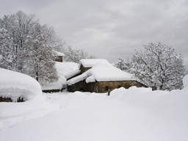
It’s Snowing!

Slide 7
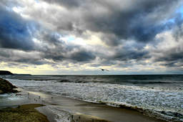
Cloudy

Slide 8
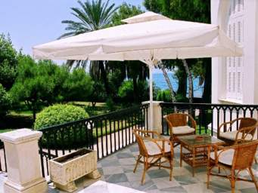
Sunny Day

Slide 9
How Weather Affects Occupations
Imagine, for example, how the following occupations are affected and write the appropriate sentence, from the list below

Slide 10
How Weather Affects Occupations
Fishermen, where strong winds prevail in their area.
………………………………………………………
Farmers, when heavy snowfall catches their animals on the slopes.
………………………………………………………
Farmers, when hail falls in their crops.
………………………………………………………

Slide 11
How the Weather Affects Plants and Animals
what is happening:
(d)to a wildflower lying on a slope when it has not rained for weeks
…………………………………………………………
(e) to a bunch of grapes when it falls a lot of rain a few weeks before the full maturity in August
…………………………………………………………
( f) to a bear when there is prolonged heat during the winter.
………………………………………………………

Slide 12
Choose the Correct Answer
1.He has lost income because the crops are destroyed.
2. The animals cannot graze and must be fed with ready food.
3. He is losing income because he cannot fish.
4. The bear will not fall into hibernation and there will be a risk of hunger.
5. The bunch of grapes will be destroyed by the rain.
6. The wildflower will wither and dry.

Slide 13
What is the weather?
When we talk about the weather, we mean:
the temperature,
the wind,
the rain,
the atmospheric pressure and
the humidity
…. that prevails in a place for a short time, for two or three days.
The weather is changing from day to day and it can change several times even in the same day.

Slide 14
What is climate?
The climate is the weather conditions :
temperature
wind,
rain
humidity
….that are repeated in a certain region almost in the same way, every season, for many years (about 30 years).
.

Slide 15
Climate:
influences the life on the planet Earth
regulates the kind of animals and plants that live in one place
guides farmers to choose the seeds to be sown
arranges the type of houses we will make, what kind of food we eat, what clothes we will wear in each region.

Slide 16
There are several kinds of climates on Earth
Some of the climate types are:
the Mediterranean
Ocean
Continental
Desert
Transitional
Temperate
Mountain
Polar climate

Slide 17
Write the Climate Corresponding to Each Country
Switzerland | Denmark | Slovenia | Estonia | Malta

Slide 18
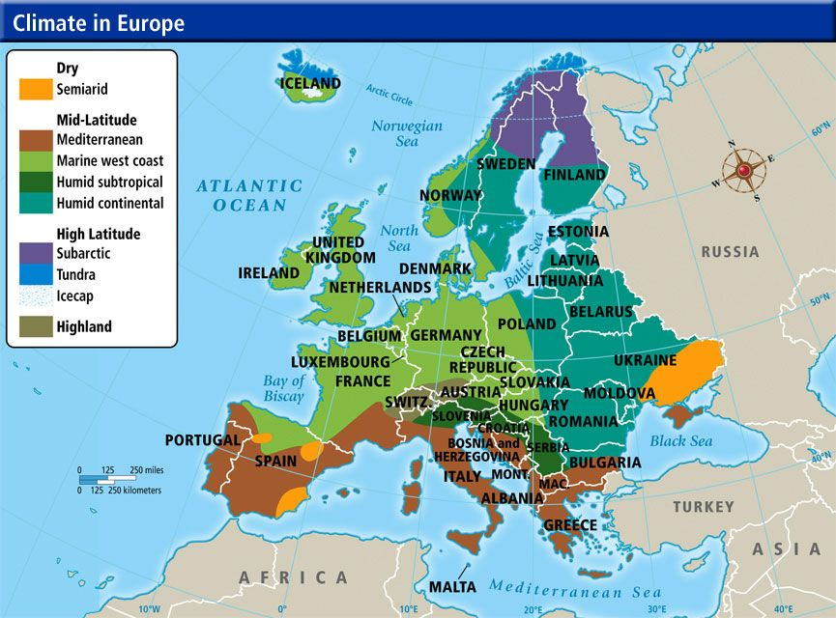

Slide 19
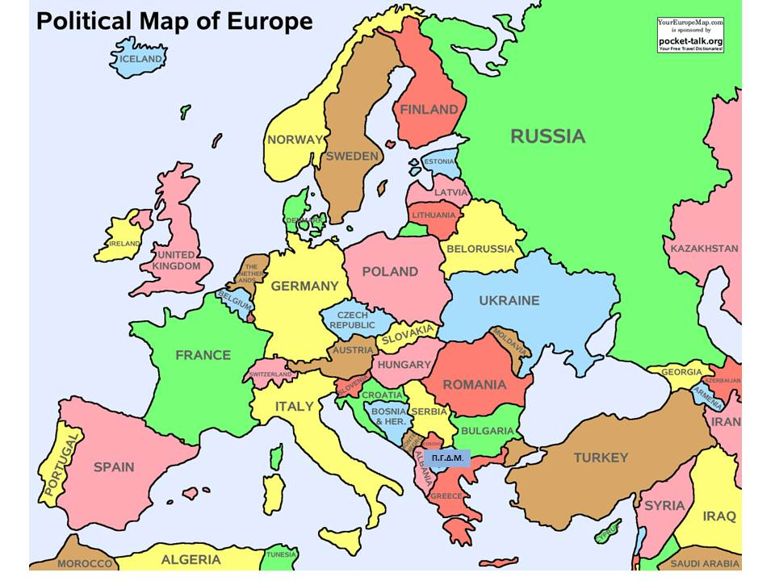

Slide 20
Climate Types
1) The climate is mainly the Mediterranean. However, due to the country's unique geography, there is a remarkable range of microclimates and local variants.
To the west of the main mountain range, the climate is generally more humid and has some marine features. The eastern part of Mountains is generally drier and hotter in the summer.
The northern regions have a transitional climate between the mainland and the Mediterranean climate.
There are also mountainous areas with alpine climate.

Slide 21
Climate Types
2) The climate is mostly oceanic with western winds.
The rains are abundant throughout the year (except winter), while temperatures are relatively mild in the winter and cool in the summer.
Snowfall occurs mainly from the beginning of December until the end of February. Rain has all the rest of the year and especially during the summer months.
Temperatures range from -2 to 5 degreeς in winter and from 11 to 22 degrees in the summer.
Temperature variations in both summer and winter are relatively small, and this is because in winter a hot stream that comes every year from the Gulf of Mexico affects the temperature of the sea, so it almost does not freeze.

Slide 22
Climate Types
3) Mild climate with significant differences between the different regions, even the closest ones.
In the Alps, there are low temperatures and notable thermal rainfall.
The Po's plain has a continental climate without many rainfalls.
The Apennines area has a continental character that becomes more apparent in the interior.
In the island and the Ionian region, the climate is typically the Mediterranean, with mild winters and hot summers.
Rainfall is minimal and concentrated mainly in the winter.

Slide 23
Climate Types
4) Climate, which ranges between sea and continental, is relatively mild.
Average coast temperatures are -2° C in January and +16 ° C in July.
During the summer, 20 ° C is frequent during the day while 14 °C is frequent at night.
Some winters may be very cold. Temperatures reach -20 °C occurs almost every winter.
Extreme winter temperatures are -34 ° C in coastal areas and at -43 ° C in the east.
The climate of the country is continental with wet winters and wet summers.

Slide 24
Climate Types
5) The climate is very similar to the Mediterranean.
It is characterized by warm summers, many sunny days and mild and rainy winters.
The warmer months are July and August when the air temperature is between 25 °C and 35°C.
It is very rarely rained at this time, and that is why it is considered to be the peak of the tourist season.
Is one of the sunniest coasts in the world

Slide 25
Climate Types
6) The climate is mildly continental due to the prevailing western ocean winds.
To the East it becomes more continental There are western streams of liquid and hot air.
The average annual temperature is 8 ° C, with the largest rainfall occurring in the summer.

Slide 26
Which of the following phrases refer to the weather and which to the climate of a place?
1)The next heat wave is expected. Weather or Climate
2)The summer in Greece is warmer than the summer in Sweden. Weather or Climate
3)Our day started sunny but suddenly a storm broke out that made us soak! Weather or Climate
4)In Warsaw (city of Poland) the winters are mild and the summers are cool with abundant rainfall.. Weather or Climate

Slide 27
Which of the following phrases refer to the weather and which to the climate of a place?
5) The temperature will fall in the next 24 hours. Weather or Climate
6)In this season, every year there is snowfall. Weather or Climate
7) The Piraeus Port Authority does not allow ships to travel due to strong winds. Weather or Climate
8) If March has two rains and April has another one, this is good for the farmer who has a lot of plants.
Weather or Climate

Slide 28
Thank you for your attention and work!

