Slide 1
Water footprint Ways of reducing water consumption

Slide 2
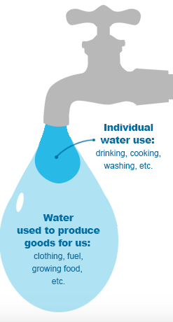
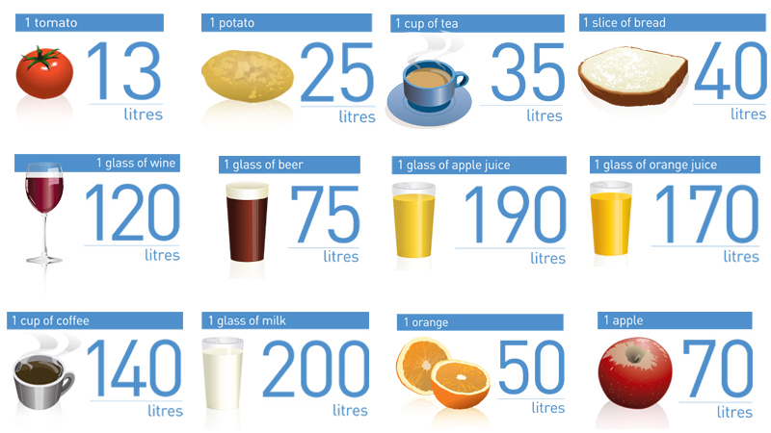
What is water footprint?
Everything we use, wear, buy, sell and eat takes water to make.
The water footprint is a measure of humanity’s appropriation of fresh water in volumes of water consumed and/or polluted.

Slide 3
Water Footprint for food items
Making just a few changes can significantly reduce your water footprint. For example, the water footprint of 200 grammes of beef is the equivalent to 47 eight-minute showers and uses four times more water than the same amount of chicken meat.
If a couple were to eat chicken instead of beef, they would reduce their water footprint by as much as 450 000 litres over a year. Vegetables have an even smaller water footprint.

Slide 4
The countries with the larger amount of water footprint
Average national water footprint per capita (m3/capita/yr). Green means that the nation’s water footprint
is equal to or smaller than global average. Countries with red have a water footprint beyond the global average

Slide 5
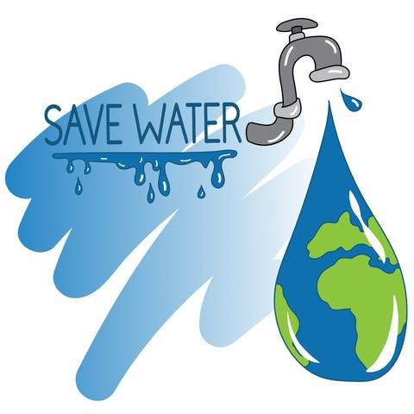
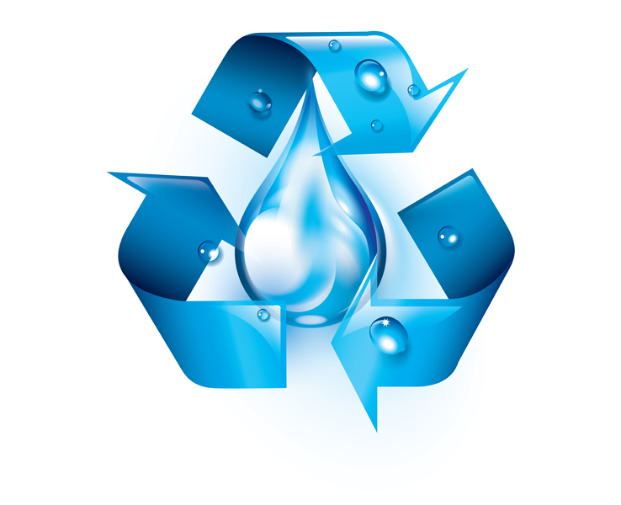
Ways of reducing water consumption at home
Check for leaks
Get in the habit of taking showers rather than baths
Turn taps off when you are brushing your teeth or washing your hands
Avoid waste of water e.g. washing car often
Use modern equipment with water economy mode

Slide 6
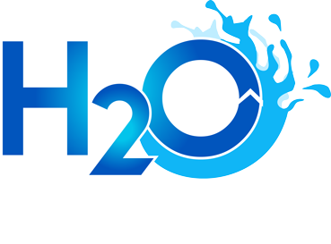
The end
Zinovia Kontaxopoulou

