Slide 1
Water footprint , Water Shortage & How To Save Water
Έλενα Νικολακέα

Slide 2
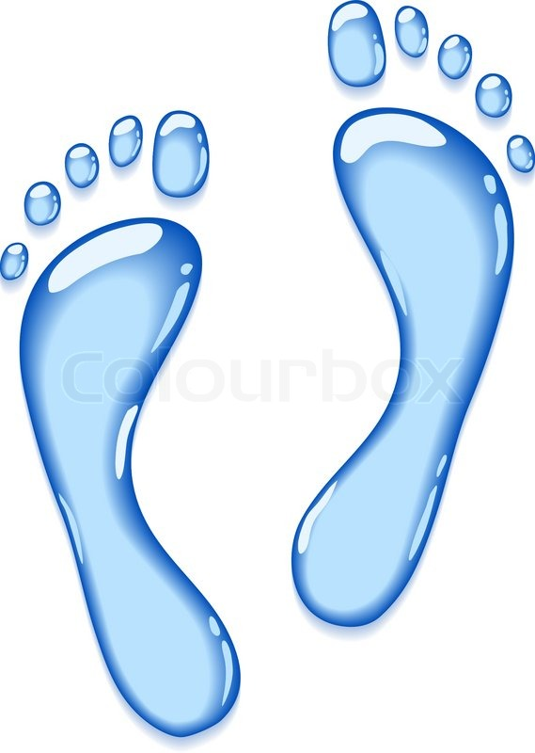
What Is Water Footprint?
Water Footprint is the amount of water used to make something, provide a service etc. such as growing vegetables, making clothes and so much more! Water is used in everything!
The water footprint can also tell us how much water is being consumed by a particular country, or even globally.

Slide 3
The Three Water Footprints
Green water footprint is particularly relevant for agricultural, horticultural and forestry products.
Grey water footprint is the amount of fresh water required to assimilate pollutants to meet specific water quality standards
Blue water footprint is water that has been sourced from surface or groundwater resources and is either evaporated, incorporated into a product or taken from one body of water and returned to another

Slide 4
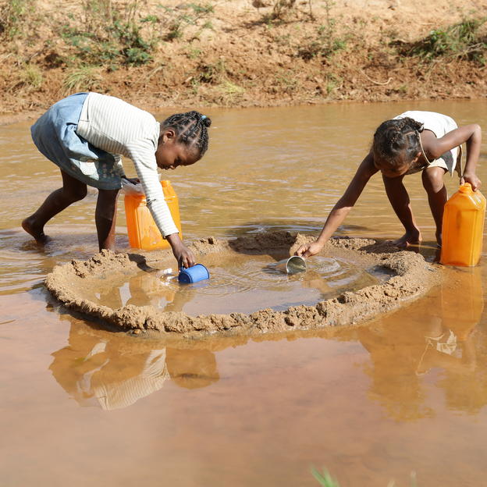
Water Shortage
Water shortage has many consequences, such as:
Increased Global Conflict
Food Shortage
Economic Slowdown
Lack of Access to Clean Water

Slide 5
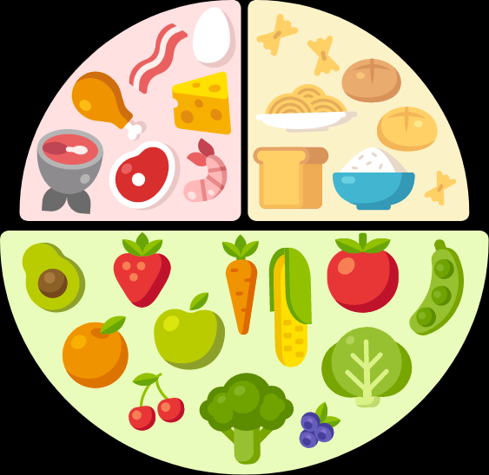
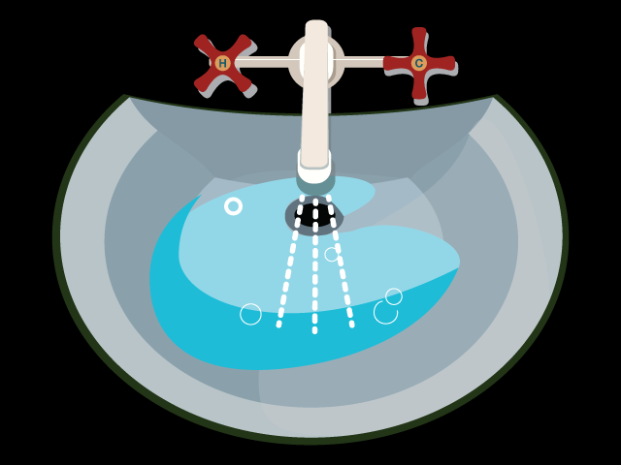
How Can I Save Water?
change your diet
It takes water – a lot of it – to grow, process and transport your food.
cut indoor water use
Every day, you rely on water for a wide variety of uses around the house.

Slide 6
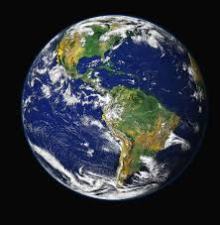
THE END
Saving water is extremely important in order to save our planet, and we must all help!

