Slide 1
20 – 2 – 2019 1ST GYMNASIUM OF CHOLARGOS AT SNFCC
ATTENDING AN ENVIRONMENTAL EDUCATIONAL PROGRAM – DOING EXPERIMENTS BASED ON CLIMATE CHANGE

Slide 2
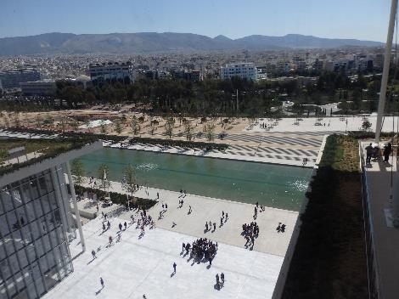
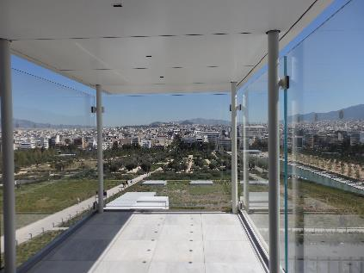
Teachers and students of 1st Gymnasium of Cholargos visited the multifunctional environmentally sustainable center SNFCC

Slide 3
Stavros Niarchos cultural center is a leading example of environmental sustainability at three levels : design and construction, operation, footprint in the local ecosystem.

Slide 4
SNFCC park stretches over an area of 21 hectares. Students were guided by a scientist of physics at a part of it. They admired a rich variety of flora …

Slide 5
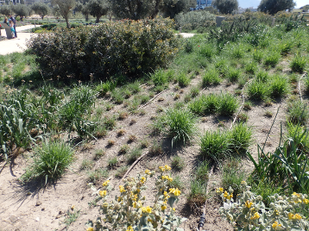
… including olive trees, aromatic herbs and other plants that reflect the Mediterranean landscape

Slide 6
They were also guided at the building of National Library. Its relocation from a historic neoclassical building in downtown Athens to its new premises at SNFCC is completed last year.

Slide 7
Then, they attended a lecture about how the scientists cope with the problem of climate change. He talked about the ways monitoring weather conditions.

Slide 8
… and took part in several experiments based on climate change and the consequences such as ice melting …

Slide 9
… Greenhouse effect, measuring and comparing temperatures.

Slide 10
All students found this program very interesting and they enjoyed their selves looking through VR glasses the whole area of Stavros Niarchos Foundation!

