Slide 1
URBAN HEAT ISLAND PHENOMENON AND WAYS TO STOP IT
EVI KOLANI

Slide 2
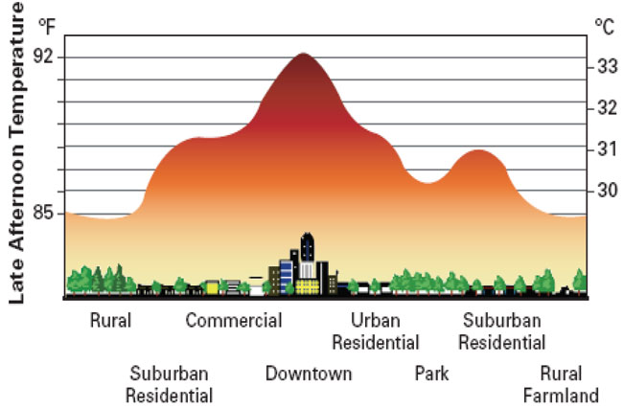
WHAT IS THE URBAN HEAT ISLAND PHENOMENON?
The urban heat island phenomenon is when a metropolitan area is significantly warmer than a rural area due to human activities.

Slide 3
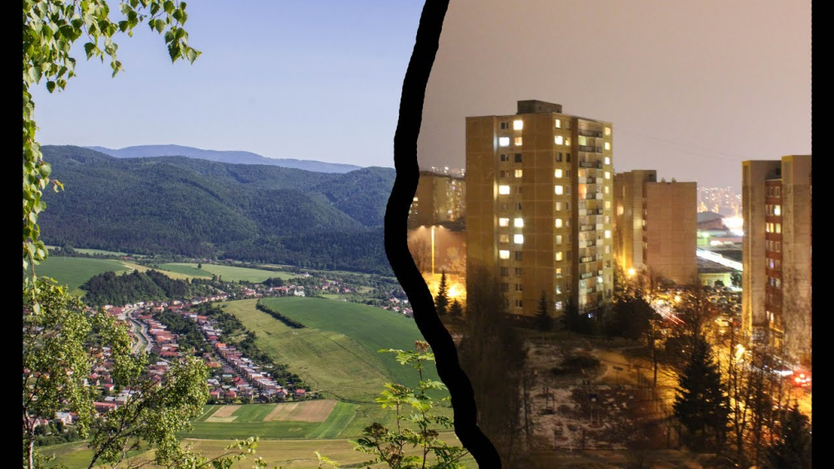
What causes this phenomenon?
The causes of the urban heat island phenomenon are:
The heat from the building materials that is released at night.
The human activities that take place in the city center.
Reduced oxygen due to the lack of green in the city center.

Slide 4
Ways to stop the urban heat island phenomenon
We can plant trees and other plants at our garden because they reduce the heat of the air by providing shade and cooling.
2. We can install green roofs. If we plant trees and flowers on our roof or rooftop they will reduce the heat of the air by absorbing her.

Slide 5
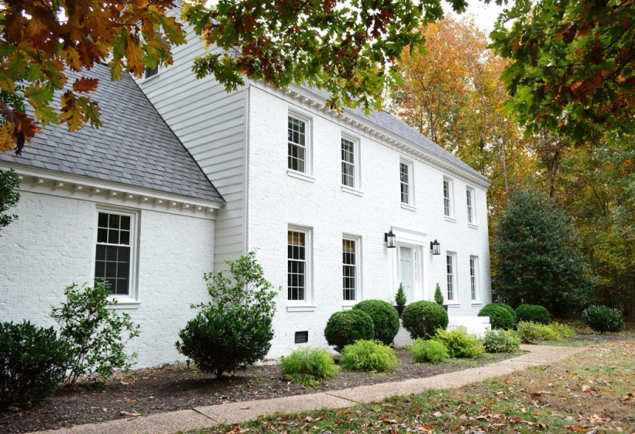
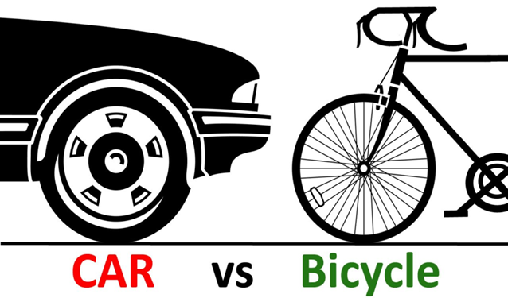
Ways to stop the urban heat island phenomenon
We can paint our houses with white color. Black and dull colors absorb lots of solar heat, which results in warm.
We can reduce the using of our car. Instead of this we can use our bicycles.

Slide 6
Thanks for watching!!!

