Slide 1
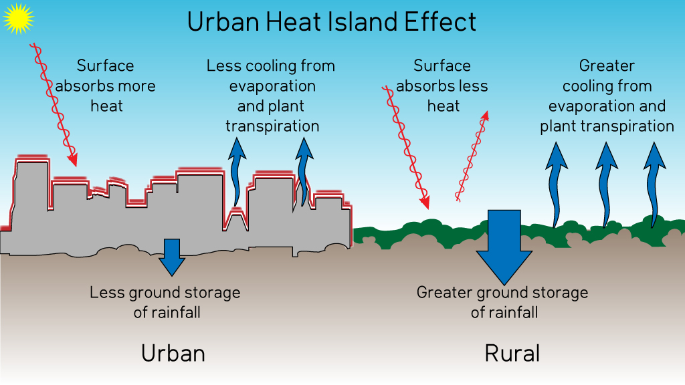
URBAN HEAT ISLAND PHENOMENON
Notes:
justynaw7@op.pl

Slide 2
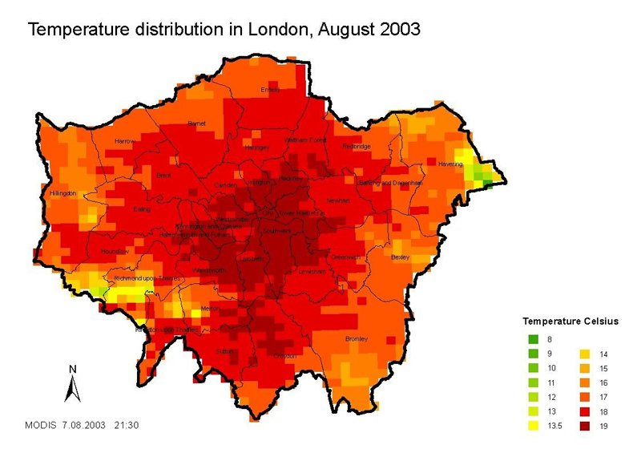
WHAT IS URBAN HEAT ISLAND PHENOMENON?
Urban heat island is meteorological phenomenon which is characterized by higher temperature in the city than in the suburbs.

Slide 3
TEMPERATURE MEASUREMENTS IN POLAND
Students from elementary school number 12 in Gdynia, during the four hot days of June perfromed asphalt and grass measurements, every day at the same time- 9p.m. They saw that temperature in the city was bigger than heat in the suburbs. It shows that if we cut down more trees and get rid of vegetation, temperature will be much higher in the city.

Slide 4
HERE ARE OUR MEASUREMENTS OF THE URBAN HEAT ISLAND PHENOMENON
GRASS IN THE SUBURBS OF GDYNIA
DATE | TIME | TEMPERATURE
12.06.2019. | 9p.m. | 26˚C
14.06.2019. | 9p.m. | 16˚C
15.06.2019. | 9p.m. | 20˚C
17.06.2019. | 9p.m. | 12˚C
ASPHALT IN THE NEIGHBORHOOD IN GDYNIA
DATE | TIME | TEMPERATURE
12.06.2019. | 9p.m. | 28˚C
14.06.2019. | 9p.m. | 23˚C
15.06.2019. | 9p.m. | 24˚C
17.06.2019. | 9p.m. | 21˚C

Slide 5
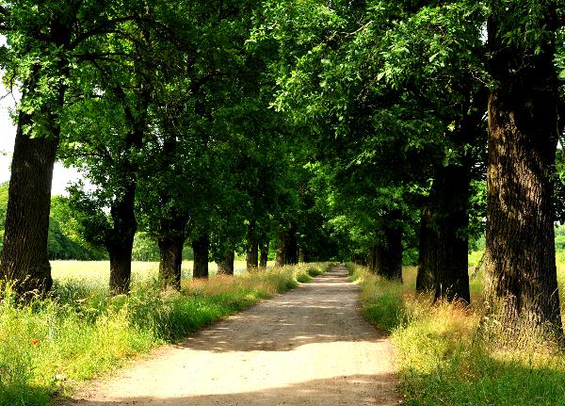
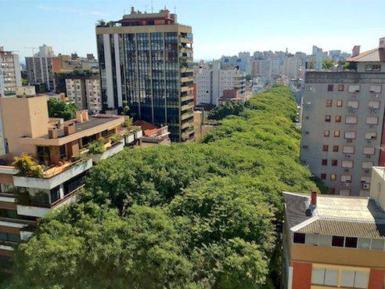
HOW TO STOP URBAN HEAT ISLAND PHENOMENON?
We have to try to stop excessive removal of vegetation. For example:
Do not waste paper because we cut the trees excessively
Take care of nature, build gardens and parks instead of blocks

Slide 6
PRESENTATION MADE BY NATASZA JURKOWSKA AND ANNA JĘDRZEJEWSKA FOR

