Slide 1
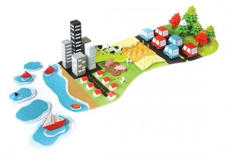
The Carbon footprint and ways to reduce it.

Slide 2
What is a carbon footprint - definition
A carbon footprint is defined as:
The total amount of greenhouse gases produced to directly and indirectly support human activities, usually expressed in equivalent tons of carbon dioxide (CO2).
In other words: When you drive a car, the engine burns fuel which creates a certain amount of CO2, depending on its fuel consumption and the driving distance. (CO2 is the chemical symbol for carbon dioxide). When you heat your house with oil, gas or coal, then you also generate CO2. Even if you heat your house with electricity, the generation of the electrical power may also have emitted a certain amount of CO2. When you buy food and goods, the production of the food and goods also emitted some quantities of CO2.

Slide 3
Different sources of carbon dioxide:
·Food
Eat less meat: CO2 emission of our food
The carbon dioxide emissions (carbon footprint) caused by our personal behavior is driven to a large extent by the type and quality of our food. The amount of greenhouse gases caused by the production of food differs very much from one food type to the other (see table below). Worst is meat and in particular beef.
A environmental friendly and "climate change friendly" nourishment is characterised as follows:
Very little (or no) meat
Eat primarily organic food
Saisonal food is preferred
Regionally produced food is preferred

Slide 4
·Plastic bags and plastic bottles – CO2 emissions during their lifetime
A number of people have asked about the implications of using plastic bags on the personal carbon footprint as well as on the environment in general. There are some comparisons between paper bags and plastic bags available which clearly show that it all depends on how many times these plastic or paper bags are being used.
Littering is probably the severest problem related to plastic bags. Nevertheless let's now have a look at the carbon dioxide (CO2) emissions for the production and incineration of plastic bags.

Slide 5
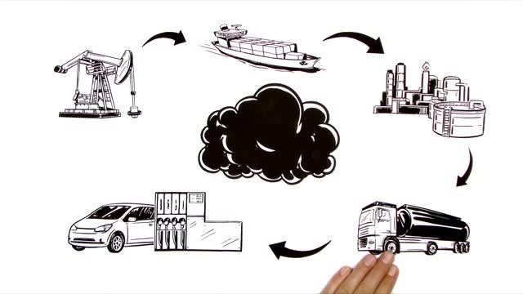
CO2 emission of electricity from nuclear power stations
How much CO₂ is produced by atomic energy?
One of the few pros of nuclear power is the relatively low emission of carbon dioxide (CO2), one of the major causes of global warming. For this reason, it has been proposed as "the" method to mitigate the effects of climate change. However a recent life cycle analysis showed that nuclear power produces 4 to 10 times higher CO2 emissions per kWh electricity than renewable energies.

Slide 6
Global carbon cycle and climate change
Life processes are fuelled by carbon compounds which are oxidized to CO2 (carbon dioxide), the latter is exhaled by all animals and plants. Conversely, CO2 is assimilated by plants during photosynthesis to build new carbon compounds. See also this comment about photosynthesis and global warming. CO2 is produced by the burning of fossil fuels, which derive from the preserved products of ancient photosynthesis. The atmosphere exchanges CO2 continuously with the oceans. Regions or processes that predominantly produce CO2 are called sources of atmospheric CO2, while those that absorb CO2 are called sinks.
>

Slide 7
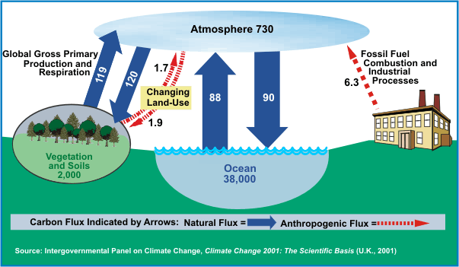
While CO2 is only a very small part of the atmosphere (0.04%), it plays an important role in the energy balance of our planet: CO2 in the atmosphere acts like a blanket over the planet by trapping long-wave radiation, which would otherwise radiate heat away from the planet (greenhouse effect). As the amount of CO2 increases, so will its warming effect. CO2 is the largest contributor (currently 63%) to this effect by long-lived gases and its role increases each year. The additional burden of CO2 in the atmosphere will remain for a very long time, of the order of thousands of years, if we have to rely on the natural mechanisms of erosion and sedimentation to process the added CO2

Slide 8
MAKRIS VANGELIS 18/4/2019

