Slide 1
Meet our environmentally friendly vehicle ☺

Slide 2
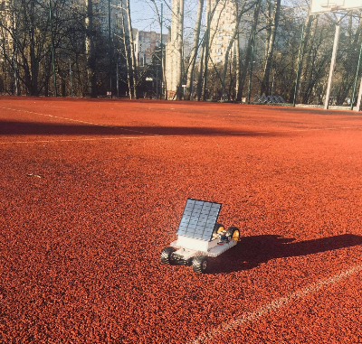
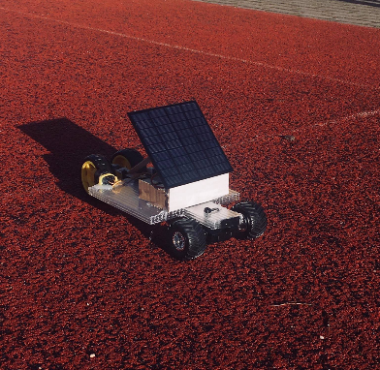
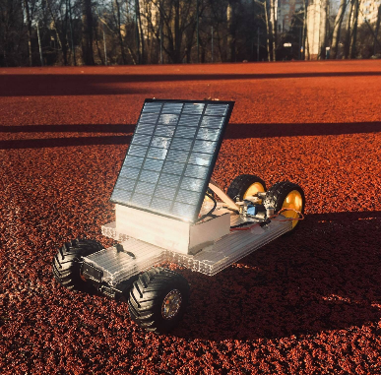
We proudly present our solar powered car! Meet Speedy Erasmus+

Slide 3
What is solar power?
•The Sun does more for our planet than providing light during daytime. Each particle of sunlight that reaches the Earth contains energy that gives power to our planet. We could assume that enough solar radiation hits the surface of the planet filing out our global energy needs for nearly an entire year.
•Where does all of this energy come from? Our Sun is like a massive nuclear reactor. Deep in the Sun’s core, nuclear fusion reactions produce huge amounts of energy which we can see and feel as light and heat.
•Solar power can be used and converted to usable energy using photovoltaics or solar thermal collectors. The most important thing is that this power is clean renewable energy resource, and plays an important part in the global energy future...

Slide 4
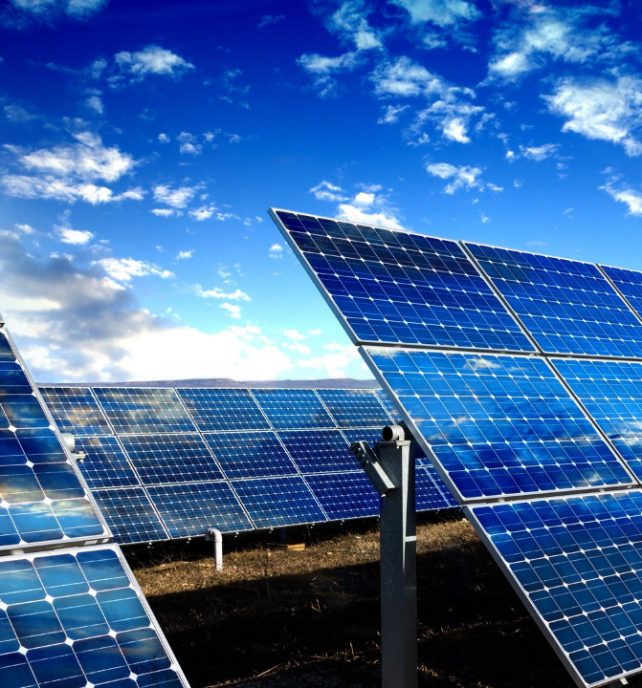
How can we use it?
Using solar panels is a very practical way to produce electricity for many appliances. A solar electrical system is potentially less expensive and can provide power for up to three decades if properly maintained.
Solar panels make it possible to live without permanent electrical connection. The greatest benefit is that it is both clean and renewable source of energy. In the time of global climate change, it has become more important to do everything we can to reduce the emission of greenhouse gases.
Other benefits of solar panels and solar power is that, once you pay for it, further usage is almost free of charge. You don’t have to pay any monthly bills. In case you use less power than your solar electrical system produces, this additional power can be sold to your electrical company!

Slide 5
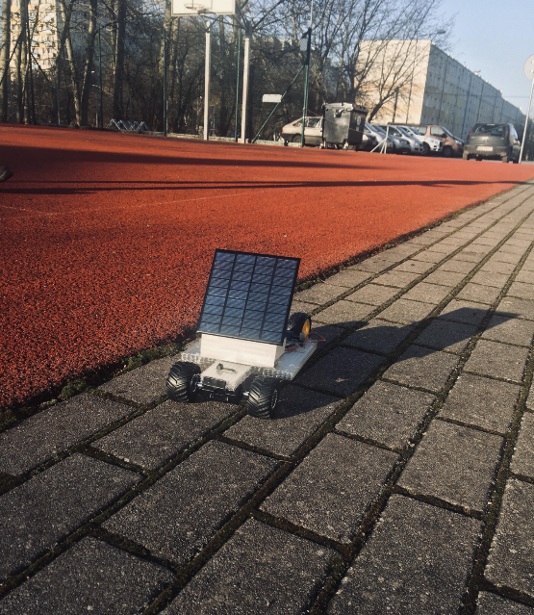
The reason of building it
This tiny solar powered car is a part of our Erasmus + project. All countries that took part in this international program had to make their own car. The goal of this special task was to conduct the final race in Italy where the little cars from different countries were to compete.
Unfortunately, due to a pandemic outbreak, the mobility in Italy was cancelled.

Slide 6
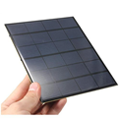
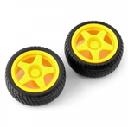
Planning process
At the beginning we met up to discuss how this
car should look like and what to buy to make it.
Then we decided to purchase online:
-a small solar panel
-some wires
-an engine
-wheels
We also needed hot glue, newspapers
and other small elements which
we promised to bring from homes.

Slide 7
Creation process
We met at the weekend. We started assembling main elements together. Initially we took the panel and combined it with wires using soldering iron. Next step was to mount an engine. Later we put all other parts together. After some time our vehicle was ready for a challenge.

Slide 8
Back room...
Except hard work we also had a good time. During break we were singing, dancing and fooling around. That's because every time we meet for Erasmus + we always have great time and every moment is wonderful.

Slide 9
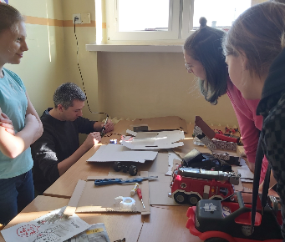
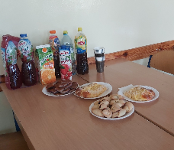
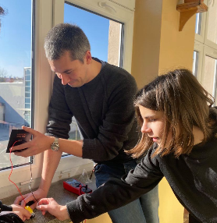
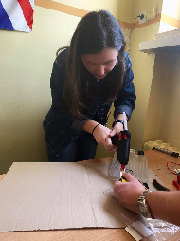
Here are some photos of us...

Slide 10
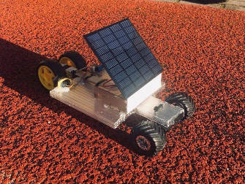
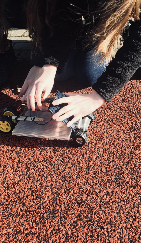
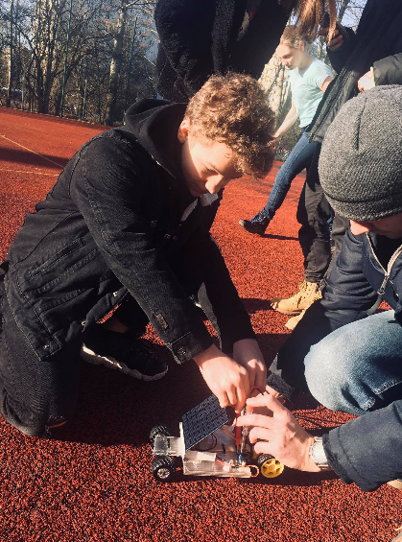
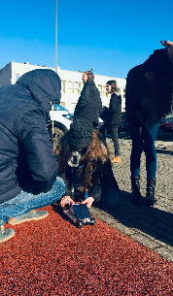

Slide 11
Thank you for watching!!! Martyna Maliszewska

