Slide 1
SCIENCE FAIR 1ST GYMNASIUM OF CHOLARGOS 2020

Slide 2
Pupils of the Erasmus team competed with their peers in groups and presented experiments experiments based on climate change.

Slide 3
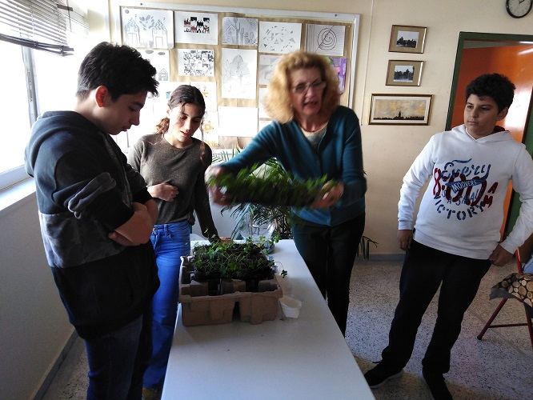
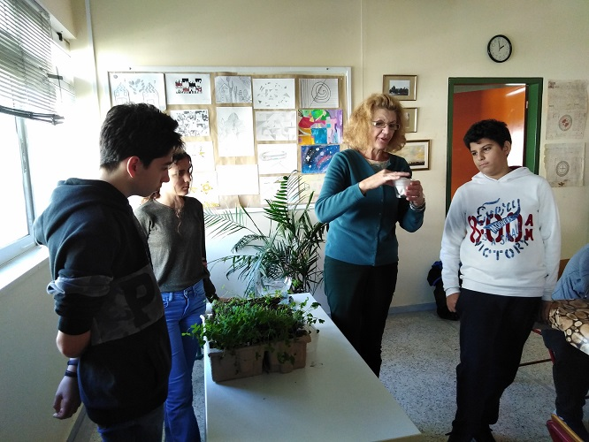
One of the best experiments connected with soil erosion. They water the plants in four pots for five days…

Slide 4
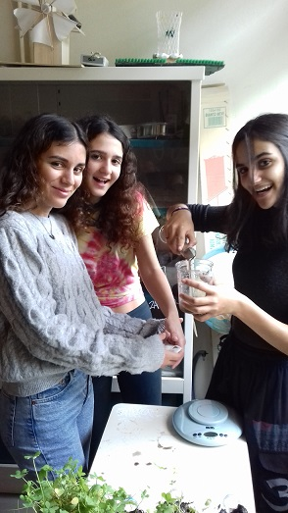
… and they consumed that the pot with more plants loose less water that the others. They learned that plantations, forests etc. are very important in case of floods or storms.

Slide 5
The second very interesting experiment was connected with the production of CO2 …

Slide 6
CO2 produced by mixing vinegar and soda put off the caddle light.

