Slide 1
REDUCE – REUSE - RECYCLE
1st Gymnasium of Cholargos
16 – 12 – 2018
Christmas bazaar
Lectures about climate change

Slide 2
Teachers and students of 1st Gymnasium
of Cholargos organized a Christmas bazaar
where they sold books and objects for Christmas decoration.

Slide 3
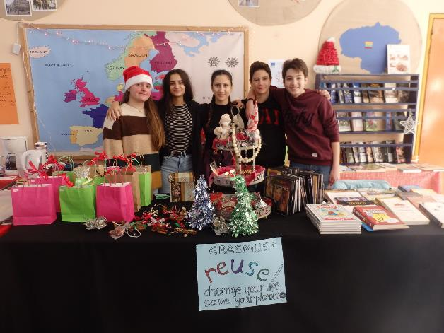
Students taking part in Erasmus project ...

Slide 4
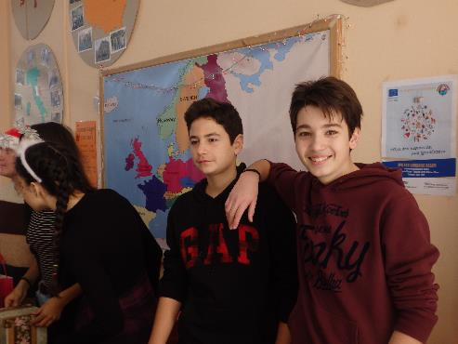
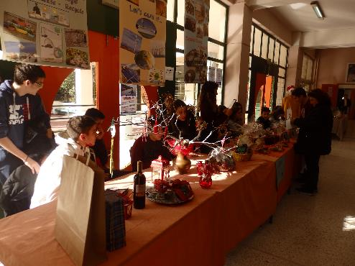
… sold books that they didn’t need and Christmas decorations made by recycling materials …

Slide 5
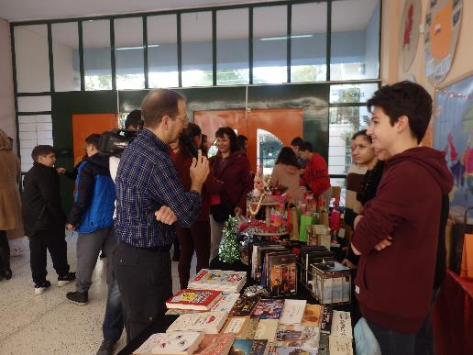
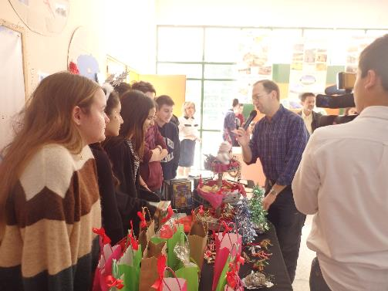
They were also interviewed live on school radio station.

Slide 6
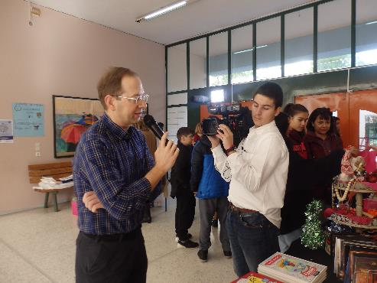
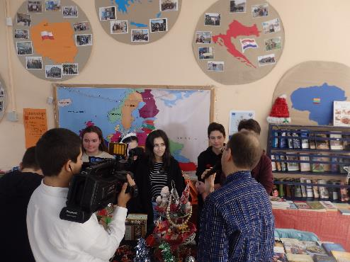
So, they had the chance to tell about Erasmus project and how they felt for their participation.

Slide 7
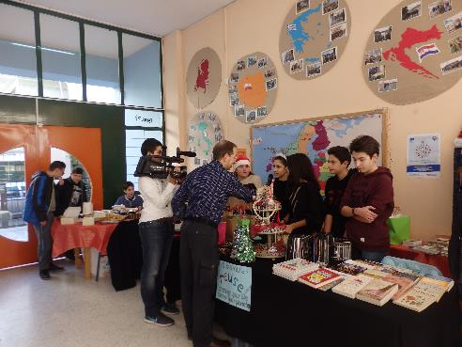
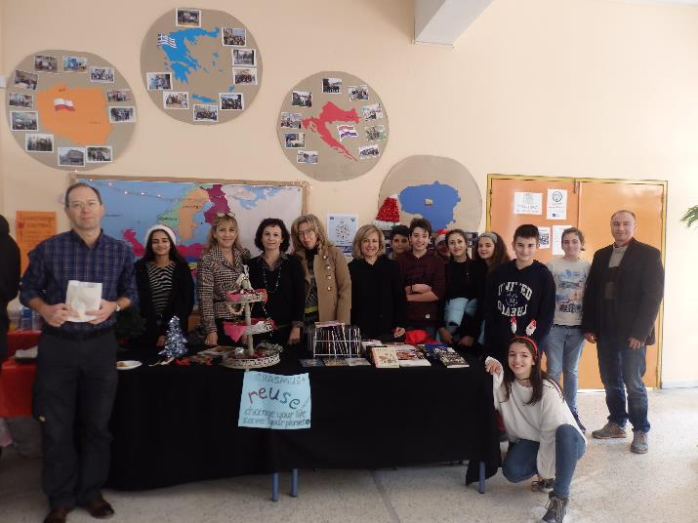

Slide 8
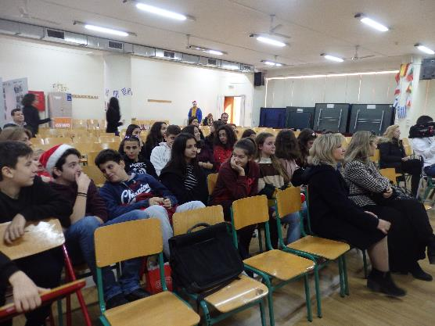
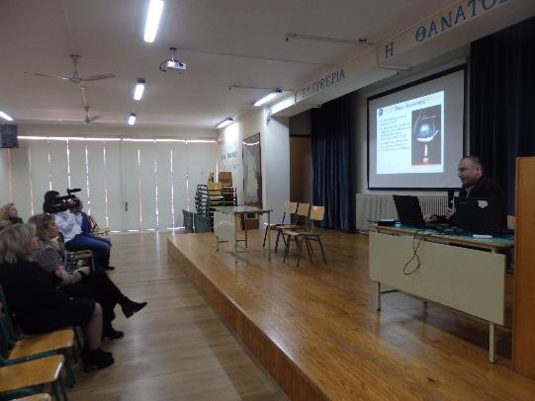
Meanwhile, two experts conducted lectures for pupils and parents …

Slide 9
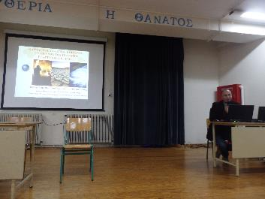
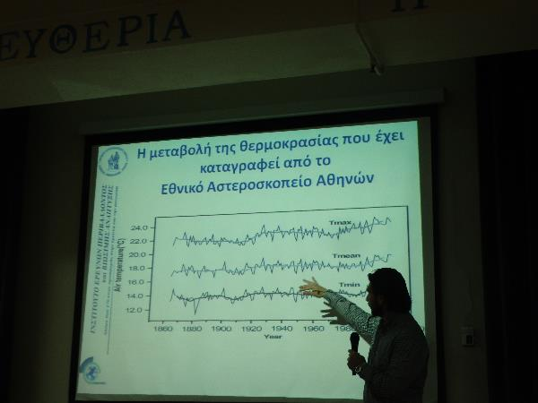
… about climate change, reducing and recycling.

Slide 10
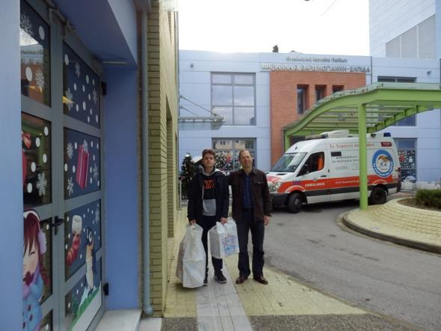
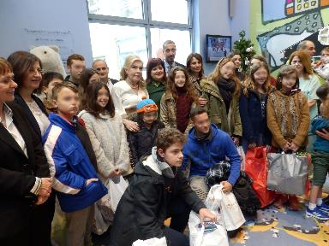
The headmaster and a representative of students donated the money earned at bazaar…

Slide 11
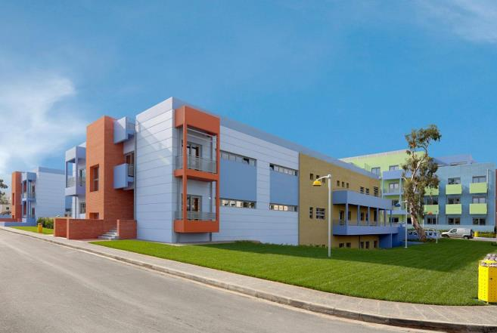
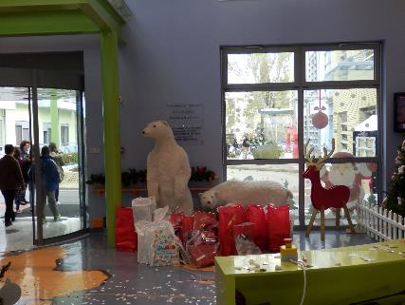
… to the hospital “Elpida” nursing children with cancer.

