Slide 1
It’s time to create a sustainable world!
Palmoil

Slide 2
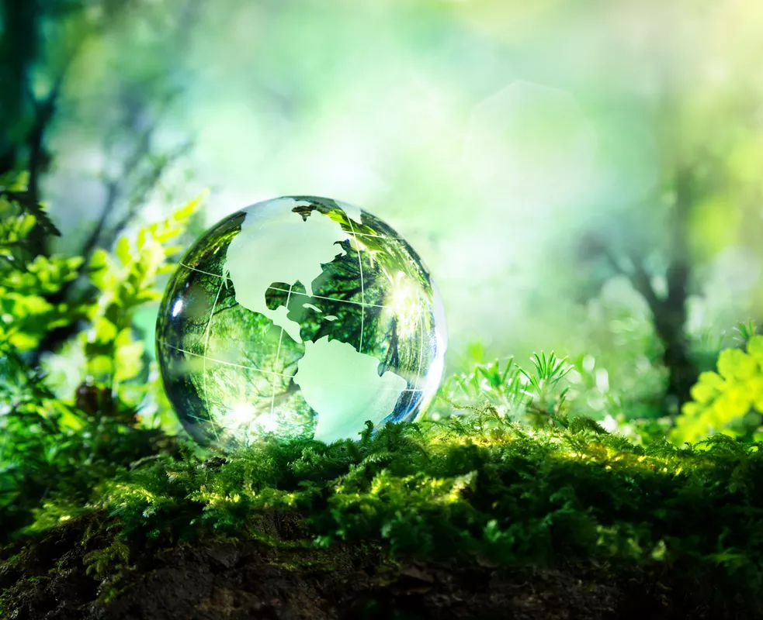
Sustainability
What is sustainability? For example: - recycle - no use of fossil resources - use products which can be used for a long time - don’t destroy forests for agriculture - clean energy - human rights - fairtrade products What do you think about when you hear “sustainability”?

Slide 4
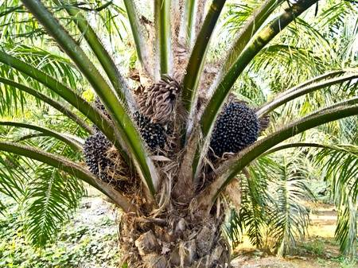
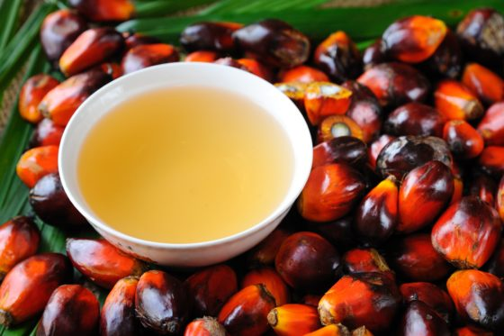
What is palmoil?
High quality vegetal oil
Gives structure to many products
Is made from the flesh of the fruit from the palmoiltree
The function of palmoil in our products is to mix every ingredient
The palmoiltree only grows in tropical forests
Low costs to produce the oil
The demand for palmoil has risen worldwide
Farmes sell the oil to traders and they sell is to big companies. The big companies make products of the oil. These products can be find in our supermarktes.
When a product says: “consists vegetal oil”, it almost always means that it consists palmoil

Slide 5
Short movie

Slide 6
A standard palmoilplantation
Huge plantation, huge area’s with only palmoiltrees
Huge areas of tropical forest are chopped down and burned down to make room for palmoiltrees
Lots of water is nessecary to grow those palmoiltrees
Working with (toxic) chemichals
Very low salaries
No safety or healt messurements during the work at the plantation
Local inhabitants are chased away (out of their houses) to make room for new plantations
Big companies do not hire local employees because they are unexperienced
The forest is important for the ecosystem. It offers room for all kinds of plants and animals, it’s protects against floods and provides oxygen
Due to the chopping of big area’s of tropical forest, during the day the local inhabitants have to deal with very high temperatures and uncontrolled forestfires. Animals and plants are endangered and may extinct. It is hard to find medicinal plants.
Land of local inhabitants get stolen by big companies

Slide 7
A sustainable palmoilplantage
Use of wastelands of agriculture land instead of forestground
Local employees
No use of chemicals or fertilizers
Pruning waste is used to “fertilize” the ground
Faire prices
Faire rights for employees
No danger for local flora and fauna

Slide 8
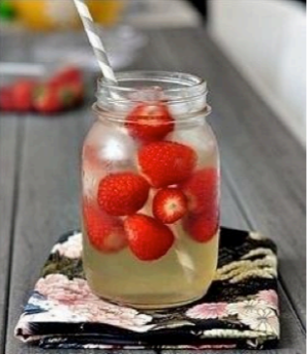
Use the worksheet to create your own sustainable product
Example to give you inspiration: Name: fruity smoothie Product characteristics: a delicious fresh drink with lots of vitamines. With a touch of honey to create a sweet taste. Ingredients: everyhing comes from the Netherlands. Tapwater, biological seasonfruits, biological mint, and biological honey Package: recycled glasses, pots and bottles. Human rights: there was paid a fair price for every ingredient. The employees got paid enough salary. Animal welfare: only biological honey was used. Biological honey comes from areas with no industry, no non-biological agriculture and no highways. The bees get their nectar from nature reserves. The bees hibernate by their own honey and not by the sugerwater from the beekeeper. Environment: 1. The fruit and the mint are biological so no poison or fertilizer was used. 2. Each season there are other types of fruit in the fruity smoothie. The fruit that grows the best in that season is used. If it was a drink that always should have strawberries in it, you should go get strawberries from other countries during the winter. Now you can always use local fruit. 3. Because the ingredients are local, they don’t have to be transported by ship or airplane. 4. In the Neterlands the tapwater is very healthy and available everywhere. It is cheap and good for the environment. 5. The package can be reused over and over again.

