Slide 1
STARTING A NEW ERASMUS PROJECT AT 1ST GYMNASIUM OF CHOLARGOS: “Stop Climate Change – Together Europe achieves more”
1st Mobility
(Greece, 21-27 October 2018)

Slide 2
The Students’ Erasmus team

Slide 3
The team of teachers participating in the new Erasmus + project (2018 – 2020)

Slide 4
The first activity of the project: “Logo contest”

Slide 5
Students designed logos for the project…

Slide 6
after learning about what characteristics should a good logo have

Slide 8
Teachers’ first meeting : deciding about the three best logos made by students

Slide 9
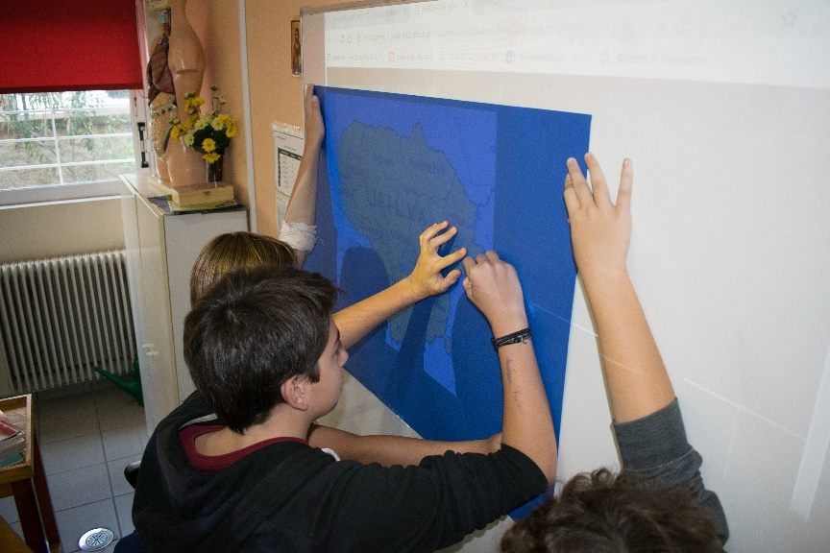
Students are working on decorating school for the mobility.

