Slide 1


Erasmus+ project 2018-2020
2018-1-HR01-KA229- 047516
Stop Climate Change – Together Europe Achieves More
WORLD ENVIRONMENT DAY 2020
MAY 2020

Slide 2
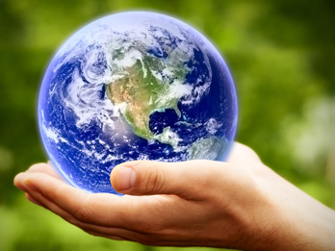
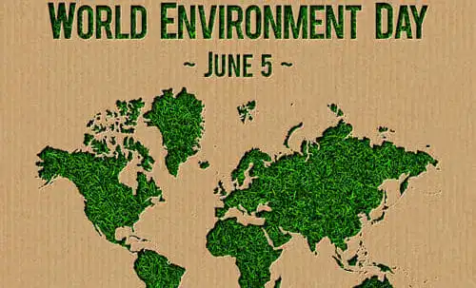
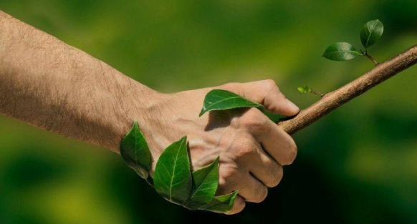
WORLD ENVIRONMENT DAY

Slide 3
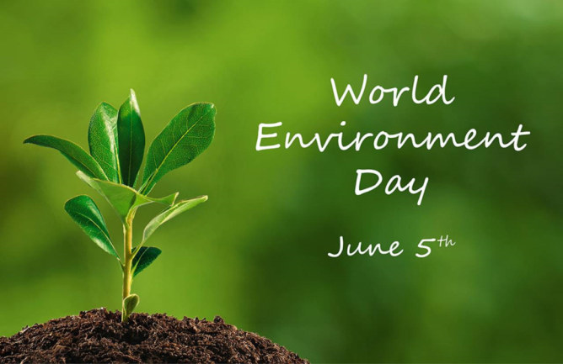
World Environment Day was established by the UN General Assembly in 1972, in memory of the Stockholm Conference on the Human Environment during which the United Nations Environment Program was formed. UNEP is an international body which has set itself the objective of promoting serious environmental protection and the sustainable use of natural resources through research grants, initiatives to protect animals and plants, and green projects. That combine productivity with respect for Nature.

Slide 4
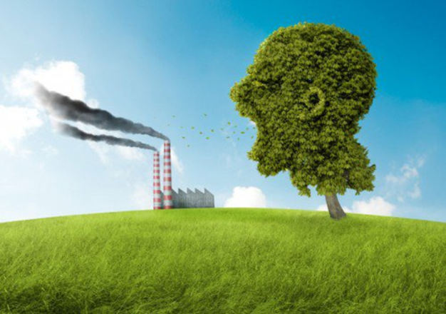
Since 1974, the commemoration of this date has helped the United Nations Environment Program (UNEP) to raise awareness and create political pressure to address growing concerns, such as the reduction of the ozone layer, the management of toxic chemicals, desertification or global warming.

Slide 5
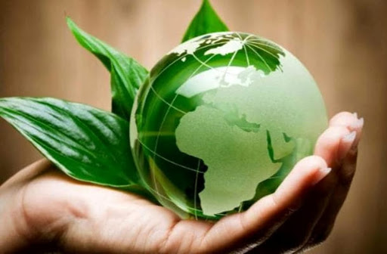
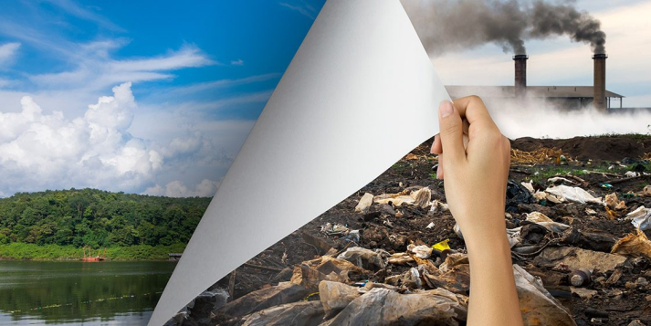
Every year the invitation is to reflect on a specific theme, with the idea that everyone can help save our planet.

Slide 6
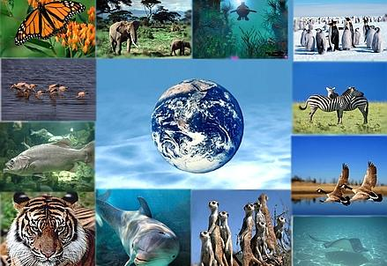
BIODIVERSITY
The theme of the 2020 edition is biodiversity, to inspire it is the consideration that between people and the environment must form a relationship so strong that they can appreciate the value of nature and biodiversity. No one can remain indifferent to the fact that life on earth is threatened by destructive behavior, biodiversity represents the salvation of the planet, for this must be valued and safeguarded.

Slide 7
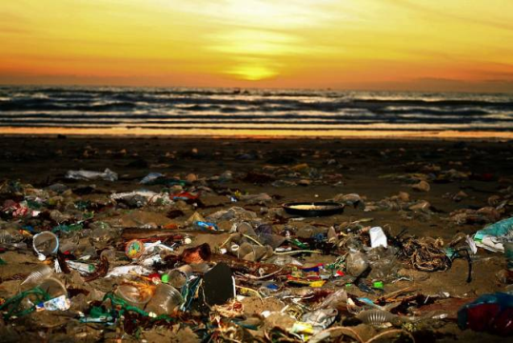
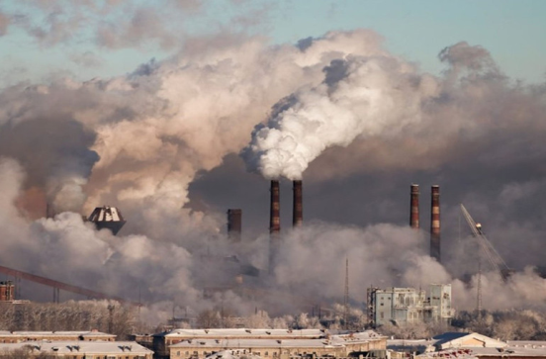
THE POLLUTION
The pollution of air, water and sea, unsustainable energy choices have had a strong impact on climate change. According to Istat data, for the years 2012-2018, the Italian population is more concerned about air pollution (55.7%) and climate change (51%). The statistics on common feeling together with the alarming state in which the environment is located impose a change of course to deal with environmental emergencies with greater awareness and the adoption of technologies and ecological measures.

Slide 8
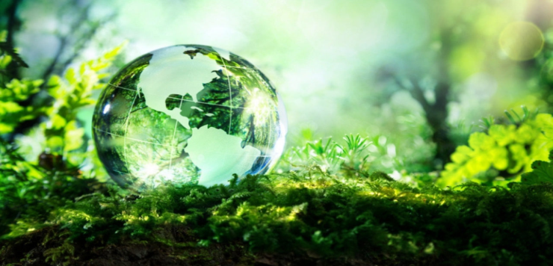
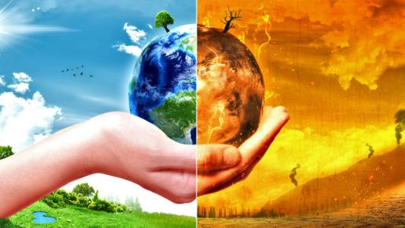
THE PROGRESS
The progress made so far, thanks to European environmental policies in recent decades, has given signs of improvement, but it is not sufficient to meet the climate and energy targets set for 2030 and 2050. Above all, we must promote environmental education, renew and increase clean technologies, accelerate the step towards sustainability to avoid irreversible damage. In order to overcome this challenge, we must begin immediately by modifying eating habits, energy consumption, production systems and the use of resources.

Slide 9
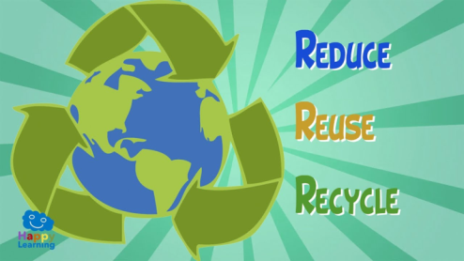
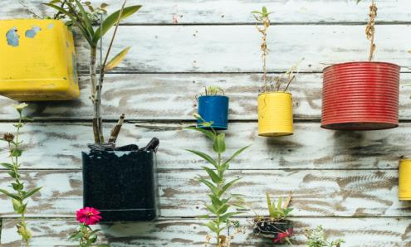
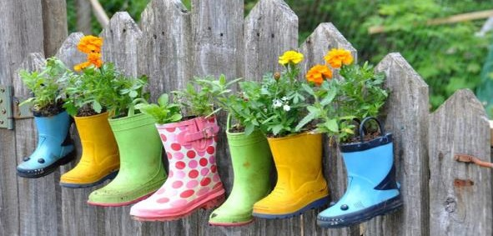
REUSING AND UPCYCLING

Slide 10
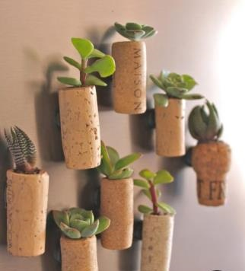
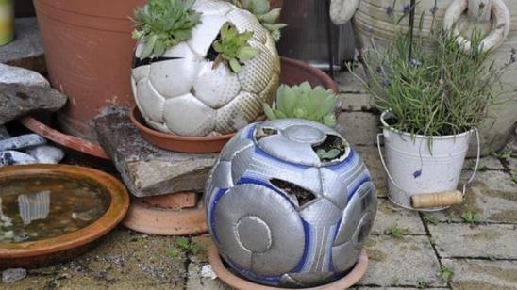
UPCYCLING
Upcycling, also known as creative reuse, is the process of transforming by-products, waste materials, useless, or unwanted products into new materials or products of better quality and environmental value.
Is one of three R for the Environment: Reduce, Reuse, Ricycle.
The goal is to protect the Planet by eliminating waste using something multiple time in a variety of ways.

Slide 11
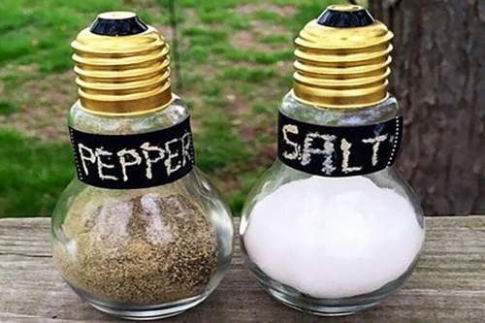
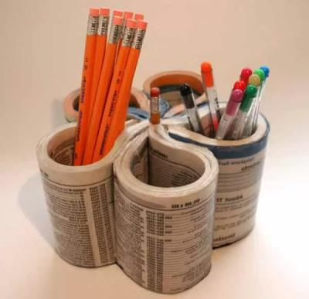
RECYCLING AND REUSING
Recycling means turning an item into raw materials which can be used again. Reusing refers to using an object as it is without treatment. This reduces pollution and waste, thus making it a more sustainable process usually for a completely new product.

Slide 12
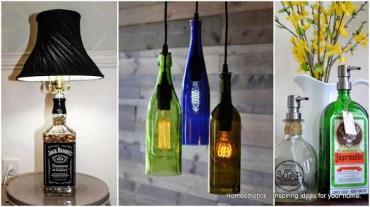
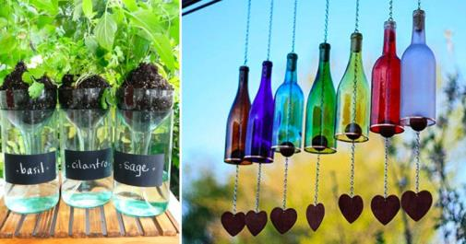
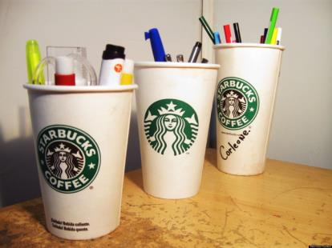
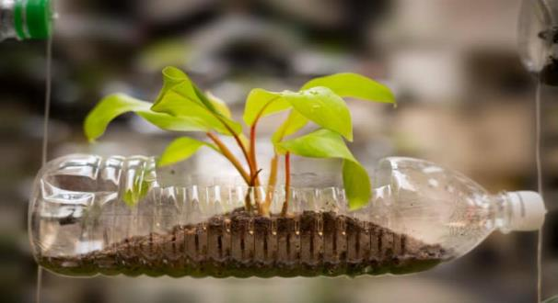

Slide 13
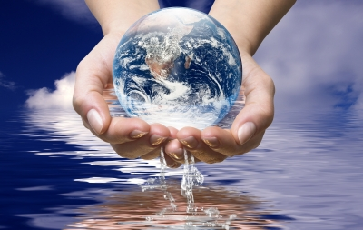
BENEFITS OF REUSING ITEMS
• Lessen the pollution and greenhouse gas emissions associated with landfill;
• Cut the financial cost of disposing of waste;
• Reduce how much you spend and find handy solutions to your challenges at home;
• Make the Planet a cleaner place;

Slide 14
GABRIELLA CICINELLI THOMAS MARTINO
MARIA GRAZIA CIOCCA VALERIA COLAVITA
PASQUALE CIOCCA EMANUELE SAVERIO SCAMAZZO
Second class of Scuola Secondaria
I Grado of Sant’Elia a Pianisi
JUAN ANDRES UTRERA PANNITTO

