Slide 1
SCIENCE CLIMATE BASED EXPERIMENTS

Slide 2
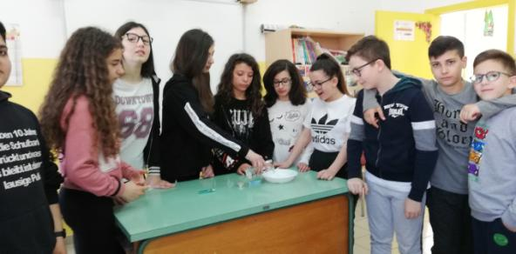
FIRST EXPERIMENT
Our students suggested doing two experiments related to greenhouse effect and climate change.
The first was on the effects of pollution on the atmosphere.

Slide 3
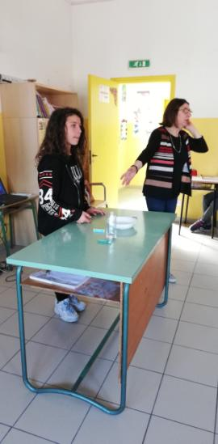
FIRST EXPERIMENT
Materials required:
A dish
A glass of water
A dye
A glass
A candle
A lighter

Slide 4
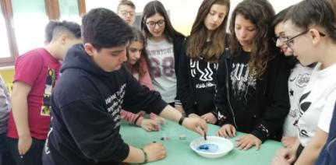
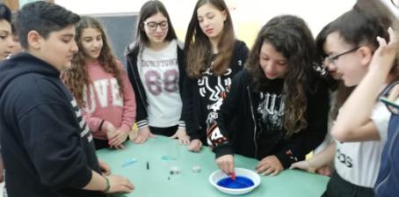
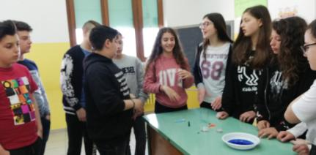
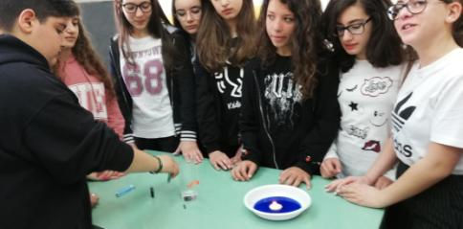
PREPARING THE EXPERIMENT

Slide 5
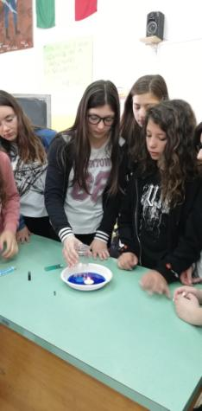
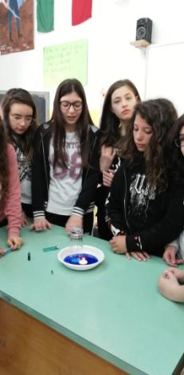
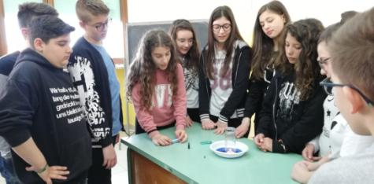
FIRST EXPERIMENT

Slide 6
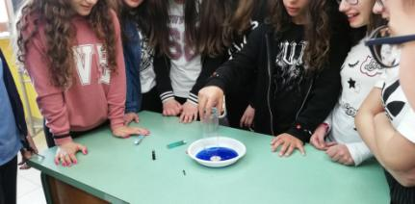
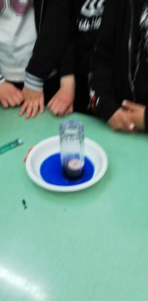
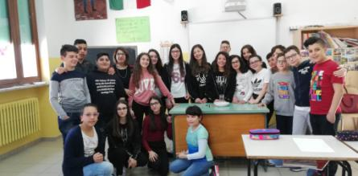
FIRST EXPERIMENT
This experiment showed us that the combustion of oxygen and the production of carbon dioxide (CO2 – a compressed gas) decreased atmospheric pressure.

Slide 7
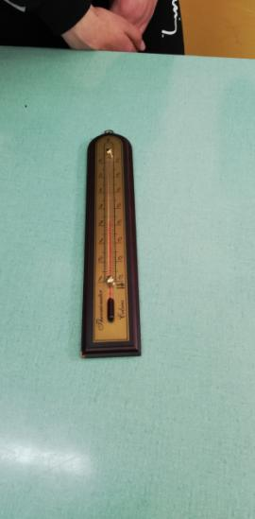
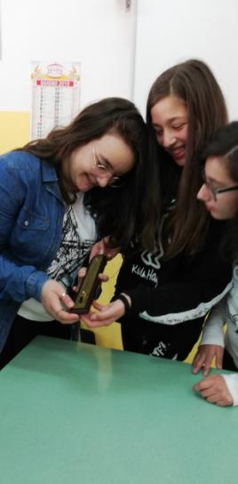
SECOND EXPERIMENT
The second one was on the increasing of temperature due to the greenhouse effect.
The negative aspect of greenhouse effect is that it traps infrared rays.

Slide 8
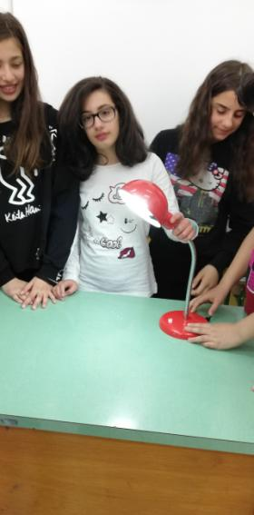
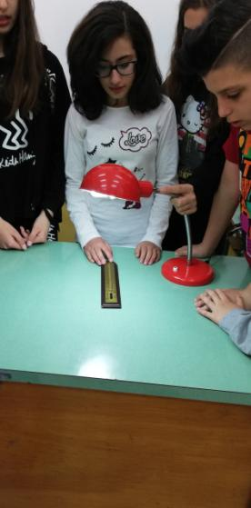
SECOND EXPERIMENT
MATERIALS REQUIRED:
A thermometer
A lamp
A glass bowl

Slide 9
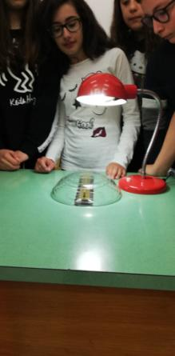
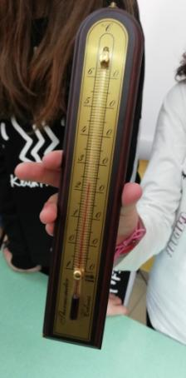
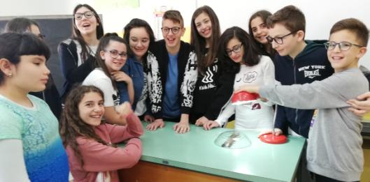
SECOND EXPERIMENT The thermometer showed the rise in temperature

