Slide 1
INVASIVE ALIEN PLANTS AND ANIMALS
ITALY

Slide 2
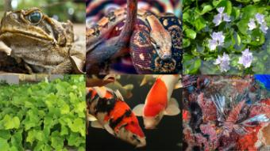
INVASIVE ALIEN SPECIES
Invasive alien species (IAS) are animals, plants or other organisms that are introduced into places outside their natural range, negatively impacting native biodiversity, ecosystem services or human well-being.
IAS are one of the biggest causes of biodiversity loss and species extinctions, and are also a global threat to food security and livelihoods.
IAS are compounded by climate change. Climate change facilitates the spread and establishment of many alien species and creates new opportunities for them to become invasive.
IAS can reduce the resilience of natural habitats, agricultural systems and urban areas to climate change. Conversely, climate change reduces the resilience of habitats to biological invasions.

Slide 3
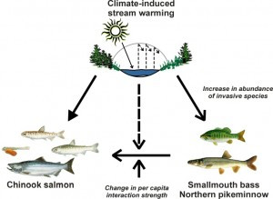
INVASIVE ALIEN SPECIES AND CLIMATE CHANGE
Extreme climatic events resulting from climate change, such as hurricanes, floods and droughts can transport IAS to new areas and decrease the resistance of habitats to invasions. Climate change is also opening up new pathways of introduction of IAS. For example, emerging Arctic shipping passages due to melting ice caps will greatly reduce the time taken for ships to travel from Asia to Europe. This will increase the risk of alien species surviving the journey.
Many IAS have the ability to expand rapidly to higher latitudes and altitudes as the climate warms, out-pacing native species. Alien species that are regularly introduced by humans but have so far failed to establish may succeed in doing so thanks to climate change, creating new sets of invaders.
Some habitats, such as temperate forests and freshwater systems that currently have thermal barriers limiting the establishment of IAS will become more suitable for alien species as the climate changes.

Slide 4
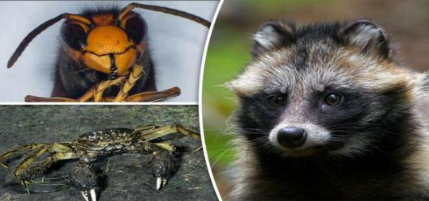
INVASIVE ALIEN SPECIES IN ITALY
Many species of plants, animals, and other organisms are considered invasive species in Italy.
Italy is among the European countries richest in biodiversity, due mainly to a favourable geographical position and a wide variety of geological, climatic and vegetation conditions.
Italy counts 3000 terrestrial species of which 1645 animal species and 1440 plant species. Vertebrate species introduced by man cause extremely relevant impacts.

Slide 5
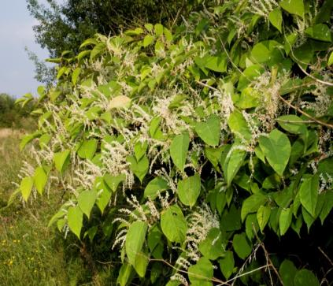
Japanese knotweed
It is listed by the World Conservation Union as one of the world's worst invasive species.
It is native to East Asia in Japan, China and Korea. In North America and Europe, the species has successfully established itself in numerous habitats and is classified as an invasive species in several countries.
Its invasive root system and strong growth can damage concrete foundations, buildings, flood defences, roads, paving, retaining walls and architectural sites. It can also reduce the capacity of channels in flood defences to carry water.
It is found in Lombardy and Valle d’Aosta, in Italy.

Slide 6
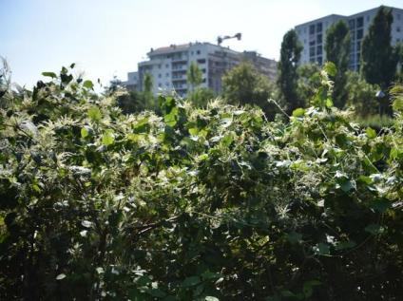
Japanese knotweed
In Milan
In Italy
Also in Italy the Reynoutria japonica, together with other species of the same genus, can be considered one of the most invasive entities. "Introduced around the middle of the nineteenth century as an ornamental plant - adds Dr. Galasso -, it was later cultivated also outside parks and gardens for soil consolidation interventions. Its presence in the spontaneous state has been documented since 1875, and since then it has begun to expand in an alarming way ».

Slide 7
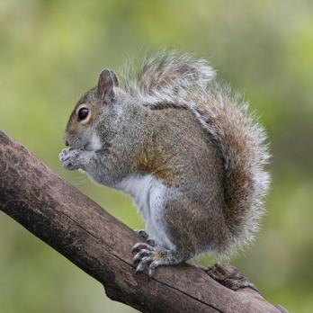
Eastern grey squirrel
Grey squirrel is a tree squirrel in the genus Sciurus. It is native to eastern North America, where it is the most prodigious and ecologically essential natural forest regenerator. Widely introduced to certain places around the world, the eastern grey squirrel in Europe, in particular, is regarded as an invasive species.

Slide 8
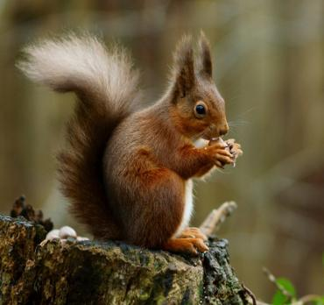
SQUIRRELS IN ITALY
In Italy there are four species of squirrels: the native red squirrel and other three species recently introduced. The red squirrel is present in the Italian peninsula with three subspecies, and is
missing only in Salento. This species is common on Alps and Apennines, while in the plains it is declining because of the habitat loss. Competition with the grey squirrel and habitat fragmentation are considered the major threats to the survival of the red squirrel.

Slide 9
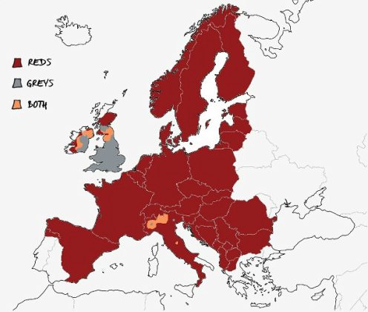
Squirrels distribution
The grey squirrel is present in Piedmont and Liguria. A study on the Piedmontese colony showed that the red squirrel is disappearing from the area colonised by the grey squirrel and the damage due to bark-stripping and feeding is considerable. Free-ranging populations of the Siberian chipmunk live in Belluno, Verona, and Rome, but records of single animals were reported for other areas. The Finlayson's squirrel is present with a small nucleus in an urban area of Piedmont. Here, the impact of this species on the vegetation appears dramatic. The eradication of the grey squirrel is a priority for the conservation of the red squirrel, but control plans for the other introduced species are also needed.

Slide 10
INVASIVE ALIEN SPECIES
It is essential that IAS be incorporated into climate change policies. This includes biosecurity measures to prevent the introduction of IAS to new regions as a result of climate change, and rapid response measures to monitor and eradicate alien species that may become invasive due to climate change.

