Slide 1


Erasmus+ project 2018-2020
2018-1-HR01-KA229- 047516
Stop Climate Change – Together Europe Achieves More
BIODIVERSITY
MAY 2020

Slide 2
BIODIVERSITY
The concept of biodiversity is very important in modern ecology and hides interesting and profound aspects, wider than simple agricultural diversity.
Biological diversity is the result of the evolutionary process that has generated the great variety of animal and plant species, the events that have determined the current biodiversity are difficult to distinguish between them.
This word is a concept that arises as a consequence of the damage caused by pollution and human action on habitats and, as the word itself says, is diversity in the biological world. Only after concerns about ruined flora and fauna was the term biodiversity used to define the biological and genetic variety found on earth.

Slide 3
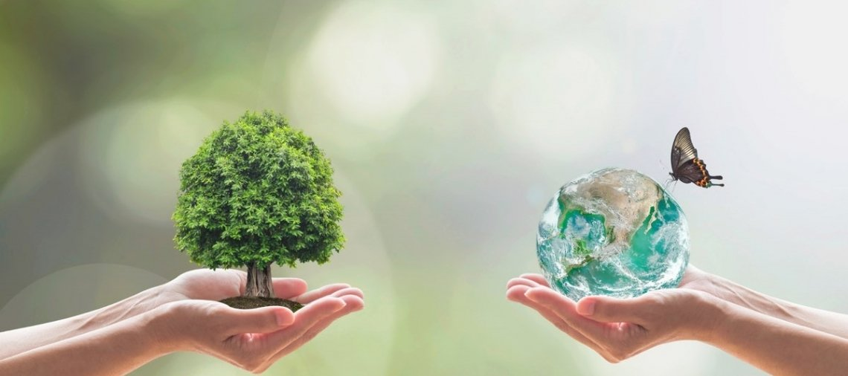
BIODIVERSITY
The biosphere is the layer in which we live and combines the atmosphere in a single system within which millions of species including humans, have had the opportunity to have breathing air, drinking water, fertile soils…
Biodiversity is defined as "the variability between living organisms from all sources.
Cultivated territories represent more than 24% of the earth's surface.

Slide 4


The year 2010 was declared by the united nations the international year of biodiversity, while the decade 2011-2020 was declared the decade of biodiversity.

Slide 5

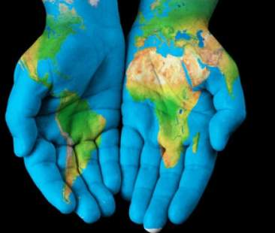
THE DAY
International Biodiversity Day is celebrated every year on May 22nd.
The day was set up by the United Nations Assembly to celebrate the Convention on Biological Diversity adopted on May 22 1992, to promote global awareness of biodiversity problems.

Slide 6
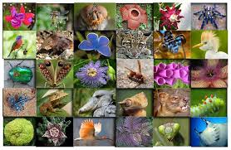

Italy
FLORA
Three species of evergreen plants mainly characterize the Italian landscape: holly, pine and cork oak. There are fruit trees, olive trees, vines and citrus fruits that characterize our Peninsula.
FAUNA
There are also many flowers. In the Alps live the eagle, the ibex, the chamois, the bear, the wolf and the marmot. While, along the coasts there are swordfish, tuna and dolphins.

Slide 7
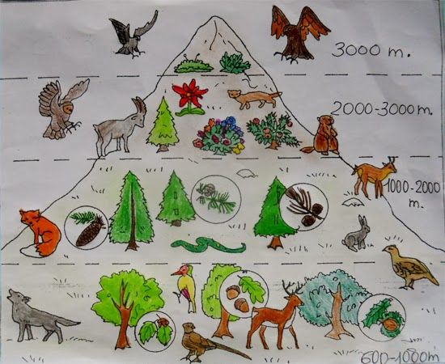
ITALY

Slide 8
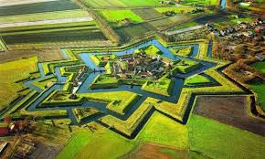
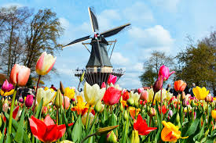
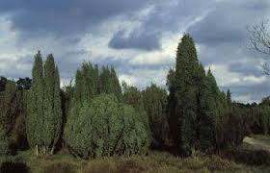
THE NEATHERLANDS
Forests mainly consist of oak, beech, ash and pine trees, but are seriously threatened by serious deforestation problems.
The fauna is typical of European countries with a temperate climate: predominated by small species and by the creation of polders creating new habitats for many species of migratory and aquatic birds. The Dutch government has promoted a conservation policy for local fauna through the creation of national parks and nature reserves.
The official symbol of the Netherlands is the famous tulip, a flower particularly common in the country but native to Turkey.

Slide 9
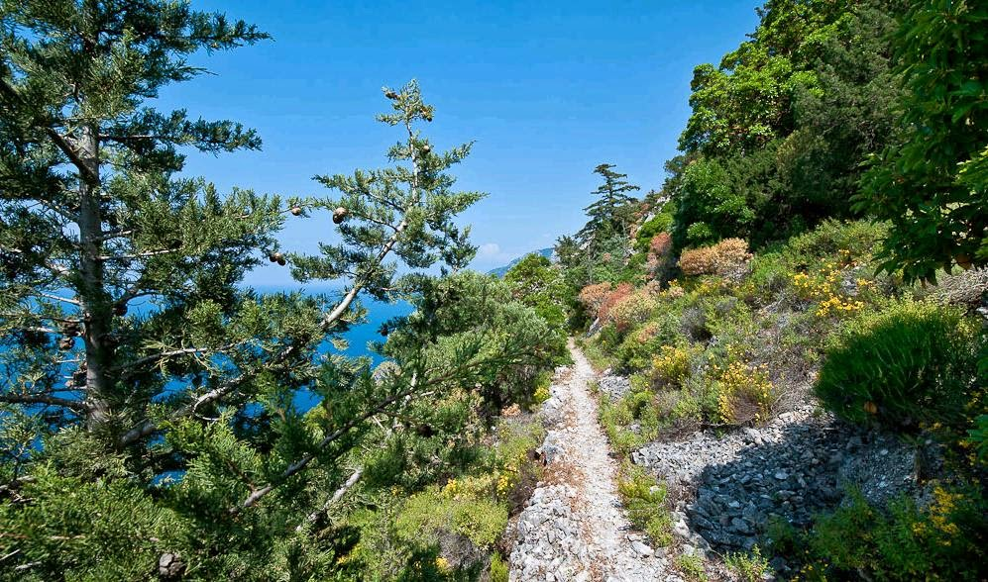
Greece
flora
Greece has a rich Mediterranean vegetation.
On the plain there are orange, olive, date, pomegranate and fig trees.
The vine thrives on the hills. There are oak, pine, chestnut and woodlands
Beeches; tulip trees, hyacinths and laurels are also widespread.
In the higher areas, the vegetation is Alpine, with firs and flowers such as anemones and cyclamens e Lichens.

Slide 10
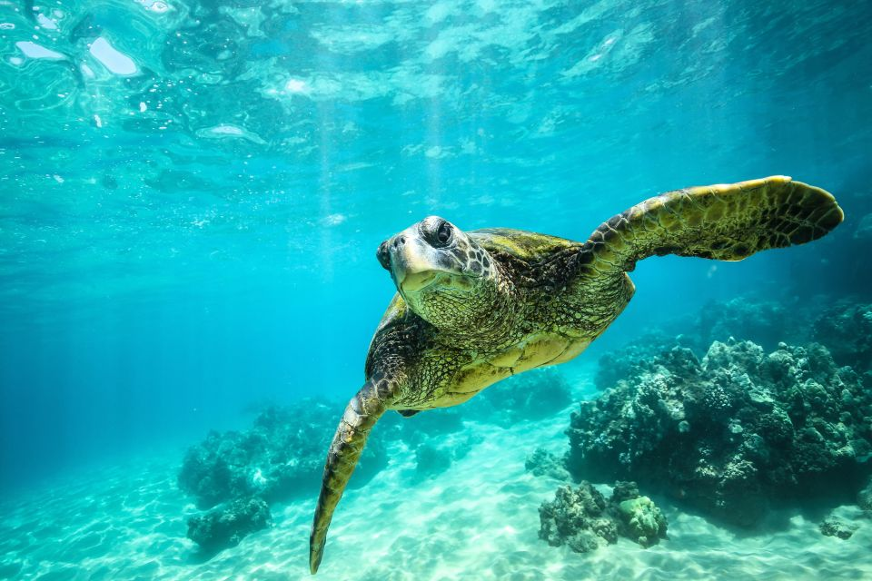
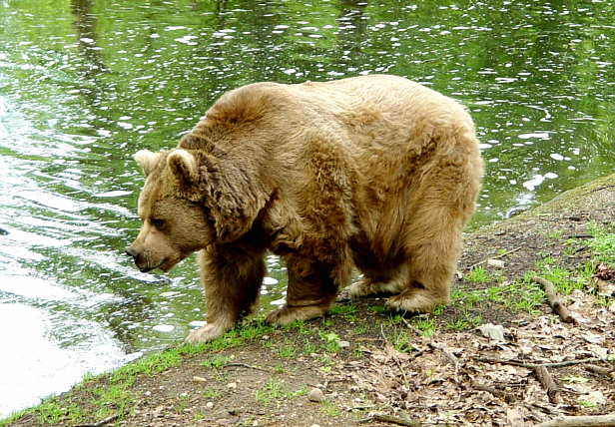
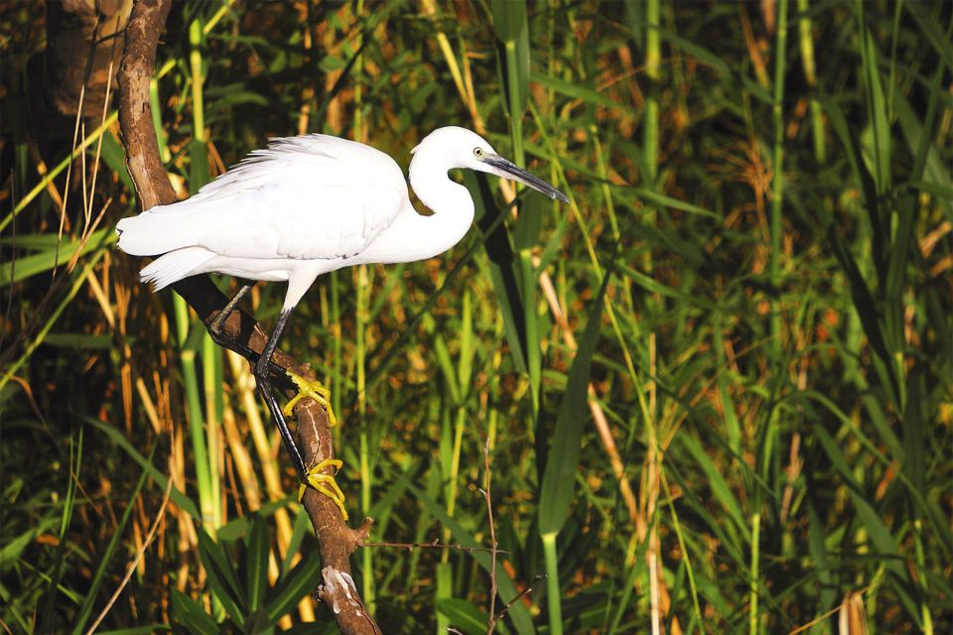
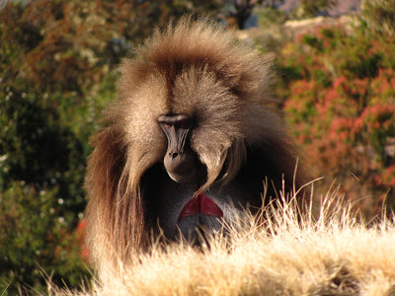
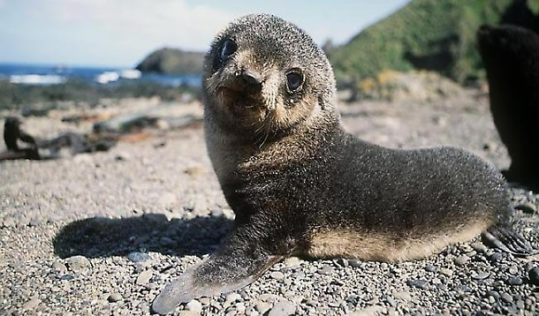
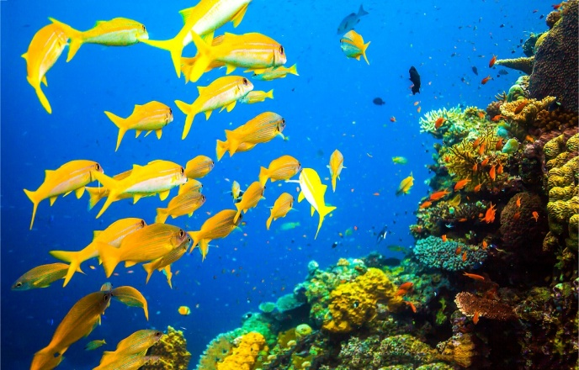
fauna
There are bears, lynx, jackals, wild boars, chamois, deer, foxes and badgers in the mountains.
Numerous bird species including hawk, pelican, white heron and stork.
There is the monk seal.
You will see in the Cyclades, many pony-birds that help men.

Slide 11
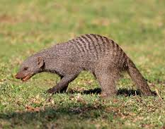
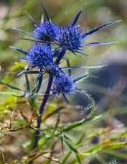
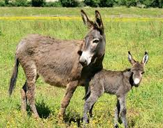
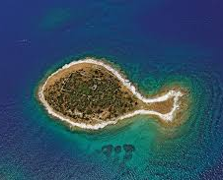
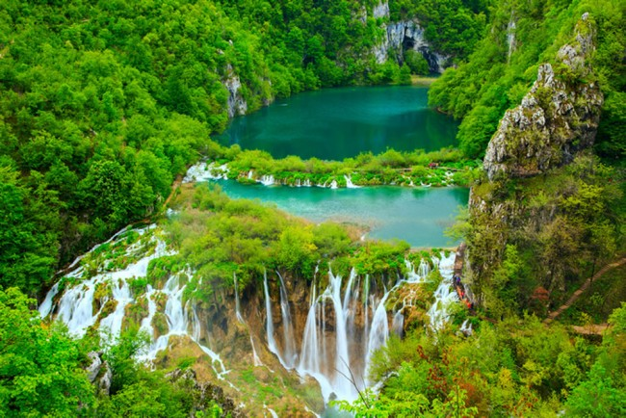
Croatia
Flora and fauna
Croatia is a fantastic place full of natural beauty.
It is characterized by mountain massifs, karts hills, river valleys and a very jagged coast with a large number of islands.

Slide 12
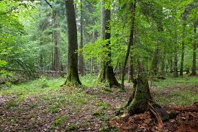
Poland
flora
Forests are composed of conifers.
In some areas of the northeast, glacial varieties grow, such as dwarf birch and Lapland willow.
Much of the country's forest has undergone deforestation to make way for agricultural land or has been damaged by air pollution.

Slide 13
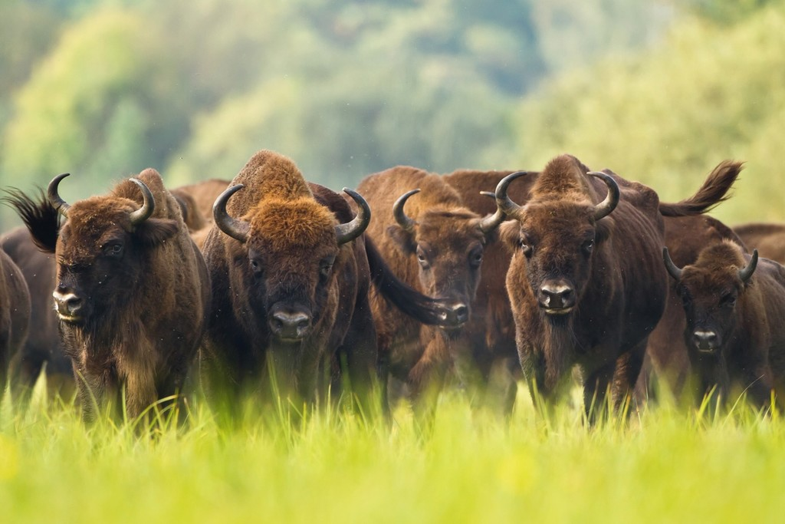
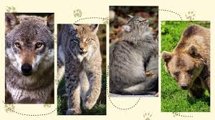
fauna
In the woods moose, chamois, lynx, wild cats, wild boars find refuge.
The European bison and tarpons are protected in the Bialowieski National Park, located on the border with the Belarusian national park, founded in 1932 to preserve the habitat of ancient European forests and declared a World Heritage Site in 1979.

Slide 14
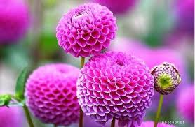
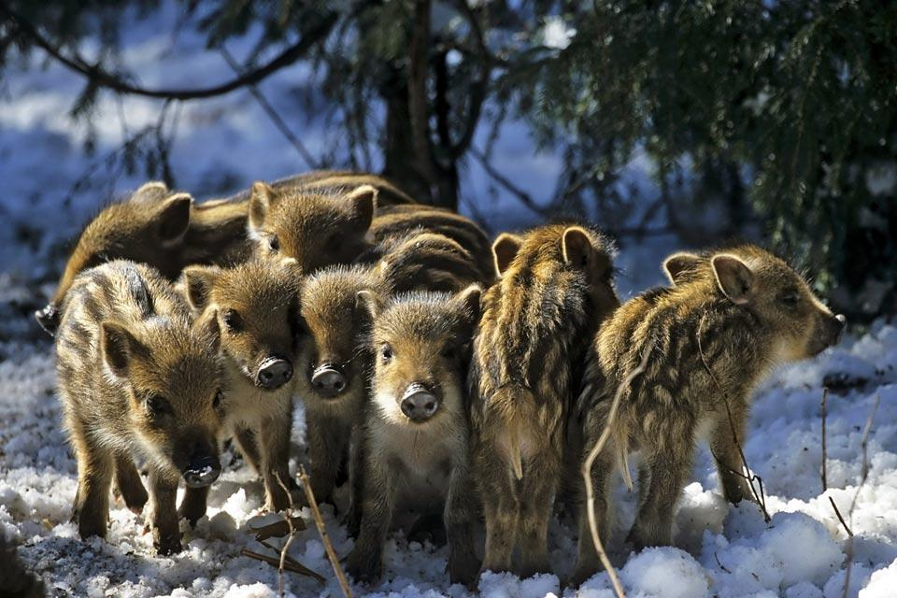
Lithuania
Flora and fauna
The Lithuanian forest is characterized by pine, fir, birch, alder, maple and lime trees.
There are the big elk, the deer, the fallow deer and the roe deer, the wild boar, the fox, the hare, the raccoon, the wolf, the lynx, the wild duck, the mink and the wild beaver.
Falcons, sparrows hawks, storks and owls are protected species.
Herons live around the marshes, Capercailzie, seagulls, wild ducks, geese and swans.

Slide 15
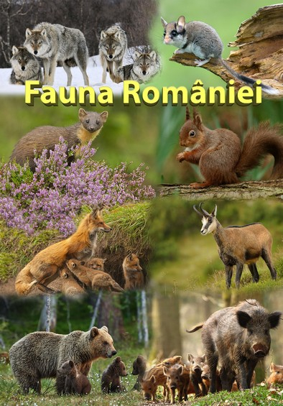
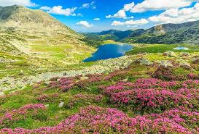
ROMANIA
Forests include beech, oak, hornbeam, ash, linden, birch and a wide variety of shrubs. Among the bushes we remember the raspberry, the blueberry and the hawthorn.
There are also some protected trees: Cajvana oak, Botosana oak.
The Bucovina mountains are home to numerous species of rare flora: sweet pea, edelweiss, snowy rose, black burdock, mountaineer.

Slide 16
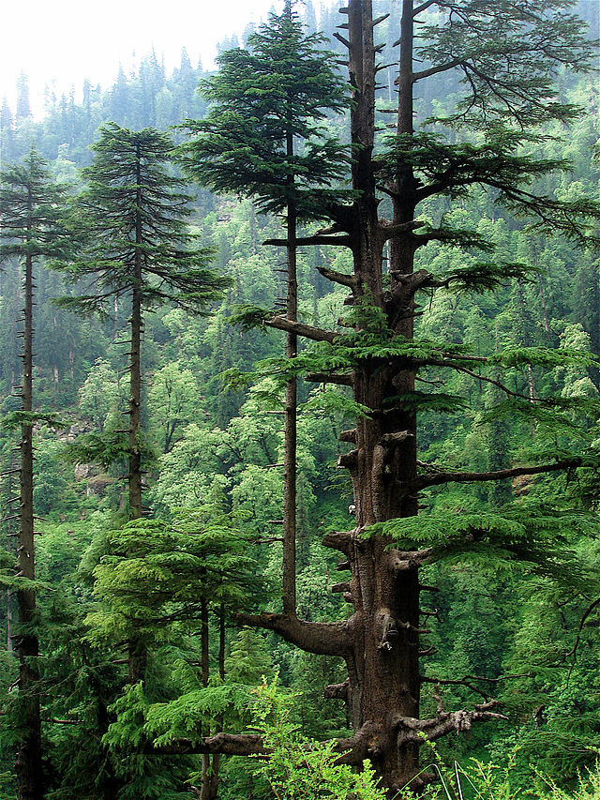
The territory of Suceava hosts over 20 natural reserves: floristic reserves, forest reserves.
The rich and precious fauna includes numerous species with high hunting value: Carpathian bear and deer, fallow deer, lynx, wolves, foxes, squirrels, wild cats, martens, stoats, fitchews, woodcocks, birches, pheasants, crows, various species of eagles and owls.
Mountain rivers are home to rare species of fish: salmon, rainbow trout, grayling, barbel, chub, wide snout.

Slide 17
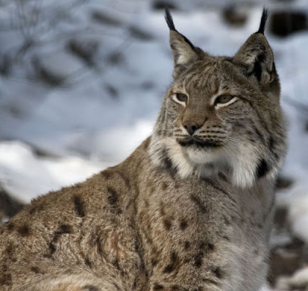
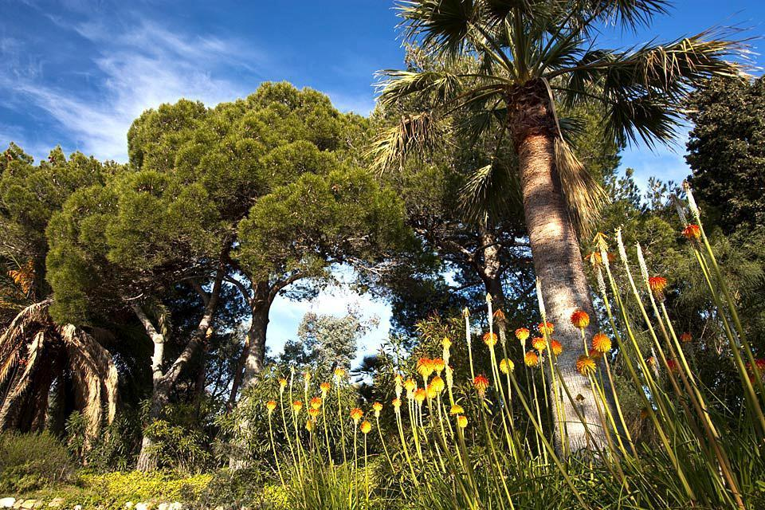
Spain
FLORA
There are deciduous forests and grasslands in the deforested areas. There are plants such as the giant thistles, agaves, cacti, cork and oaks. In the warmer areas sugar cane, banana trees, cotton, bamboo grow.
FAUNA
There are wolves, foxes, wild cats, hares, squirrels, storks, flamingos, chameleons and monkeys.

Slide 18
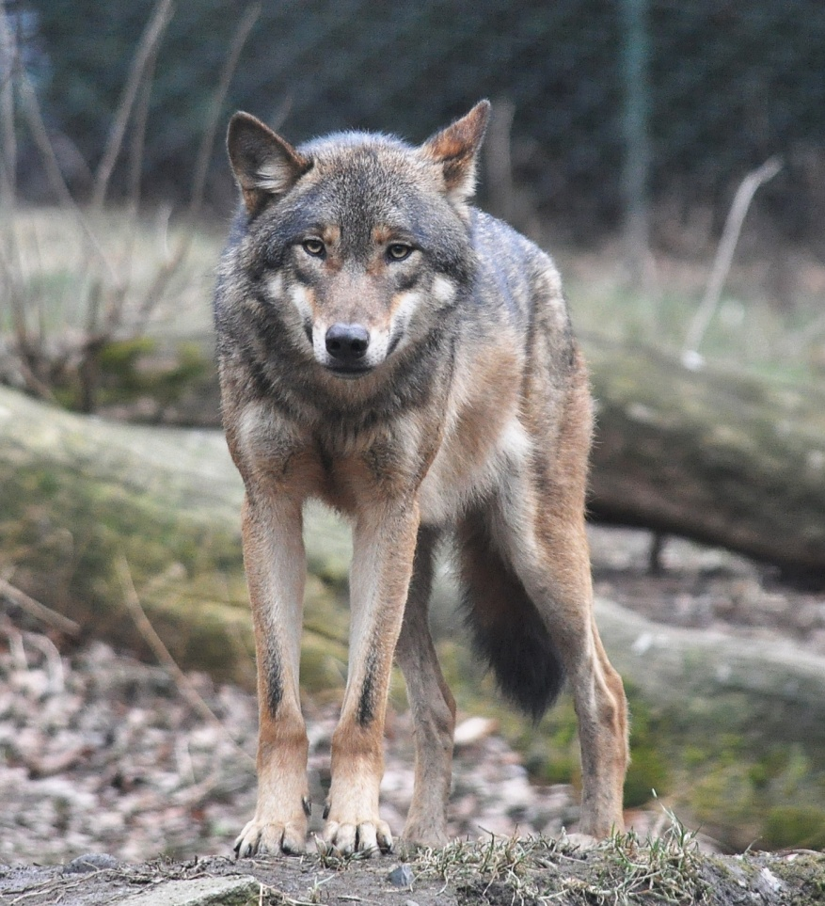
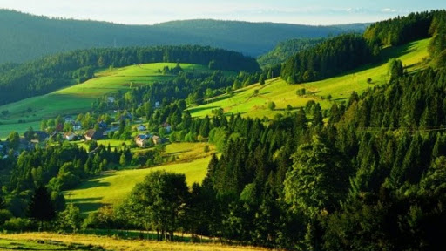
GERMANY
FLORA
One of the best known forests is "the black forest". There are oaks, ash trees, lime trees, beeches and conifers; and vineyards.
FAUNA
There are deer, wild boars, hares, weasels, badgers, wolves and foxes, the white stork. There are also many fish.

Slide 19
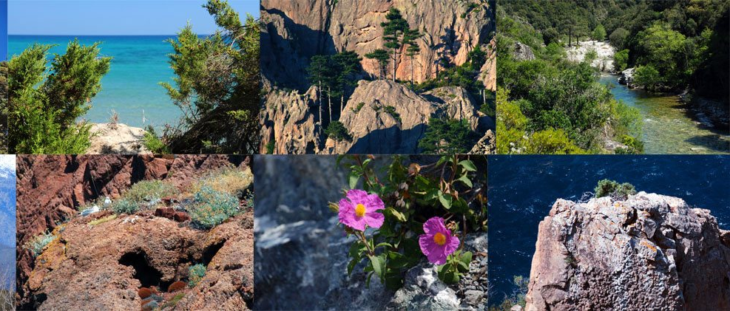
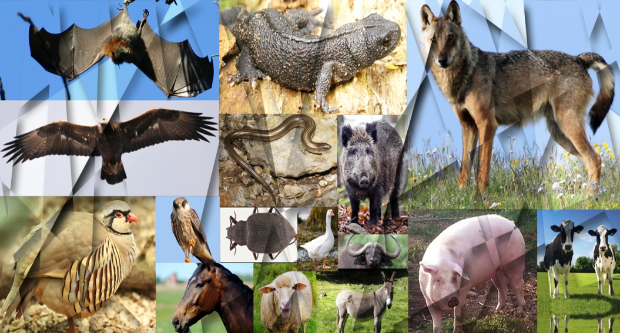
FRANCE
FLORA
There are lavender rose, cent folia, jasmine, tuberose, rosemary, verbena, lemon balm.
FAUNA
This region is habited by the horse, the pink flamingo, the Pyrenean dog, the Friesian which is a breed of cow.

Slide 20
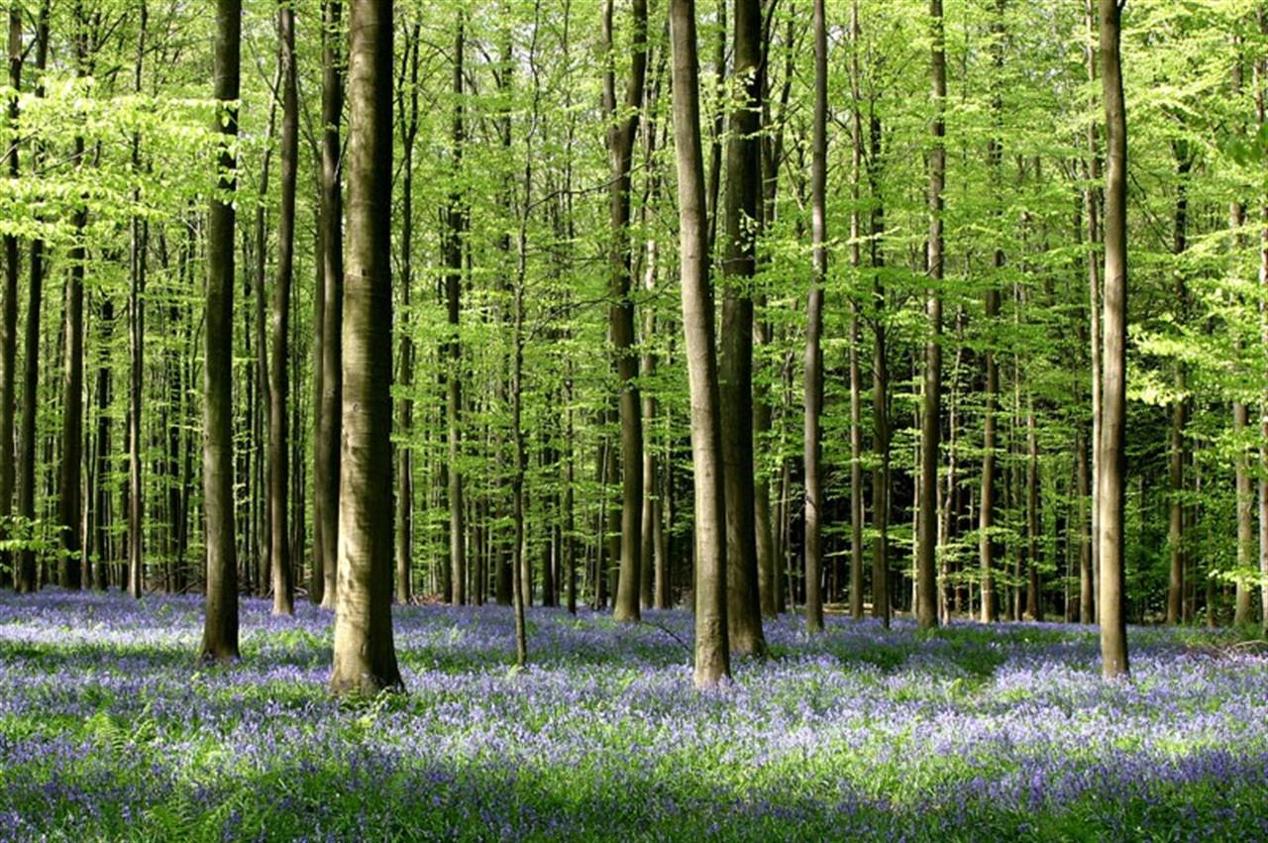
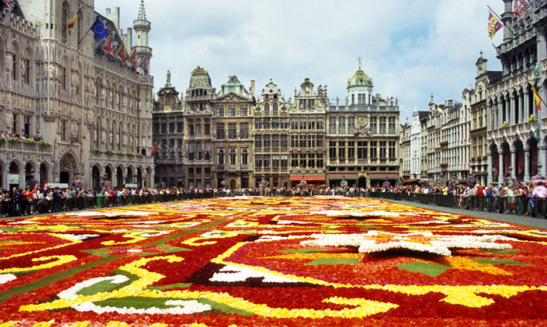
BELGIUM
The forest areas of the flat and hilly regions are mainly composed of broad-leaved trees such as oak, elm and beech trees.
Coniferous forests, heaths and bogs are widespread in the ardennes massif.
There are flowering plants such as hyacinths, goldenrods, periwinkles and digitalis.
Wildlife includes fox, badger, squirrel, weasel and marten. Fallow deer and wild boar live in mountainous regions.

Slide 21
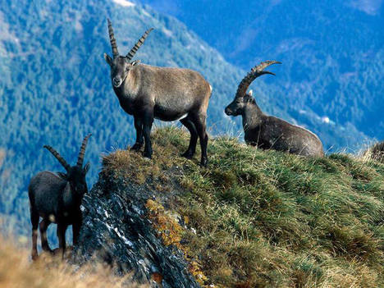
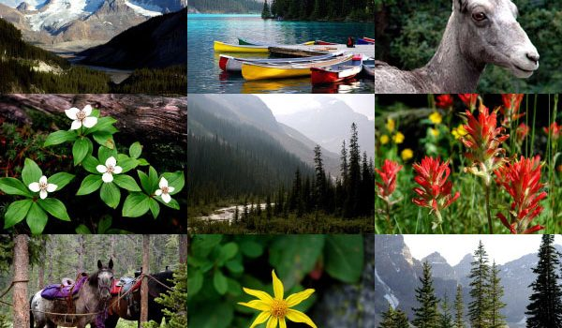
Austria
There are deciduous, birch, coniferous, spruce, black pine and stone pine forests. Austrian fauna is typical of the regions of central and alpine Europe.
There you can find roe deer, hares, foxes, squirrels, pheasants, partridges and, in the high mountains, marmots and ibexes.
The ibex, which was in danger several decades ago, has been reintroduced and protected throughout the alps so that today in austria, as in other neighboring countries, it lives organized in numerous colonies capable of living according to a management no more than absolute protection.

Slide 22
REALIZED BY:
Second class of Scuola Secondaria I Grado of Sant’Elia a Pianisi (CB)
Mattia
Iosue
Angelica Pia Cerviero
Camilla
Faiella
Antonio
Lariccia
Ahmad
Shariati
Alessandra
Cicolella
Francesca
De Rita

