Slide 1
Erasmus+ project 2018-2020 2018-1-HR01-KA229- 047516 Stop Climate Change – Together Europe Achieves More
GLOBAL WARMING AND GREENHOUSE EFFECT
April 2019

Slide 2
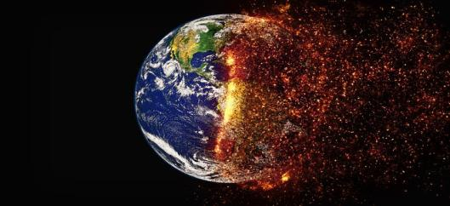
GLOBAL WARMING According to the vast majority of climate scientists, the planet is heating up. Scientists have concluded that this appears to be the result of increased human emissions of greenhouse gases, especially carbon dioxide, which trap heat near the surface of Earth.

Slide 3
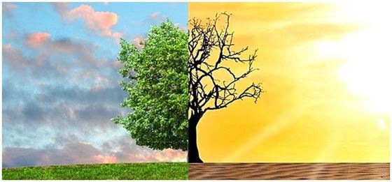
THE RISE IN TEMPERATURE
Change over time
Though warming has not been uniform across the planet, the upward trend in the globally averaged temperature shows that more areas are warming than cooling. Since 1901, the planet’s surface has warmed by 0.7–0.9° Celsius (1.3–1.6° Fahrenheit) per century, but the rate of warming has nearly doubled since 1975 to 1.5–1.8° Celsius (2.7–3.2° Fahrenheit) per century, according to the international State of the Climate in 2017 report.

Slide 4
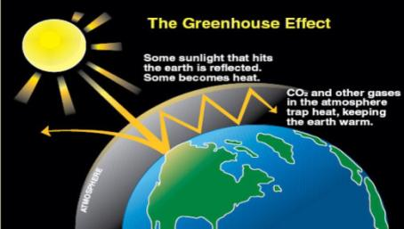
GREENHOUSE EFFECT
Earth’s atmosphere works something like a giant glass greenhouse. As the sun’s rays enter our atmosphere, most continue right down to the planet’s surface. As they hit the soil and surface waters, those rays release much of their energy as heat. Some of the heat than radiates back out into space.
However, certain gases in our atmosphere, such as carbon dioxide, methane and water vapor, work like a blanket to retain much of that heat. This help to warm our atmosphere.

Slide 5
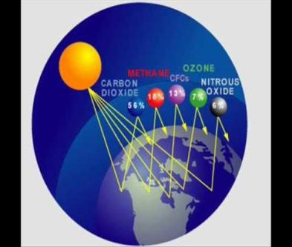
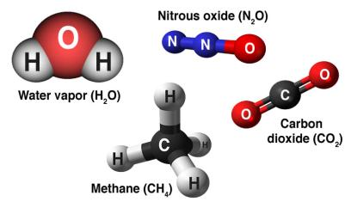
GREENHOUSE EFFECT
The gases help warming our atmophere because they absorb heat and radiate it back to the earth's surface. They have a heat-trapping effect, so they are nicknamed “greenhouse gases”.
Without the “greenhouse effect”, Earth would be too cold to support most forms of life.

Slide 6
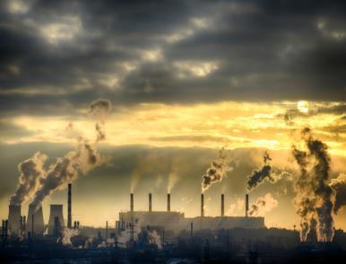
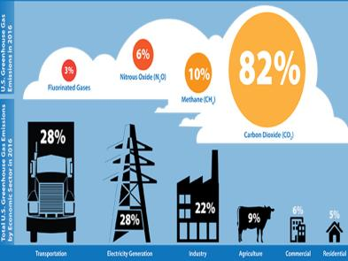
BURNING OF FOSSIL FUELS Carbon dioxide is released when we use fossil fuels, such as coal, oil and natural gas. We burn these fuels, made from the ancient remains of plants and animals, to run electricity-generating plants that power factories, homes and schools. Products of these fossil fuels, such as gasoline and diesel fuel, power most of the engines that drive cars, airplanes and ships.

Slide 7
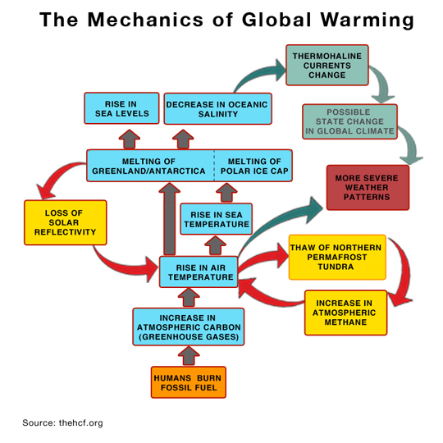
GLOBAL WARMING

Slide 8
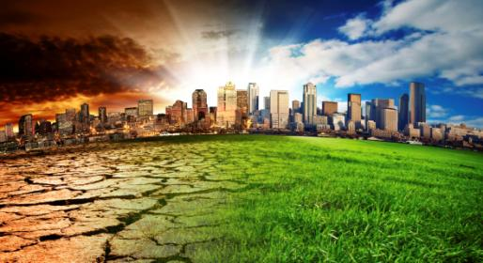
THE CHANGING OF THE LANDSCAPE
Humans have further increased the levels of greenhouse gases in the air by changing the landscape. Plants take up carbon dioxide to make food in a process calle photosynthesis. Once cut down, they can no longer take in carbon dioxide, and this gas begins building up in the air instead of fueling the growth of plants. So by cutting down trees and forests for farmland and other human uses, more carbon dioxide is also added into the atmosphere.

Slide 9
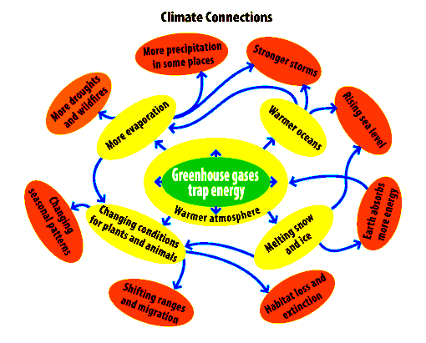
EFFECTS OF GLOBAL WARMING
Heat is energy and when you add energy to any system changes occur.
Because all systems in the global climate system are connected, adding heat energy causes the global climate as a whole to change.
Much of the world is covered with ocean which heats up. When the ocean heats up, more water evaporates into clouds.
Where storms like hurricanes and typhoons are forming, the result is more energy-intensive storms. A warmer atmosphere makes glaciers and mountain snow packs, the Polar ice cap, and the great ice shield jutting off of Antarctica melt raising sea levels.
Changes in temperature change the great patterns of wind that bring the monsoons in Asia and rain and snow around the world, making drought and unpredictable weather more common.

Slide 10
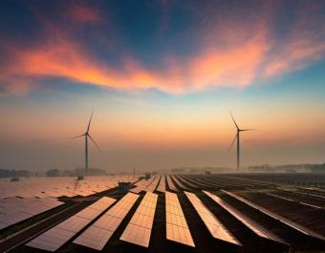
RENEWABLE ENERGIES Renewable energy sources are literally found in sunlight, in the air, deep underground and in our oceans. They are part of the planet’s physical structure, which means they are constantly being renewed by natural means. They simply cannot run out.
A series of alternative renewable energy sources are:
geothermal energy;
hydroelectric energy;
marine energy;
solar energy;
wind energy;
biomass energy;
waste-to-energy;
energy or cogeneration from groundwater.

Slide 11
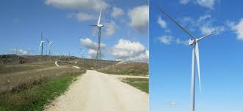
WIND ENERGY There is a Wind Farm in the territory of Pietracatella, near Sant’Elia a Pianisi. These are some wind turbines.

Slide 12
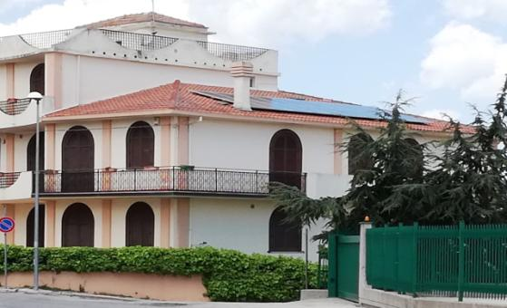
SOLAR PANELS This is one of the houses with solar panels on its roof in Sant’Elia a Pianisi.

