Slide 1
FORESTS, FIRES AND CLIMATE CHANGE

Slide 2
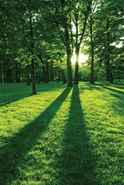
IMPORTANCE AND VALUE OF TREES
Trees are important to our environment as they promote well-being through shelter, food, timber as well as spiritual, aesthetic and cultural values. Trees play a vital role in promoting the health of human beings and wildlife. Here are few of the importance of trees why they required to be protected, conserved and standing long:
Absorb CO2
Food Source for Wildlife
Reduce Energy Demand
Prevent Soil Erosion and Water Pollution
Increase Beauty and Property Values
Create Economic Opportunities

Slide 3
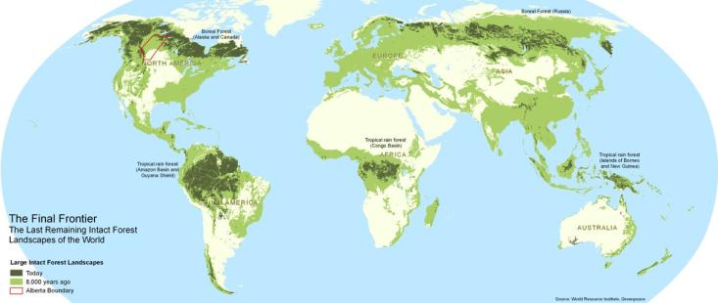
WHAT IS A FOREST?
A forest is a community of trees, shrubs, herbs, and associated plants and organisms that cover a considerable area that use oxygen, water and soil nutrients as the community attains maturity and reproduces itself.
The word “Forest” comes from the Latin word “Foris”, that means “Outside”.
Forest is one of the most important natural resources of the earth. Approximately 1/3rd of the earth’s total area is covered by forests.

Slide 4
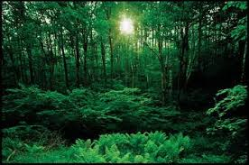
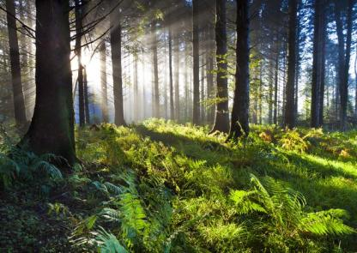
The importance of forests cannot be underestimated
We depend on forests for our survival, from the air we breathe to the wood we use. Besides providing habitats for animals and livelihoods for humans, forests also offer watershed protection, prevent soil erosion and mitigate climate change. Yet, despite our dependence on forests, we are still allowing them to disappear.

Slide 5
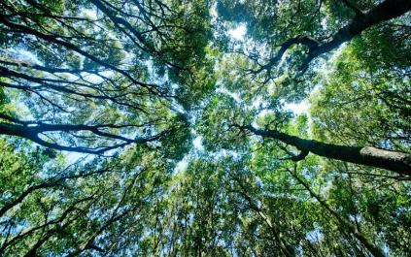
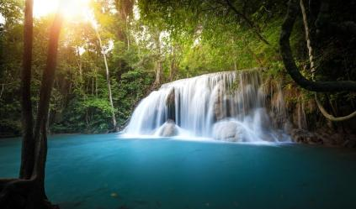
Some reasons why forests are important
They help us breathe
They're more than just trees
People live there, too
They keep us cool
They keep Earth cool
They make it rain
They fight flooding
They refill aquifer
They block wind
They keep dirt in its place
They clean up dirty soil
They clean up dirty air
They muffle noise pollution
They feed us
They heal us
They help us make things
They create jobs
They create majesty
They help us explore and relax

Slide 6
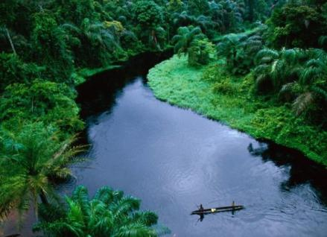
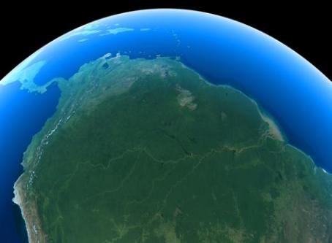
TROPICAL FORESTS Southeast Asian and Amazon Rainforest

Slide 7
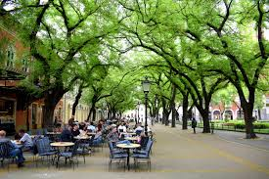
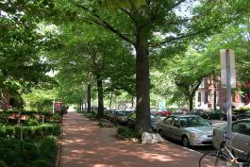
FORESTS AND CLIMATE
Forests pump out oxygen we need to live and absorb the carbon dioxide we exhale (or emit).
Urban trees help buildings stay cool, reducing the need for electric fans or air conditioners, while large forests can tackle daunting tasks like curbing a city's "heat island" effect or regulating regional temperatures.
Trees also have another way to beat the heat: absorb CO2 that fuels global warming. Plants always need some CO2 for photosynthesis, but Earth's air is now so thick with extra emissions that forests fight global warming just by breathing. CO2 is stored in wood, leaves and soil, often for centuries.
Large forests can influence regional weather patterns and even create their own microclimates. The Amazon rainforest, for example, generates atmospheric conditions that not only promote regular rainfall there and in nearby farmland, but potentially as far away as the Great Plains of North America.

Slide 8
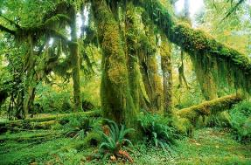
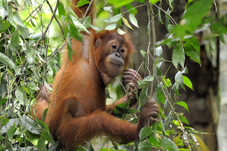
BIODIVERSITY
Nearly half of Earth's known species live in forests, including 80% of biodiversity on land. That variety is especially rich in tropical rainforests, but forests teem with life around the planet: Insects and worms work nutrients into soil, bees and birds spread pollen and seeds, and keystone species like wolves and big cats keep hungry herbivores in check.

Slide 9
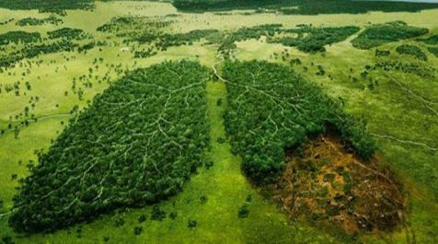
Forests cover nearly a third of all land on Earth, providing vital organic infrastructure for some of the planet's densest, most diverse collections of life. They support countless species, including our own, yet we often seem oblivious of that. Humans now clear millions of acres from natural forests every year, especially in the tropics, letting deforestation threaten some of Earth's most valuable ecosystems.
A forest's root network stabilizes huge amounts of soil, bracing the entire ecosystem's foundation against erosion by wind or water. Not only does deforestation disrupt all that, but the ensuing soil erosion can trigger new, life-threatening problems like landslides and dust storms.
We tend to take forests for granted, underestimating how indispensable they still are for everyone on the planet. That would quickly change if they all disappeared, but humanity might not survive that scenario.

Slide 10
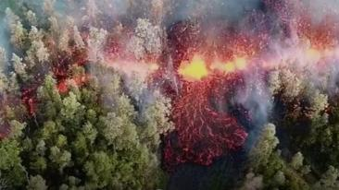
FIRES What causes forest fires?
One of the most prevalent causes of global deforestation and destruction of wildlife is fire.
Discovered fossil charcoal indicate that forest fires are not new to modern history as some date back to over one hundred million years ago. The Earth is said to be a fundamentally flammable planet because of the existence of vegetation rich in carbon, dry climates, oxygen in the atmosphere, lightning, and volcanic activities among others.

Slide 11
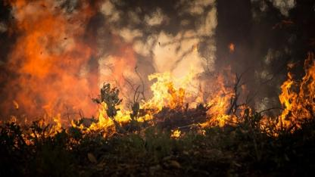
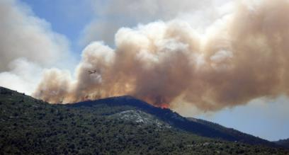
Forest or wildlife fires spread at different speeds depending on vegetation, weather conditions, and physical features.
90% of all forest fires are caused by human involvement.
Human activities near or within forested areas are the number one cause of forest fires. Smoking near vegetation can cause a widespread fire. Equipment such as machinery used in logging and hunting can also cause fires. Bullets hitting on some dry vegetation may result in fires.
Electric faults from facilities or electricity plants near forests can also cause fires. In some extreme cases, people have deliberately caused fires during hunting to corner wild animals while others burn forests to clear the way for agriculture or development activities.
Some people just start fires without any reason (arson).

Slide 12
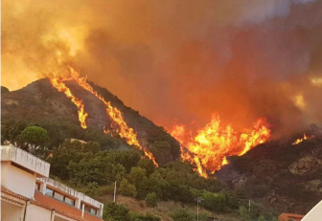
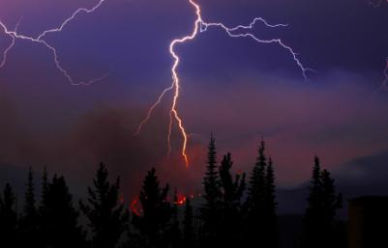
Natural causes
Lightning is the biggest natural cause of forest fires. Lightning fires are always more common immediately after dry seasons when vegetation is still dry. Lightning fires destroy more vegetation than human-caused fires. This is because lighting fires occur in remote areas far from human presence and are not notice in time, unlike fires caused by human activities.
In rare occurrences, volcanic activities such as eruptions and lava flow can cause fires which are difficult to put out because of the lava flow and other associated risks.
Spontaneous combustion of dry leaves and vegetation may also be responsible for some fire outbreaks.
Most natural fires are usually monitored and allowed to burn, with the aim of balancing a forest's ecology. Vegetation may also be burned occasionally in order to balance species.

Slide 13
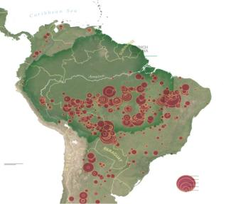
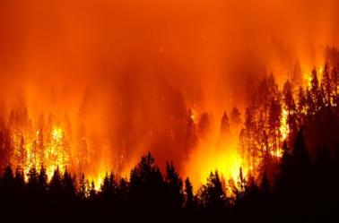
Fires in the Amazon Rainforest
There have been a lot of fires this year
Brazil - home to more than half the Amazon rainforest - has seen a high number of fires in 2019, Brazilian space agency data suggests.
The National Institute for Space Research (Inpe) says its satellite data shows an 76% increase on the same period in 2018.
Other countries have also been affected
A number of other countries in the Amazon basin - an area spanning 7.4m sq km (2.9m sq miles) - have also seen a high number of fires this year: Venezuela, Peru and Bolivia.

Slide 14
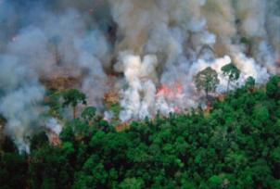
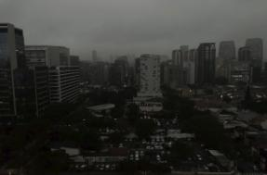
Fires in the Amazon Rainforest
Forest fires are common in the Amazon during the dry season, which runs from July to October. They can be caused by naturally occurring events, such as lightning strikes, but this year most are believed to have been started by farmers and loggers clearing land for crops or grazing.
There had been a noticeable increase in large, intense, and persistent fires along major roads in the central Brazilian Amazon.
The fires are emitting large amounts of smoke and carbon
Plumes of smoke from the fires have spread across the Amazon region and beyond.
the smoke has been travelling as far as the Atlantic coast.
The fires have been releasing a large amount of carbon dioxide.
They are also emitting carbon monoxide - a gas released when wood is burned and does not have much access to oxygen.

Slide 15
Fires and Climate Change
The Amazon basin - home to about three million species of plants and animals, and one million indigenous people - is crucial to regulating global warming, with its forests absorbing millions of tonnes of carbon every year.
But when trees are cut or burned, the carbon they are storing is released into the atmosphere and the rainforest's capacity to absorb carbon is reduced.
When the frequency of forest fires in a given area is high, the consequences can be devastating. If some specialists consider fire to be a windfall for the ecosystem (elimination of diseased plants and plants, increased plant and animal diversity, etc.), we must not forget that the natural cycles of forests are disturbed and that some species disappear, while invasive plants proliferate. Forest fires increase carbon dioxide levels in the atmosphere, contributing to the greenhouse effect and climate change. In addition, ashes destroy much of the nutrients and erode the soil, causing flooding and landslides.

Slide 16
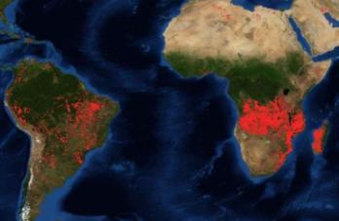
Fires in African Forests
In NASA satellite images, forest fires in central Africa appear to burn alarmingly like a red chain from Gabon to Angola similar to the blazes in Brazil’s Amazon.
Experts say central Africa’s rainforest fires are often more seasonal and linked to traditional seasonal farming methods.
No doubt the region is key for the climate: The Congo Basin forest is commonly referred to as the “second green lung” of the planet after the Amazon.
The forests cover an area of 3.3 million square kilometres in several countries, including about a third in the Democratic Republic of Congo, and the rest in Gabon, Congo, Cameroon and Central Africa.
Just like the Amazon, the forests of the Congo Basin absorb tons of carbon dioxide (CO2) in trees and peat marshes - seen by experts as a key way to combat climate change. They are also sanctuaries for endangered species.

Slide 17
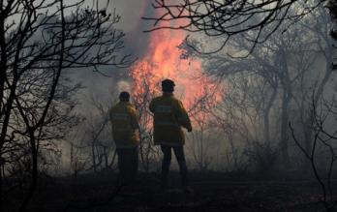
How to prevent fire
The ability of foresters to be effectual in preventing forest fires and minimizing them:
reducing the amount of flammable substances in the area
breaking its contiguity vertically as well as horizontally
Good infrastructure also helps minimize the area a fire spreads to, such as access roads and water supply
early detection of the fire
availability of sufficient firefighters to reach the fire as soon as possible
additional factors that can reduce the number of forest fires: community participation in fire prevention through publicity and education, legislation, law enforcement and penalties.
A forest fire ignites when there is high temperature, oxygen and flammable material.
A forest fire will spread when assisted by contiguous flammable material, both horizontal and vertical, by slopes and ravines and by weather conditions, primarily strong winds, low humidity and high temperatures.

Slide 18
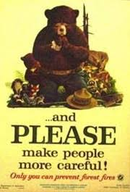
Finally... “Can you suggest your own solution to prevent forest fires?”

