Slide 1
FLOODS
Causes, Effects and Solutions

Slide 2
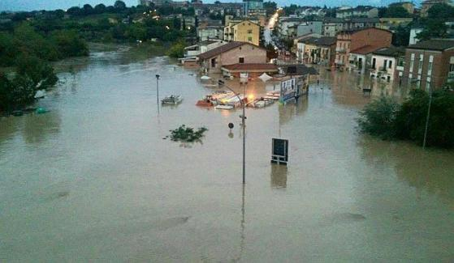
A flood is a body of water that covers land which is normally dry. Floods are common natural disasters that can affect millions of people around the world. They destroy houses and buildings, and carry soil away from valuable farming land. Flooded streets in Benevento, Campania, October 15th, 2015

Slide 3
What causes flooding?
Few events that can cause flooding:
Rains
River overflow
Hurricanes, Strong winds in coastal areas
Dam breaking
Ice and snow-melts

Slide 4
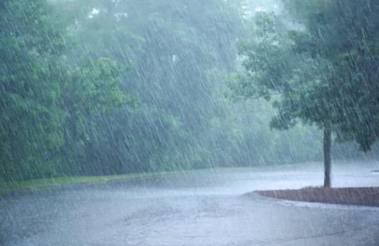
Rains Each time there are more rains than the drainage system can take, there can be floods. Sometimes, there is heavy rain for a very short period that result in floods. In other times, there may be light rain for many days and weeks and can also result in floods.

Slide 5
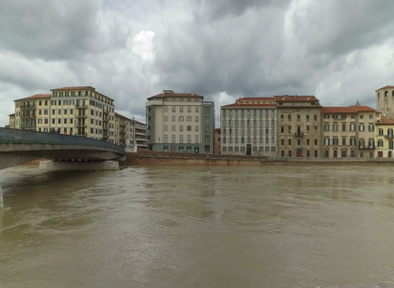
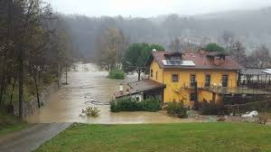
River overflow Rivers can overflow their banks to cause flooding. This happens when there is more water upstream than usual, and as it flows downstream to the adjacent low-lying areas (also called a floodplain), there is a burst and water gets into the land.

Slide 6
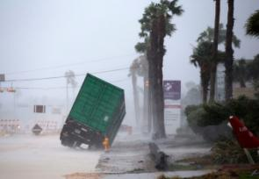
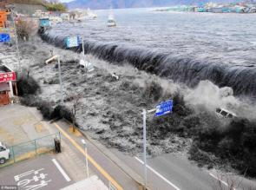
Hurricane and Tsunami
Hurricanes, Strong winds in coastal areas
Sea water can be carried
by massive winds and
hurricanes onto dry coastal
lands and cause flooding.
Sometimes this is made
worse if the winds carry
rains themselves.
Sometimes water from the
sea resulting from a
tsunami can flow inland to
cause damage.

Slide 7
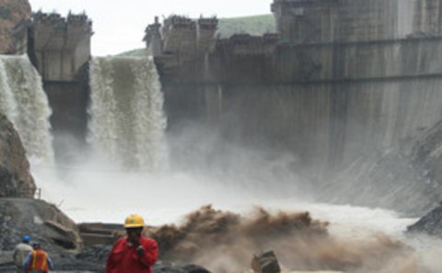
Dam Breaking. Dams are man-made blocks mounted to hold water flowing down from a highland. The power in the water is used to turn propellers to generate electricity. Sometimes, too much water held up in the dam can cause it to break and overflow the area. Excess water can also be intentionally released from the dam to prevent it from breaking and that can also cause floods.

Slide 8
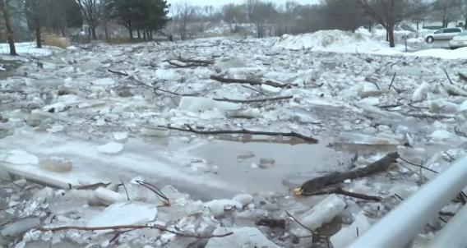
Ice and snow-melts In many cold regions, heavy snow over the winter usually stays un-melted for sometime. There are also mountains that have ice on top of them. Sometimes the ice suddenly melts when the temperature rises, resulting in massive movement of water into places that are usually dry. This is usually called a snowmelt flood

Slide 9
Types of Floods
Three major flood types: Flash floods, Rapid on-set floods and Slow on-set floods.
Flash floods
This kind occurs within a very short time (2-6 hours, and sometimes within minutes) and is usually as a result of heavy rain, dam break or snow melt. Sometimes, intense rainfall from slow moving thunderstorms can cause it.
Rapid on-set floods
Similar to flash floods, this type takes slightly longer to develop and the flood can last for a day or two only.
Slow on-set floods
This kind is usually as a result of water bodies over flooding their banks. They tend to develop slowly and can last for days and weeks. They usually spread over many kilometers and occur more in flood plains (fields prone to floods in low-lying areas).

Slide 10
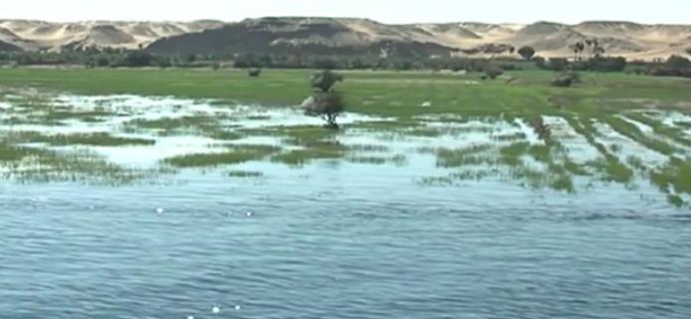
Flooding has always been a part of human history. Many ancient civilizations developed along waterways and rivers because people needed water for their fields. Floods are not always destructive natural events. Before the Assuan High Dam was built yearly floods in Egypt brought along nutrients and made the land around the Nile very fertile.

Slide 11
Climate change and Flooding
Heavy rainfall caused by climate change as well as human alteration of the land are the main drivers of more frequent flooding.
With rising global temperatures due to increased heat-trapping emissions, more water evaporates from the land and oceans. The warmer atmosphere can hold more water vapor. This means that when it rains, there is a higher potential for heavy rainfall, which is the main cause of inland flooding.

Slide 12
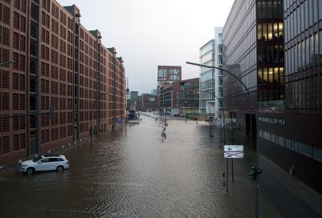
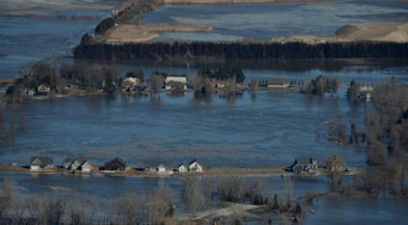
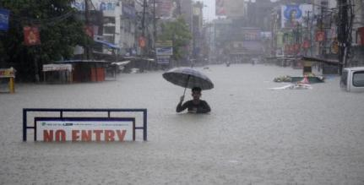
Heavy rainfall events, with severe flooding, are occurring more often in the central and Eastern United States, Northern Europe and northern Asia.

Slide 13
Effects of flooding
Floods can have devastating consequences and can have effects on the economy, environment and people.
Economic
During floods (especially flash floods), roads, bridges, farms, houses and automobiles are destroyed. People become homeless. Additionally, the government deploys firemen, police and other emergency apparatuses to help the affected. All these come at a heavy cost to people and the government. It usually takes years for affected communities to be re-built and business to come back to normalcy.

Slide 14
Effects of flooding
Environment
The environment also suffers when floods happen. Chemicals and other hazardous substances end up in the water and eventually contaminate the water bodies that floods end up in. Additionally, flooding causes kills animals, and others insects are introduced to affected areas, distorting the natural balance of the ecosystem.

Slide 15
Effects of flooding
People and animals
Many people and animals have died in flash floods. Many more are injured and others made homeless. Water supply and electricity are disrupted and people struggle and suffer as a result. In addition to this, flooding brings a lot of diseases and infections including military fever, pneumonic plague, dermatopathia and dysentery.

Slide 16
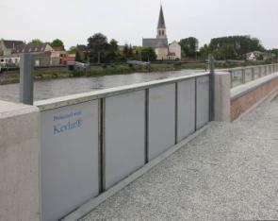
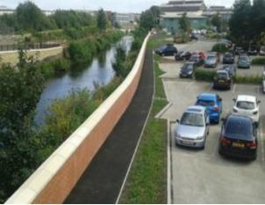
How to prevent floods
Some suggestions:
Cut carbon emissions to limit global warming
Invest in flood-resilient landscapes and infrastructure
Tackle climate change
Increase spending in flood defences
Protect wetlands and introduce plant trees strategically
Restore rivers to their natural courses
Put up more flood barriers

Slide 17
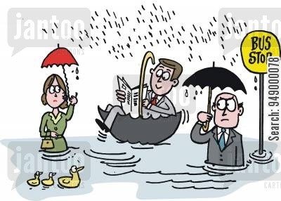
Finally…
“ Can you suggest your own solution to prevent flooding?”

