Slide 1
ENDANGERED ANIMALS
ITALY

Slide 2
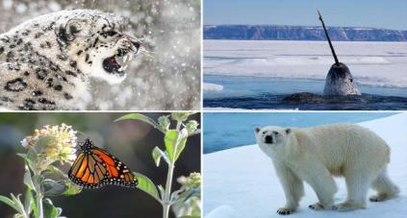
CLIMATE CHANGE AND ANIMALS
Climate change has a widespread impact across the globe, especially on animal species.
Animals from all different regions and habitats are being affected by the changing climate, whether it's directly from rising temperatures or from their food source becoming harder to find.
While this list includes 15 species, this list isn't exhaustive. There are many more feeling the impacts of the shifting global climate all over the world.

Slide 3
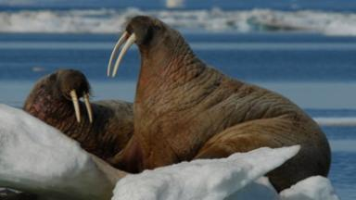
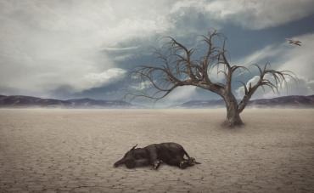
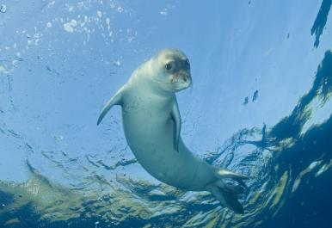
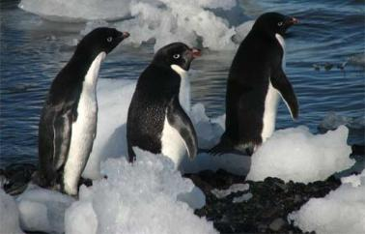
SOME ENDANGERED ANIMALS walrus - elephant - monk seal - penguin

Slide 4
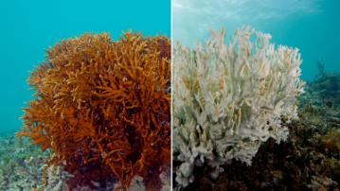
WORLD BIODIVERSITY
World biodiversity has declined alarmingly in half a century: more than 25,000 species, almost a third of those known, are in danger of disappearing. Climate change will be responsible for 8% of these.
"Human activity, the consumption of fossil fuels, the acidification of the oceans, pollution, deforestation, and forced migrations threaten life forms of all kinds. It is estimated that one-third of corals, freshwater molluscs, sharks, and rays, one-fourth of all mammals, one-fifth of all reptiles, and one-sixth of all birds are heading towards extinction". This resounding paragraph taken from the book The Sixth Extinction (2015) by journalist and Pulitzer Prize winner Elizabeth Kolbert is a good summary of the current situation of the natural biodiversity on planet Earth.

Slide 5
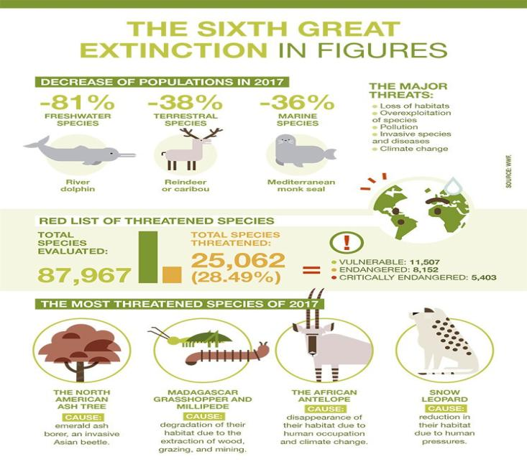

Slide 6
CHANGES IN TEMPERATURE
Changes in temperature might not seem extensive, but we are already seeing dramatic results in many areas:
Some islands no longer exist, because of the sea levels rising.
The occurrence of natural disasters is increasing.
A number of stunning destinations are on the brink of vanishing.
Wildlife species are needing increasing protection due to changing ecosystems and habitat loss.
In practice, climate change affects animal species in the following ways:
Climate patterns change and animals have to adapt accordingly.
Animals experience habitat loss due to increased greenhouse emissions.
Animals have to alter their breeding and feeding patterns in order to survive.
If these animal species can’t migrate to more favourable climatic areas, their fate might be sealed.

Slide 7
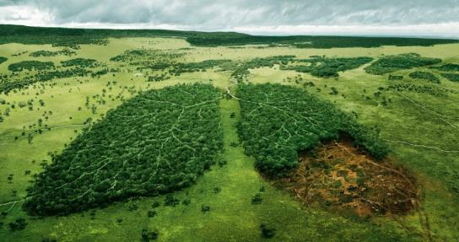
DEFORESTATION
Forests help protect the planet by absorbing massive amounts of carbon dioxide (CO2), the most abundant type of pollution that causes climate change. Unfortunately, forests are currently being destroyed or damaged at an alarming rate. Logging and clearing land for agriculture or livestock release huge amounts of carbon dioxide and other harmful greenhouse gases into the atmosphere. It also diminishes those regions’ ability to absorb carbon pollution.

Slide 8
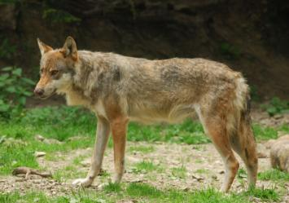
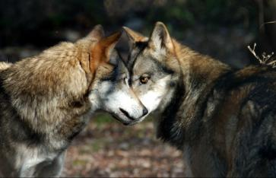
ENDANGERED ANIMALS IN ITALY
Italian wolf
The Italian wolf (Canis lupus italicus), also known as the Apennine wolf, is a proposed subspecies of grey wolf native to the Italian Peninsula. It inhabits the Apennine Mountains and the Western Alps.
It has been strictly protected in Italy since the 1970s, when the population reached a low of 70–100 individuals. The population is increasing in number, though illegal hunting and persecution still constitute a threat.

Slide 9
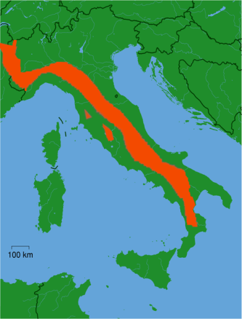
ENDANGERED ANIMALS IN ITALY
The Italian wolf was widespread in the Italian Peninsula, including Sicily, until the mid-1800s. The extermination of the grey wolf in Italy was not as complete as in Northern Europe, due to greater cultural tolerance of the species. It was largely extirpated in the Alps during the 1920s, and disappeared from Sicily in the 1940s.
The Italian wolf was first given legal protection on 23 July 1971.
Italian wolf range, Canis lupus italicus, Altobello, 1921

Slide 10
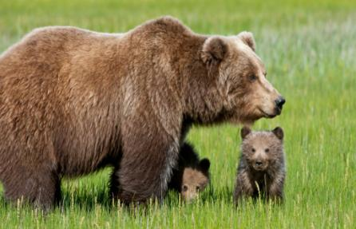
ENDANGERED ANIMALS IN ITALY
The Marsican brown bear is the symbol of animal protection in Italy. It is endemic to Italy and still has a small number of individuals.
The Marsican brown bear, also known as the Apennine brown bear, is a critically endangered subspecies of the brown bear, with a range restricted to the Abruzzo National Park, and the surrounding region in Italy.
The Marsican brown bear lives its life in isolation. The 50 bears that remain in the Abruzzo National Park have characteristics that differ from other brown bear subspecies. It has a relatively calm temperament, with no aggression shown towards humans.
Marsican brown bear

Slide 11
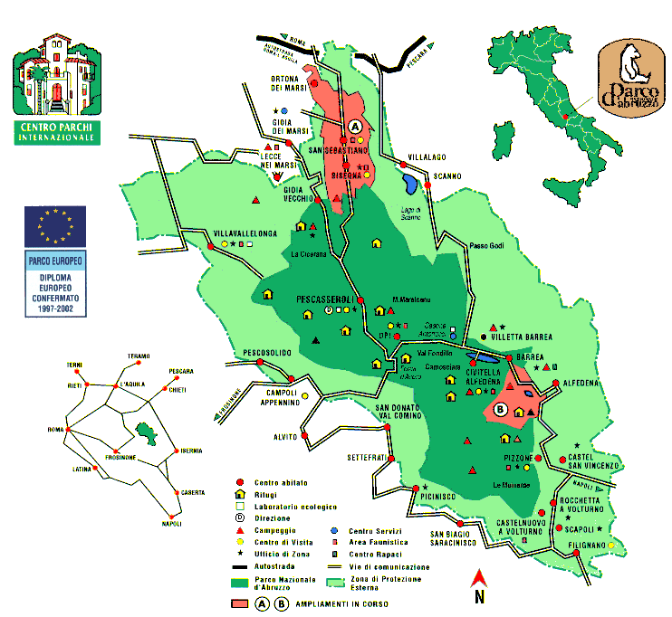
ENDANGERED ANIMALS IN ITALY
The Abruzzo National Park of Italy
There are roughly only 50 of Marsican brown bears left mainly due to loss of habitat. They are often killed accidentally by being poisoned, poached, or hit by a motor vehicle

