Slide 1

CLIMATE CHANGE AND HEALTH

Slide 2
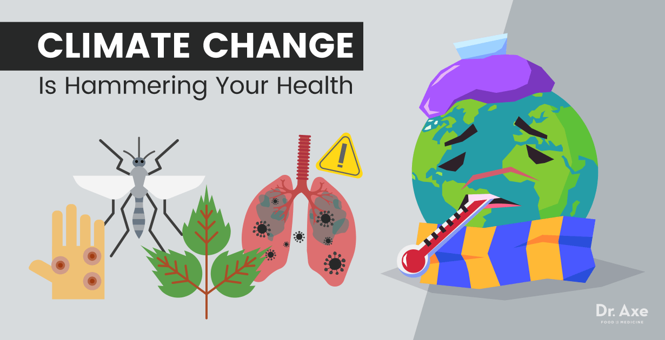
What is the impact of climate change on health?
Although global warming may bring some localized benefits, such as fewer winter deaths in temperate climates and increased food production in certain areas, the overall health effects of a changing climate are likely to be overwhelmingly negative. Climate change affects social and environmental determinants of health – clean air, safe drinking water, sufficient food and secure shelter.

Slide 3
CLIMATE IMPACT
Extreme high air temperatures contribute directly to deaths from cardiovascular and respiratory disease, particularly among elderly people.
High temperatures also raise the levels of ozone and other pollutants in the air that exacerbate cardiovascular and respiratory disease. Pollen and other aeroallergen levels are also higher in extreme heat. These can trigger asthma.
Rising sea levels and increasingly extreme weather events will destroy homes, medical facilities and other essential services. More than half of the world's population lives within 60 km of the sea. People may be forced to move, which in turn heightens the risk of a range of health effects, from mental disorders to communicable diseases.
Increasingly variable rainfall patterns are likely to affect the supply of fresh water. A lack of safe water can compromise hygiene; in extreme cases, water scarcity leads to drought and famine.

Slide 4
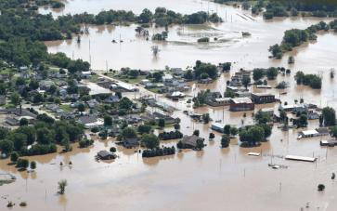
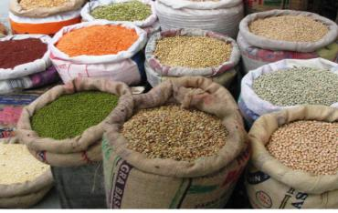
CLIMATE IMPACT
Floods are also increasing in frequency and intensity and they contaminate freshwater supplies, heighten the risk of water-borne diseases, and create breeding grounds for disease-carrying insects such as mosquitoes. They also cause drownings and physical injuries, damage homes and disrupt the supply of medical and health services.
Rising temperatures and variable precipitation are likely to decrease the production of staple foods in many of the poorest regions. This will increase the prevalence of malnutrition and undernutrition.
Climatic conditions strongly affect water-borne diseases and diseases transmitted through insects, snails or other cold blooded animals.

Slide 5
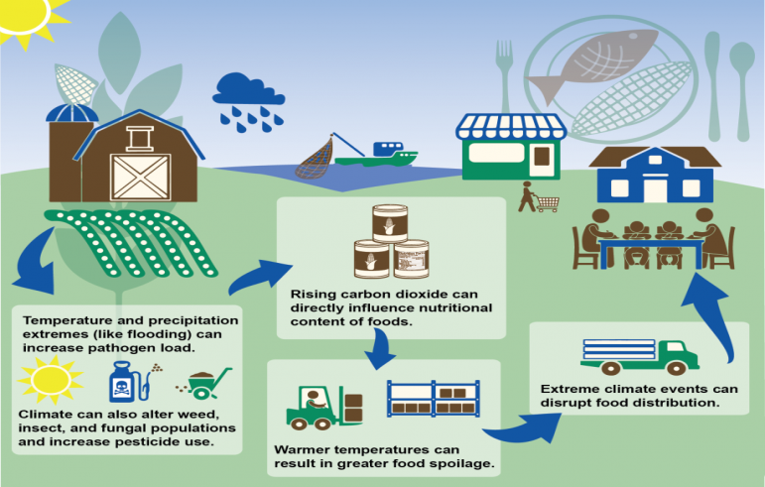
CLIMATE IMPACT

Slide 6
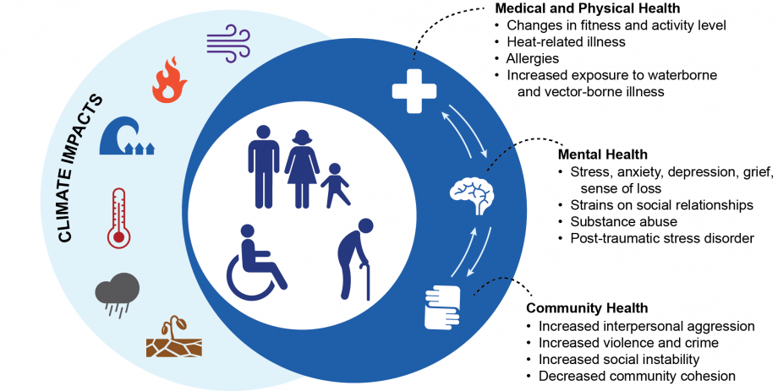
CLIMATE IMPACT ON HEALTH

Slide 7
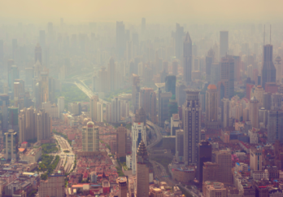

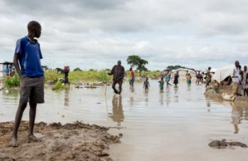
Who is at risk?
All populations will be affected by climate change, but some are more vulnerable than others. People living in small island developing states and other coastal regions, megacities, and mountainous and polar regions are particularly vulnerable.

Slide 8
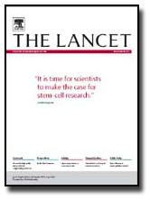
What are we doing to combat climate change?
If the effects of climate change are already in place, the answers to tackle them are lagging behind.

Slide 9
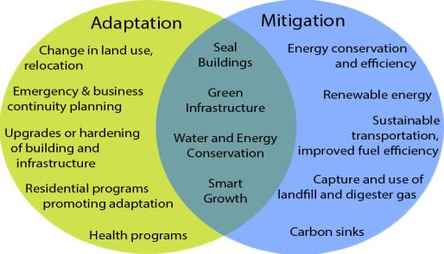
WHAT CAN WE DO?
Mitigation policies
It has been highlighted in studies conducted in different countries, the important advantage in terms of cost-benefits of mitigation strategies with effects on the environment and with important public health implications.

Slide 10
