Slide 1
Erasmus+ project 2018-2020 2018-1-HR01-KA229- 047516 Stop Climate Change – Together Europe Achieves More
CLIMATE CHANGE
November 2018

Slide 2
What is climate change? Climate change is a global challenge that has no borders and to combat it requires coordinated work by all countries.
Two concepts: climate change and global warming. There is an important difference between them, however, given that it is global warming that causes climate change. As the planet’s temperature rises more than it would naturally, the climate varies.
Although it is certain that Earth has naturally warmed up and got colder during other eras, such cycles have always been much slower, taking millions of years, whereas now, within a period of just 200 years, we are reaching levels that in the past brought about extinctions.

Slide 3
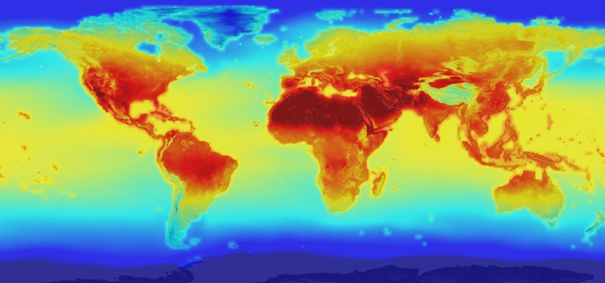
CLIMATE CHANGE

Slide 4
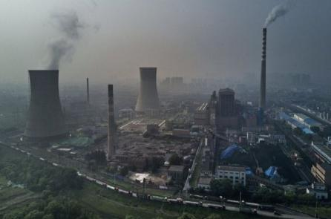
When did humans first begin to cause climate change?
Experts agree that the Industrial Revolution was the turning point when emissions of greenhouse effect gases entering the atmosphere began to soar. The Industrial Revolution was itself borne out of smaller revolutions: agricultural, technological, demographic, transport, finance, creating a new model of production and consumption.

Slide 5
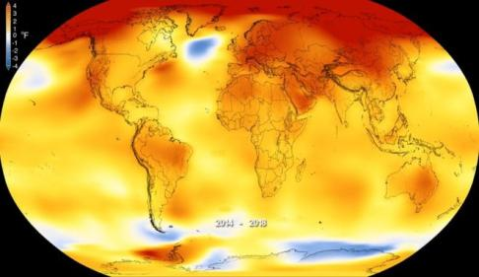
CLIMATE CHANGE
The main impact was the increase in the global temperature of the planet, which has risen 1.1°C since this period, although it is estimated that, by the end of the present Century, the thermometer could rise by 2.7 °C even if national commitments to reduce emissions are fulfilled.

Slide 6
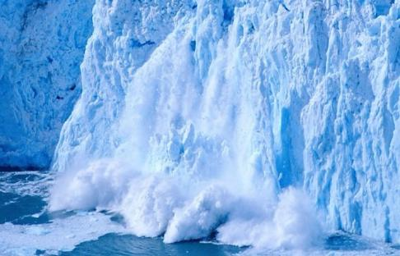
Consequences of climate change
The global temperature increase brings disastrous consequences, endangering the survival of the Earth’s flora and fauna, including human beings. The worst climate change impacts include the melting of the ice mass at the poles, which in turn causes rising sea level, producing flooding and threatening coastal environments through which small island states risk disappearing entirely.

Slide 7
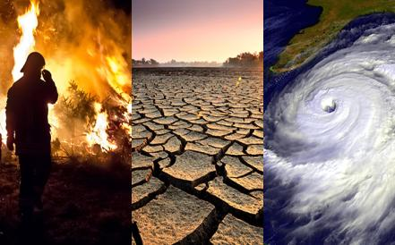
Consequences of climate change
Climate change also increases the appearance of more violent weather phenomena, drought, fires, the death of animal and plant species, flooding from rivers and lakes, the creation of climate refugees and destruction of the food chain and economic resources, especially in developing countries.

Slide 8
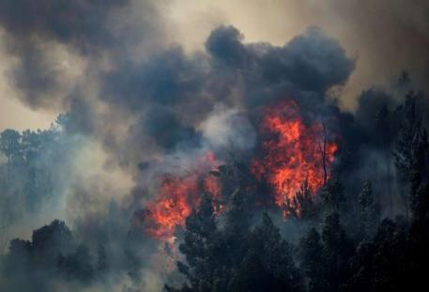
Consequences for Europe
Southern and central Europe are seeing more frequent heat waves, forest fires and droughts.
The Mediterranean area is becoming drier, making it even more vulnerable to drought and wildfires.
Northern Europe is getting significantly wetter, and winter floods could become common.
Urban areas, where 4 out of 5 Europeans now live, are exposed to heat waves, flooding or rising sea levels, but are often ill-equipped for adapting to climate change.

Slide 9
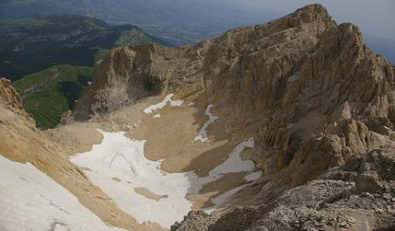
CONSEQUENCES FOR ITALY
What remains of the Calderone glacier in Abruzzo.
Europe's most southerly glacier
ALPINE GLACIERS
As Italy's Alpine glaciers recede, the melted water contributes to rising sea levels. The loss of glaciers also increases global temperatures as the large tracts of white ice are no longer present to reflect the sun's rays back out to space.

Slide 10
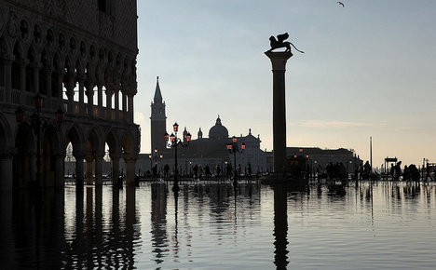
CONSEQUENCES FOR ITALY
As Italy's glaciers wilt in the sun, – the coastal waters around the country will rise, putting low-lying cultural treasures at risk.
For starters, this would destroy the city of Venice. A slew of Unesco World Heritage sites, such as the archaeological sites of Pompeii and Herculaneum, would be swallowed by the rising tide.

Slide 11
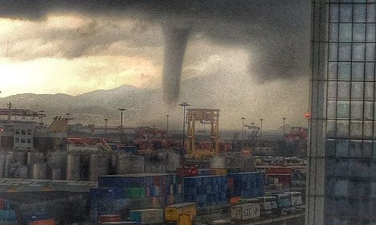
More extreme weather
Higher global temperatures cause higher rates of evaporation, change the way air moves and affect the amount of water vapour the air can hold.
On a global scale it is disrupting weather systems and causing violent and unpredictable events such as storms and droughts.
This is already happening in Italy .

Slide 12
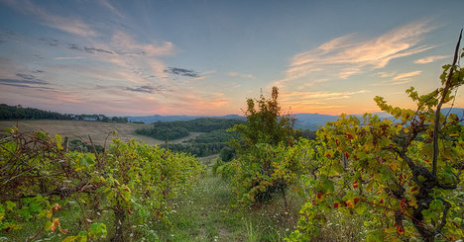
More extreme weather
This year's extreme summer heatwave saw a tornado in Venice and floods and landslides across the country which cost lives and created millions of euros worth of damage. Unfortunately, Italy can expect more of the same over the next few years. Grapes are one of the most weather-sensitive crops and thrive in Italy thanks to its long, hot summers and cool, dry winters. A 2013 study by Conservation International warned that if trends continue at the current rate, Italy's famed wines could soon disappear from our tables.

