Slide 1
Erasmus+ project 2018-2020 2018-1-HR01-KA229- 047516 Stop Climate Change – Together Europe Achieves More
CARBON FOOTPRINT

Slide 2
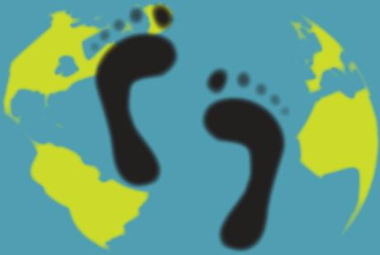
CARBON FOOTPRINT
A carbon footprint is the total amount of greenhouse gases produced to directly and indirectly support human activities, usually expressed in equivalent tons of carbon dioxide (CO2). Carbon dioxide is a so called greenhouse gas causing global warming.

Slide 3
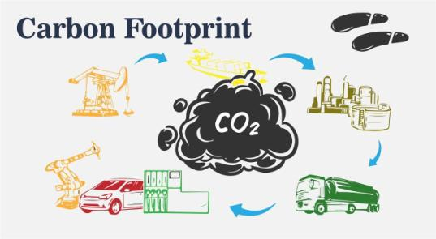
CARBON FOOTPRINT
When you drive a car, the engine burns fuel which creates a certain amount of CO2, depending on its fuel consumption and the driving distance. When you heat your house with oil, gas or coal, then you also generate CO2. Even if you heat your house with electricity, the generation of the electrical power may also have emitted a certain amount of CO2. When you buy food and goods, the production of the food and goods also emitted some quantities of CO2.

Slide 4
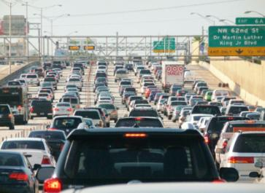
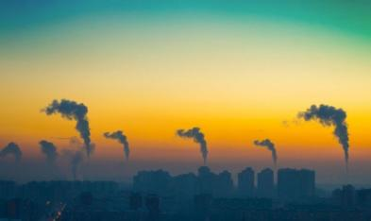
CARBON FOOTPRINT
Direct carbon emissions
Direct carbon emissions come from sources that are directly from the site that is producing a product. An example for industry would be the emissions related to burning a fuel on site. On the individual level, emissions from personal vehicles or gas burning stoves . Other emissions are related to purchased electricity, heat, and/or steam used on site.

Slide 5
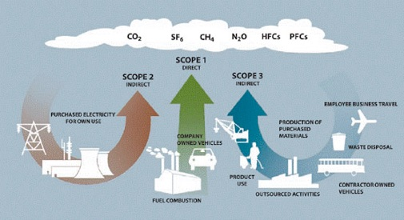
CARBON FOOTPRINT
Indirect carbon emissions
They may include:
Transportation of materials/fuels
Any energy used outside of the production facility
Wastes produced outside of the production facility
Any end-of-life process or treatments
Product and waste transportation
Emissions associated with selling the product

Slide 6
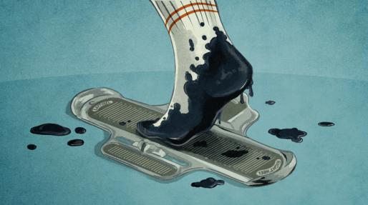
CARBON FOOTPRINT
The carbon footprint shows how much carbon dioxide and other greenhouse gases a person produces in everyday life. It measures the amount of fossil fuels and electricity someone uses up as well as the carbon footprint of the products they buy. When we use our cars or heat our homes with oil or natural gas, carbon dioxide and various other gases are set free. These emissions lead to a denser atmosphere and global warming.

Slide 7
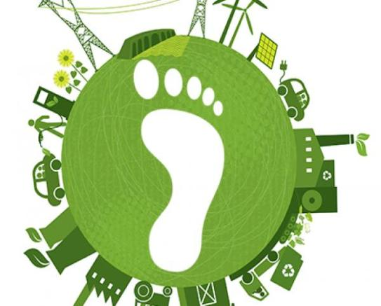
CARBON FOOTPRINT
The most common way to reduce the carbon footprint of humans is to
Reduce,
Reuse,
Recycle,
Refuse.

Slide 8
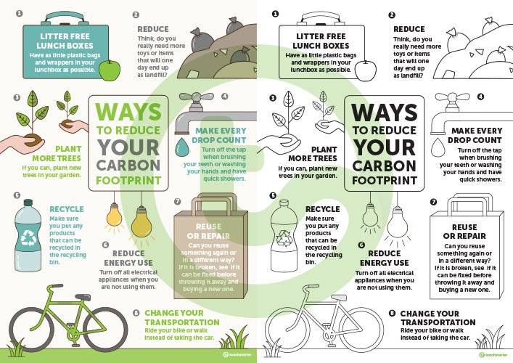

Slide 9
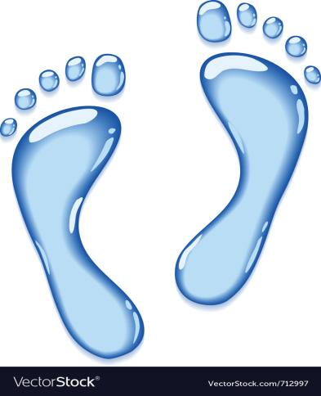
WATER FOOTPRINT
What is a water footprint?
Everything we use, wear, buy, sell and eat takes water to make.
The water footprint is a measure of humanity’s appropriation of fresh water in volumes of water consumed and/or polluted.

Slide 10
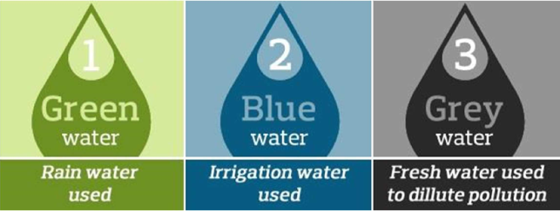
WATER FOOTPRINT
Three water footprints:
Green water footprint is water from precipitation that is stored in the root zone of the soil and evaporated, transpired or incorporated by plants. It is particularly relevant for agricultural, horticultural and forestry products.
Blue water footprint is water that has been sourced from surface or groundwater resources and is either evaporated, incorporated into a product or taken from one body of water and returned to another, or returned at a different time. Irrigated agriculture, industry and domestic water use can each have a blue water footprint.
Grey water footprint is the amount of fresh water required to assimilate pollutants to meet specific water quality standards. The grey water footprint considers point-source pollution discharged to a freshwater resource directly through a pipe or indirectly through runoff or leaching from the soil, impervious surfaces, or other diffuse sources.

Slide 11
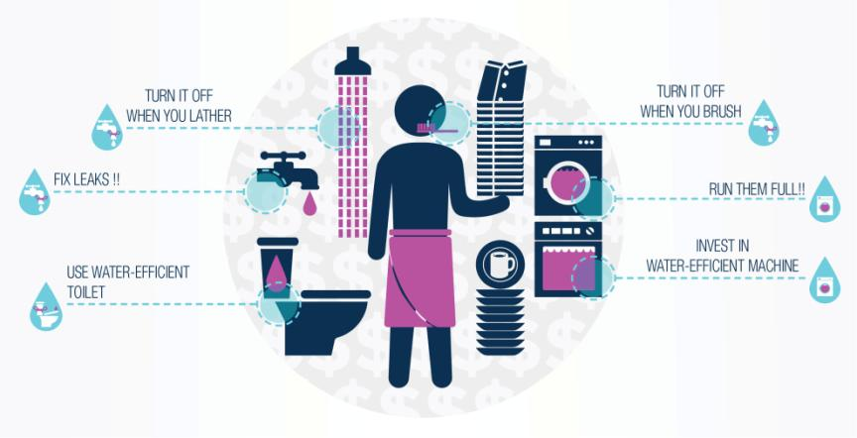
SOME WAYS TO REDUCE OUR WATER FOOTPRINT

