Slide 1
AGRICULTURE AND CLIMATE CHANGES

Slide 2
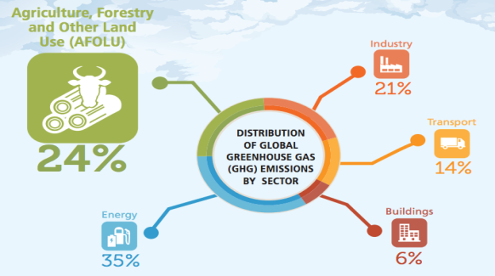
Agriculture is highly exposed to climate change, as farming activities directly depend on climatic conditions.
Agriculture also contributes to climate change through the release of greenhouse gases into the atmosphere.

Slide 3
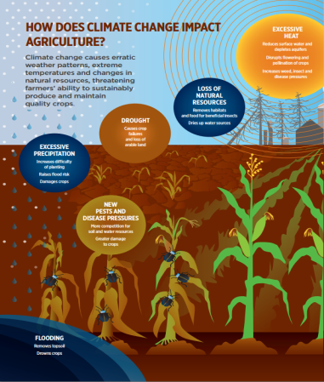
Agriculture and climate changes
Climate change, which is largely a result of burning fossil fuels, is already affecting the Earth’s temperature, precipitation, and hydrological cycles. Continued changes in the frequency and intensity of precipitation, heat waves, and other extreme events are likely, all which will impact agricultural production. Furthermore, compounded climate factors can decrease plant productivity, resulting in price increases for many important agricultural crops.

Slide 4
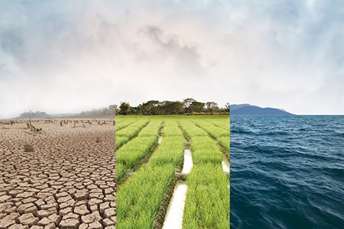
Agriculture and climate changes
Climate change can disrupt food availability, reduce access to food, and affect food quality. For example, projected increases in temperatures, changes in precipitation patterns, changes in extreme weather events, and reductions in water availability may all result in reduced agricultural productivity.

Slide 5
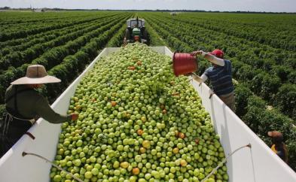
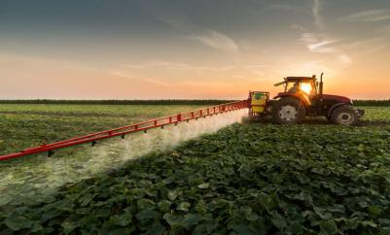
How does agriculture contribute to climate change?
At the same time, agriculture – especially intensive agriculture, characterised by monocultures and aimed at feeding farm animals – is one of the sectors that generates the highest amount of emissions of CO2 (the main greenhouse gas). This quantity can be compared only to the sum total of the CO2 emitted by all forms of transportation.

Slide 6
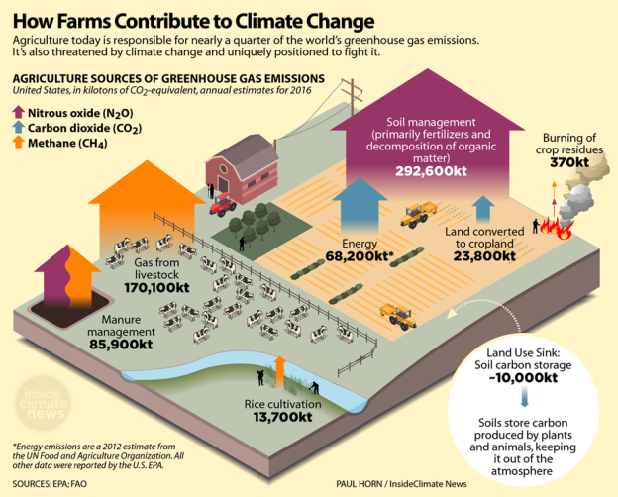

Slide 7
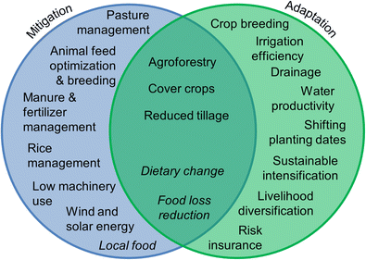
Climate change mitigation
However, agriculture can also contribute to climate change mitigation by reducing greenhouse gas emissions and by sequestering carbon while maintaining food production.

Slide 8
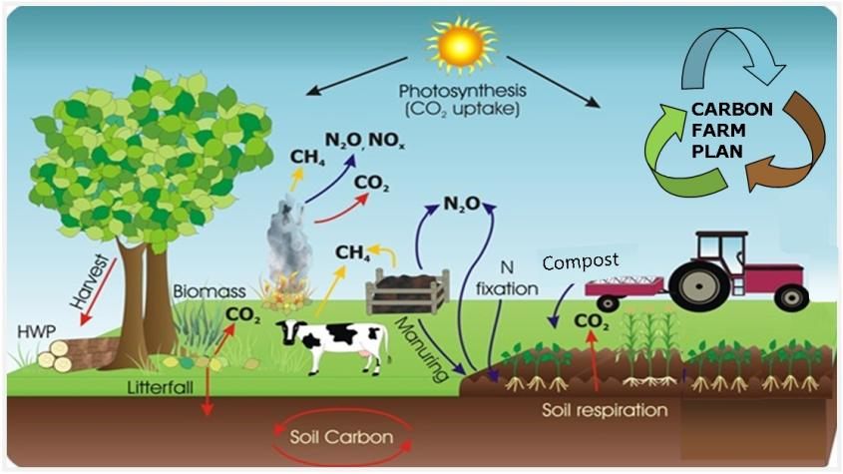
Sequestering carbon while maintaining food production

Slide 9
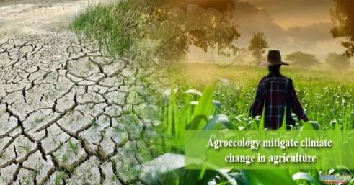
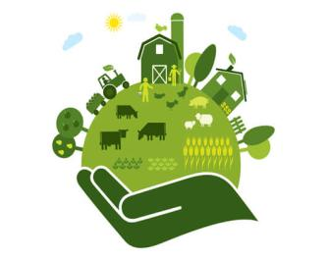
Agroecology
Agroecology is the study of ecological processes applied to agricultural production systems.
Agroecology is an integrated approach that simultaneously applies ecological and social concepts and principles to the design and management of food and agricultural systems. It seeks to optimize the interactions between plants, animals, humans and the environment while taking into consideration the social aspects that need to be addressed for a sustainable and fair food system.

Slide 10
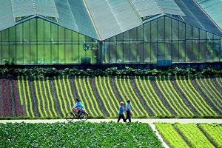
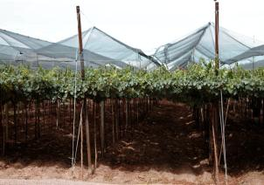
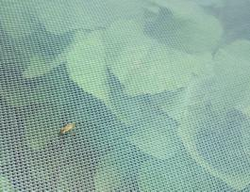
Adaptation to climate change and some crop protection
Adaptation strategies are short and long-term changes to human activities that respond to the effects of changes in climate. In agriculture, adaptation will require cost-effective investments in water infrastructure, emergency preparation for and response to extreme weather events, development of resilient crop varieties that tolerate temperature and precipitation stresses, and new or improved land use and management practices.

Slide 11
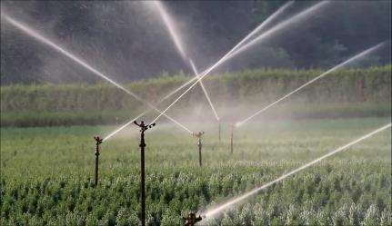
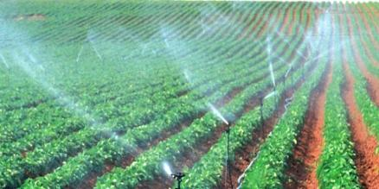
Agricultural water
Water is essential for every form of life, for all aspects of socio-economic development, and for the maintenance of healthy ecosystems.
Agricultural water is water that is used to grow fresh produce and sustain livestock. The use of agricultural water makes it possible to grow fruits and vegetables and raise livestock, which is a main part of our diet.
Irrigated agriculture remains the largest user of water globally.
Agriculture irrigation accounts for 70% of water use worldwide.
When agricultural water is used effectively and safely, production and crop yield are positively affected. The key is to implement management strategies that improve water use efficiency without decreasing yield. Some examples include improved irrigation scheduling and crop specific irrigation management.

Slide 12
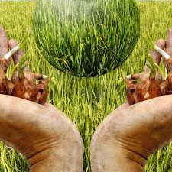
Agriculture and climate changes
Human activities across the globe—including fossil fuel use, deforestation, and agricultural practices—are contributing to the buildup of atmospheric carbon dioxide and other greenhouse gases.
Reduced global beef consumption, reduced food waste, and better farm nutrient management and production can deliver big climate wins while maintaining food security and building resilience.

