Slide 1
Things to know about climate change
Rob Segers

Slide 2
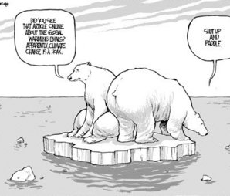
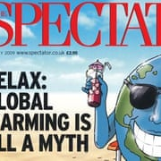
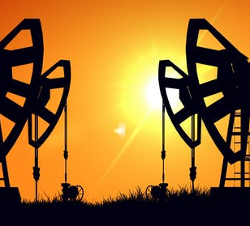
Things to know about climate change
It’s NOT a myth, hoax or a conspiracy among scientists.

Slide 3
Things to know about climate change
Climate Time Machine
https://climate.nasa.gov/interactives/climate-time-machine?utm_source=DMdelivery&utm_medium=email&utm_content=Climate%20Time%20Machine&utm_campaign=13159%20Geogids_januari2013_g

Slide 4
The world is getting warmer

Slide 5
The world is getting warmer
Earth’s temperature goes up and down from year to year—but over the past half century it has gone up a lot.
Carbon dioxide warms the planet, and we’ve increased the amount in the air by nearly half, mostly since the 1960s.

Slide 7
We’re sure
Scientists have concluded humans are causing global warming
More than 9 out of 10 climate scientists agree:
“Our carbon emissions are the main
cause of global warming”.

Slide 8
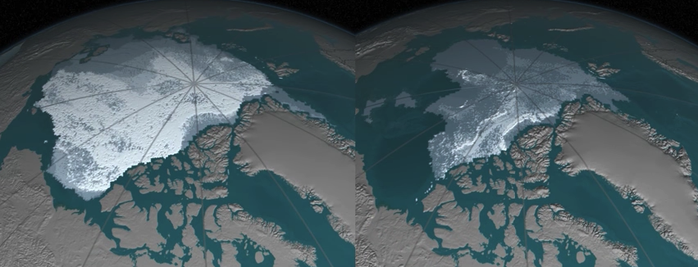
Ice is melting fast
Arctic sea ice is shrinking, and glaciers are retreating worldwide.

Slide 9
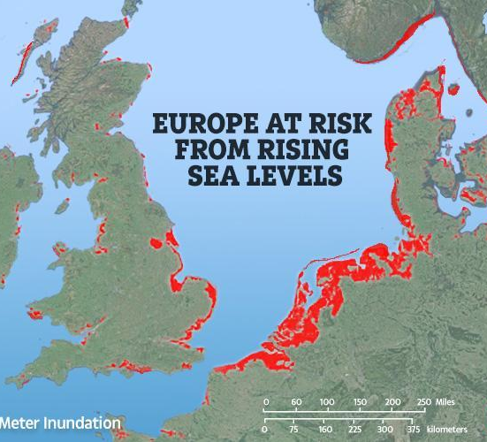
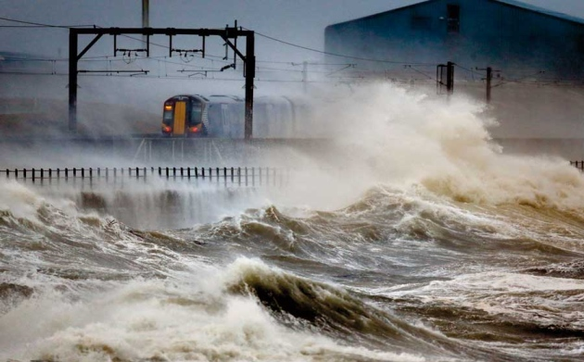
Sea levels are rising

Slide 10
Sea levels are rising

Slide 11
Sea levels are rising

Slide 12
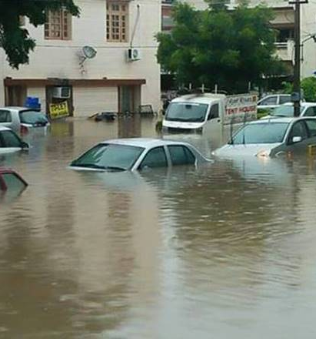
Weather is wreaking havoc
More global natural disasters (1980 compared to 2016)
More storms
More floods and landslides
More droughts, heat waves, and forest fires
Worldwide, the number of climate-related disasters has more than tripled since 1980.

Slide 13
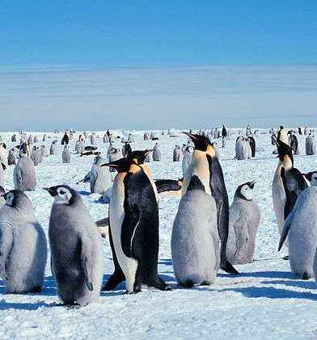
Species are being disrupted
Animals and plants are already vanishing from parts of their range that are now too hot.
Extinctions come next.
In some part of the world 47% of the species already vanished.

Slide 14
What can we do about it?
?????

Slide 15
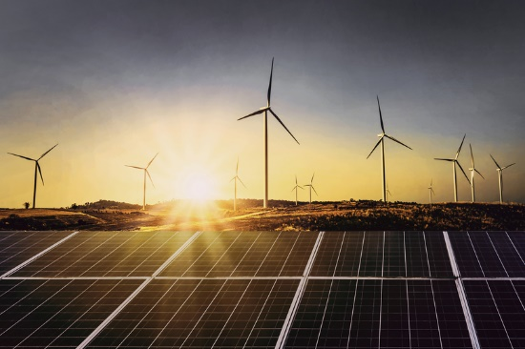
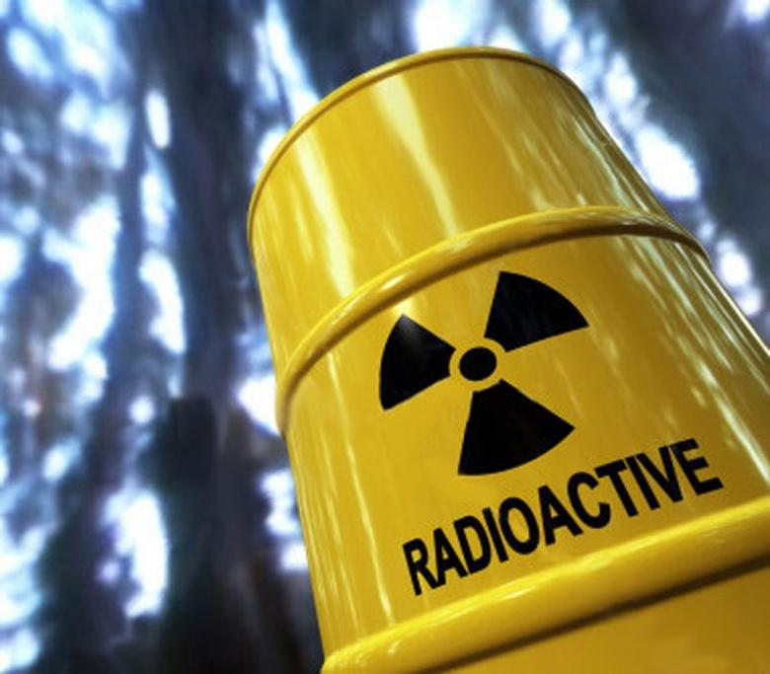
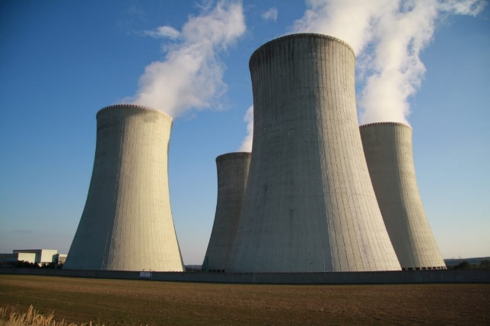
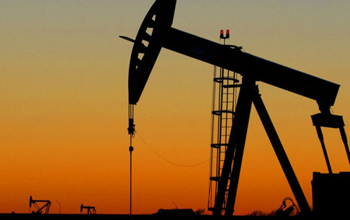
We can do something about it?
Use more renewables energy
Renewables, the fastest-growing energy source, are projected to triple by 2040.
Decrease finite / fossil fuels
(shrink the use of crude oil, natural gas or coal)
Nuclear power (what about nuclear waste?)

Slide 16
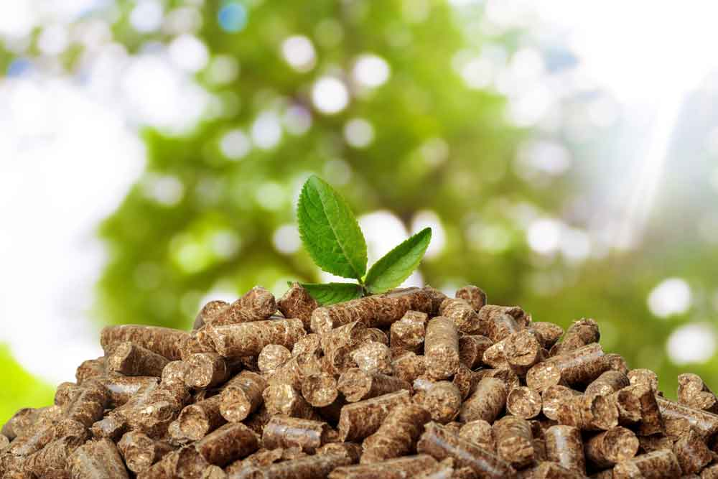
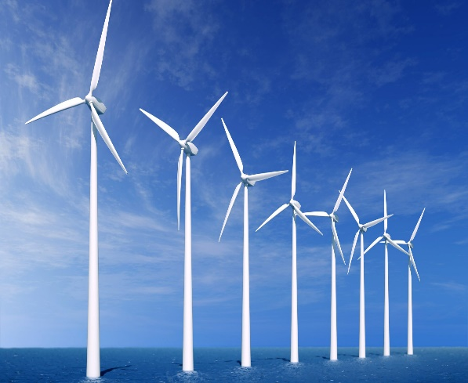
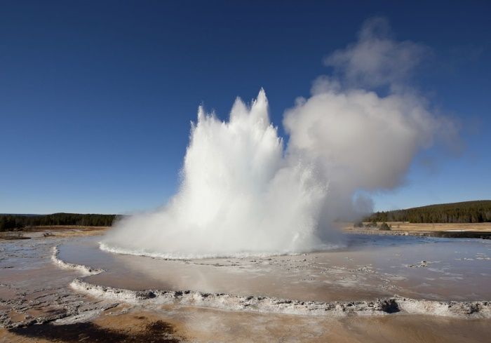
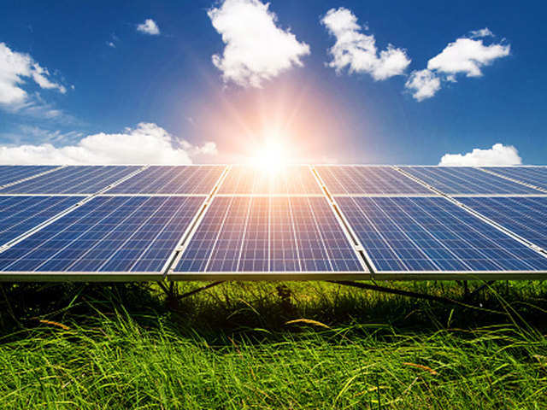
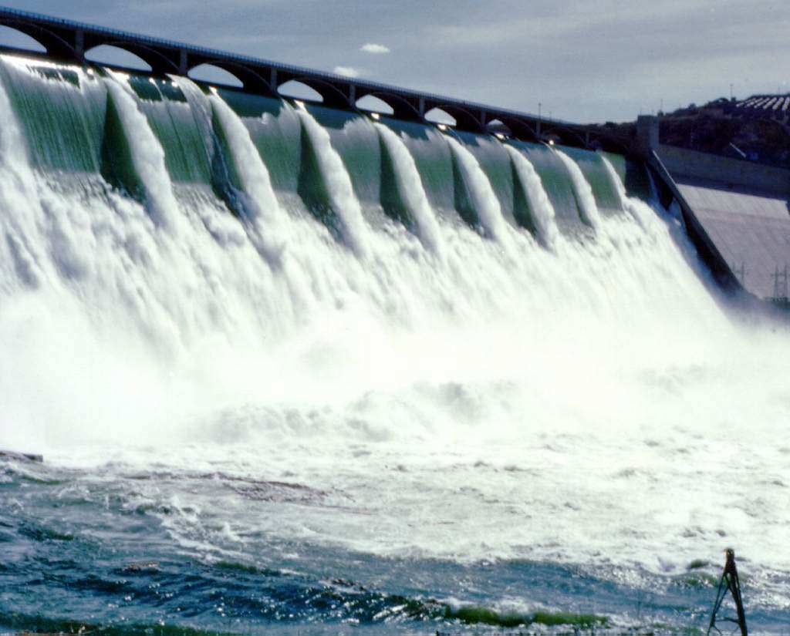
Renewables energy? Biomass and recycling
Wind energy
Geothermal energy
Solar energy
Hydropower

Slide 17
Questions

Slide 18
Things to know about climate change

