Slide 1
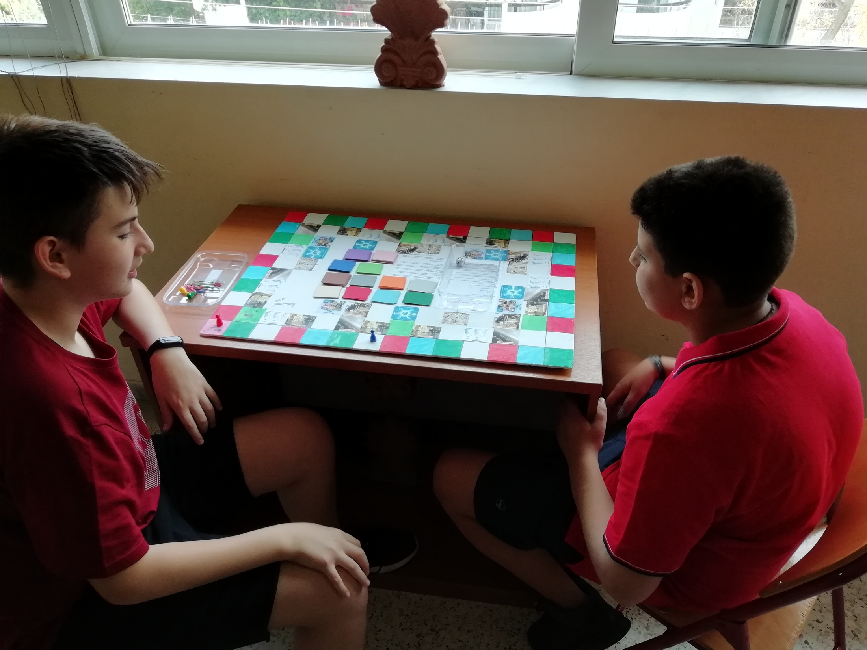
Save The Planet Game ERASMUS+ 2018-2020 ‘’STOP CLIMATE CHANGE’’

Slide 2
THIS IS AN EDUCATIONAL AND AMUSING GAME. IT NEEDS 1-4 PLAYERS. IT IS SUITABLE FOR ALL AGES (CHILDREN AND ADULTS).

Slide 3
THIS GAME PROVIDES US WITH THE OPPORTUNITY TO LEARN ABOUT CLIMATE CHANGE AND ITS CONSEQUENCES AND FIND WAYS TO DEAL WITH IT.

Slide 4
THE PLAYER WHO CONTRIBUTES TO THE ENVIRONMENTAL DESTRUCTION GETS NEGATIVE POINTS AND HE IS AT DISADVANTAGE IN COMPARISON TO THE OTHER PLAYERS.

Slide 5
THE PLAYER WHO CONTRIBUTES WITH HIS ACTIONS TO THE PROTECTION OF THE ENVIRONMENT RECEIVES POSITIVE POINTS AND HE IS IN ADVANCED POSITION IN COMPARISON WITH THE OTHER PLAYERS.

Slide 6
THE WINNER IS THE PLAYER WHO HAS THE MOST POSITIVE POINTS AT THE END OF THE GAME (AFTER SUBTRΑCTING THE NEGATIVE POINTS HE GOT DURING THE GAME).

Slide 7
REMEMBER: THERE ARE MANY WAYS TO SAVE THE PLANET EARTH IF YOU ARE WILLING TO DO SO. ENJOY THE GAME!!!

