Slide 1
ISTITUTO COMPRENSIVO SANT’ELIA A PIANISI
Our students play and sing European Anthem.

Slide 2
Sant’Elia a Pianisi 3rd October 2018 Erasmus Plus Project 2018-20 Presentation ceremony
«STOP CLIMATE CHANGE
TOGETHER EUROPE ACHIEVES MORE»

Slide 3
The members of the local authorities (Headmistress, Teachers, Mayor, Deputy mayor, Regional councilor for culture),
Parents and Students
are present

Slide 5
Articles on the newspaper

Slide 6
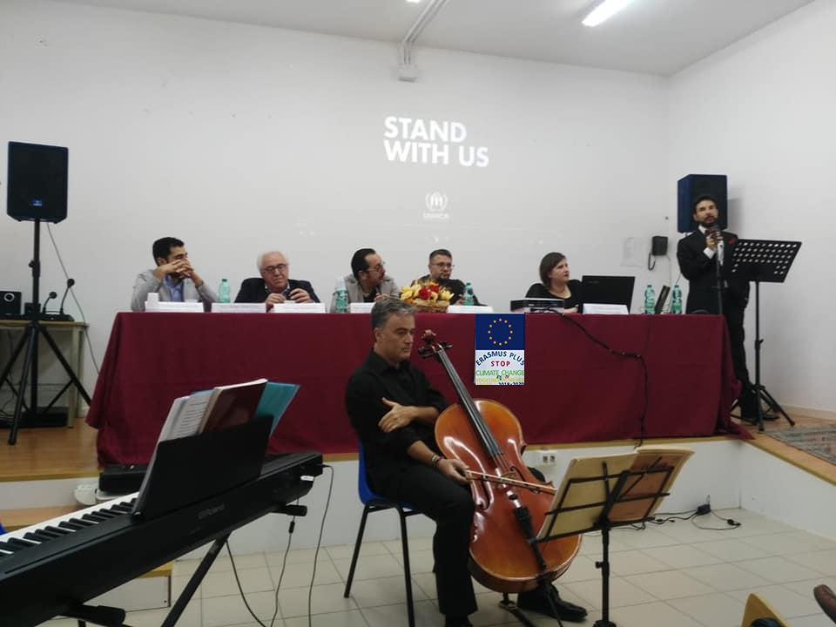
There are various interventions of a pedagogic, social, scientific and technical nature.
The ceremony is cheered by the presence of musicians

Slide 7
MUSICIANS

Slide 8
STUDENTS

Slide 9
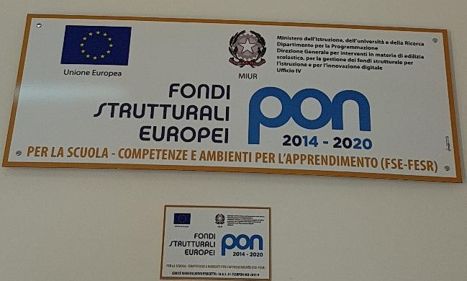
FAMILIES
In our school there are other European Projects.
Parents and students appreciate them very much, too.

Slide 10
Erasmus Plus Project: To understand how to preserve the health of the world

Slide 11
ERASMUS PLUS PROJECT: to meet new people and learn new cultures

Slide 12
We are ready to leave for Cholargos !

