Slide 1
Opening ceremony of the project
Alytaus r. Simno gimnazija Erasmus+ project 2018-2020 Stop Climat Change – Together Europe Achieves More
October, 2018

Slide 2
The purpose of the project is to improve students' skills in the field of foreign languages, ICT, improve their team-work skills, creativity and critical thinking. Pupils will become aware of climate changes and they will try to find ways to mitigate them . Within the project there are various activities planned, for instance taking part in project logo design competition, creating a presentation about the school, students and the country, posters on the partner countries, measuring the weather regularly, attending climate based lessons in English, taking part in international environmental days, studying climate changes, ways of reducing carbon footprint, ways of protecting endangered animals and plants.

Slide 3
Within the project there are 6 short-term exchanges of groups of pupils and their teachers to partner schools planned:
- Osnovna škola Bartola Kašića, Vinkovci, Croatia
- 1st Gymnasium of Cholargos, Athens, Greece
- Szkola Podstawowa Nr12, Gdynia, Poland
Instituto Comprensivo Sant’Elia a Pianisi, Sant’Elia a Pianisi, Italy
BC Broekhin Roermond, Roermond, the Netherlands

Slide 4
The project coordinator Rasa Ručienė presented the project, its objectives and activities on October18

Slide 5
The geography teacher Gediminas Kanapickas presented the situation of climate chanange in Lithuania

Slide 6
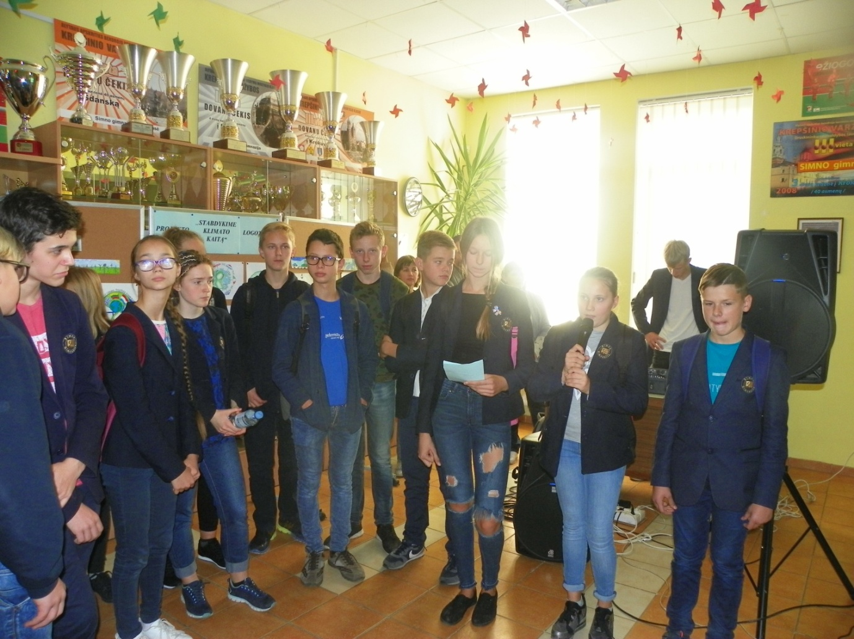
Students of the 7 grade shared their impressions about Clean up Day in Meteliai regional park

Slide 7
The biology teacher Rima Pavoliene presented what actions have already been done in our gymnasium to reduce effect of climate change

Slide 8
Logo designs exibition was organised

