Slide 1
MONITORING THE WEATHER

Slide 2
1ST Gymnasium of Cholargos bought a weather station. A geologist came and gave a presentation about the way students use it.

Slide 3
He showed students the parts of the weather station and how they work …

Slide 4
Then, he divided students into groups. Each group had to undertake some tasks.

Slide 5
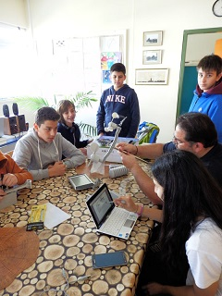

Slide 6
Finally, the weather station had been established at the top floor of the school bulding.

