Slide 1
MONITORING THE WEATHER
Alytaus r. Simno gimnazija Erasmus+ project 2018-2020 Stop Climate Change – Together Europe Achieves More

Slide 2
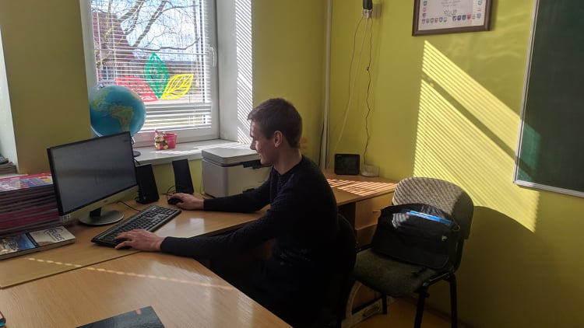
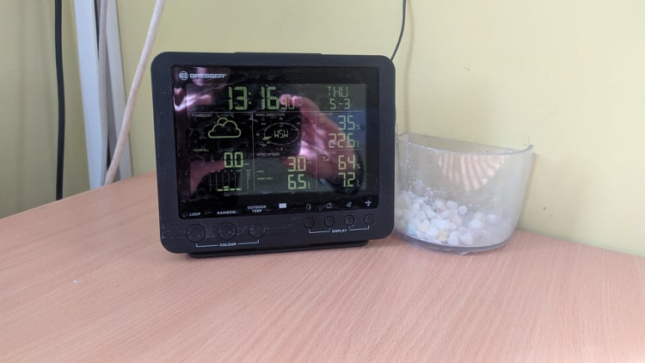
The main climate indicators: temperature, rainfall, pressure, humidity, wind direction and speed are being monitored and recorded since 2018.

Slide 3
The average temperature in 2018 was 8.5 ° C, and in 2019 it was already 10.7 ° C. Winters in particular are warming up, with average temperatures in December and February being 2.9 ° C and 2.1 ° C in 2019. In 2020, positive temperatures were recorded in January at 2.3 ° C. The standard temperature is 7 ° C, so the average annual temperature in Simnas is already 2-3 ° C higher.
The standard rainfall rate in Simnas is 650 mm / year. In 2018, it was 450 mm and in 2019 it was only 274 mm per year. So 2019 was exceptionally dry. I would like to distinguish between April with 0 mm rainfall and July and August with 2.2 mm and 2.6 mm. The consequences of such low rainfall we feel and see. The lakes and rivers are drained, groundwater do not fill up wells.

Slide 4
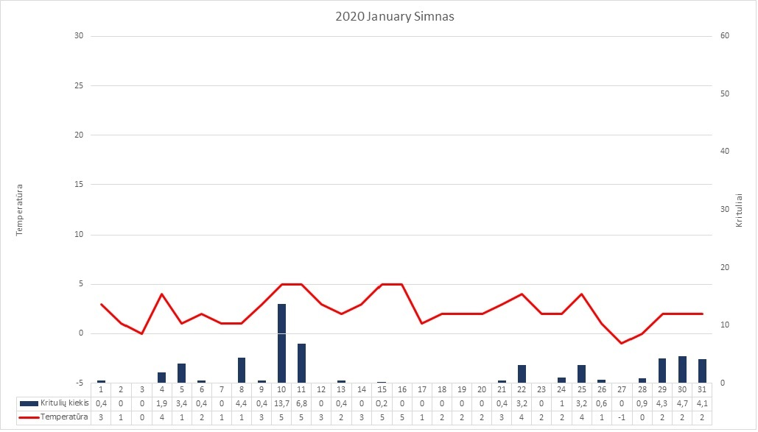

Slide 5
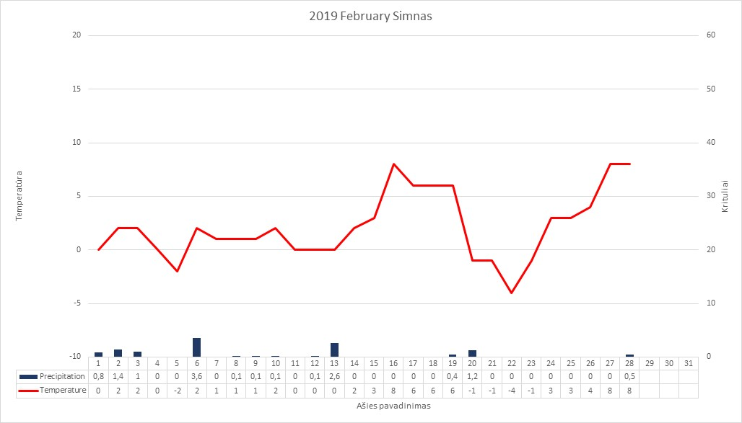

Slide 6
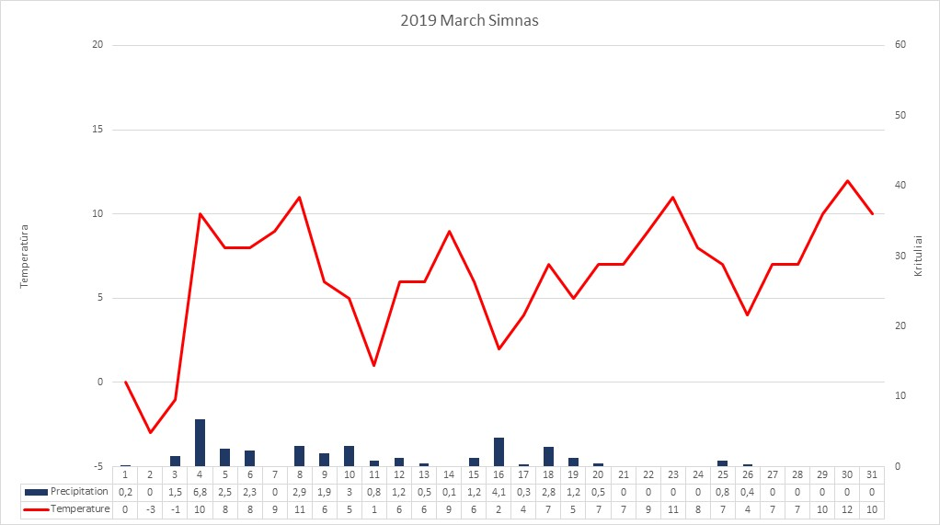

Slide 8
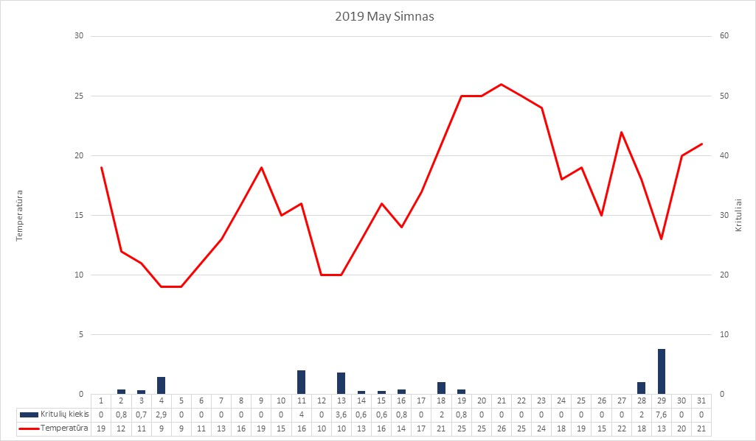

Slide 9
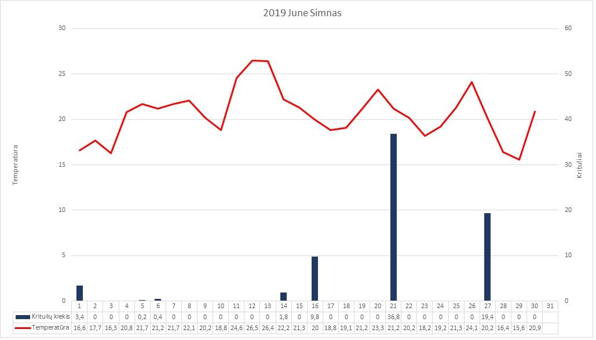

Slide 10
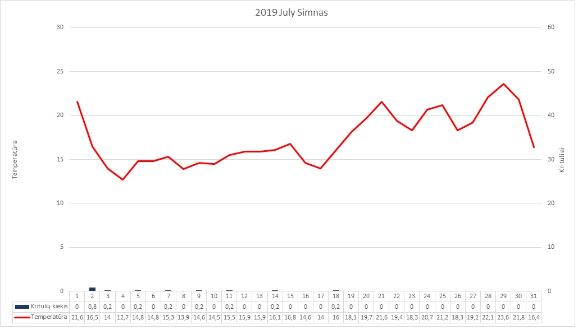

Slide 11
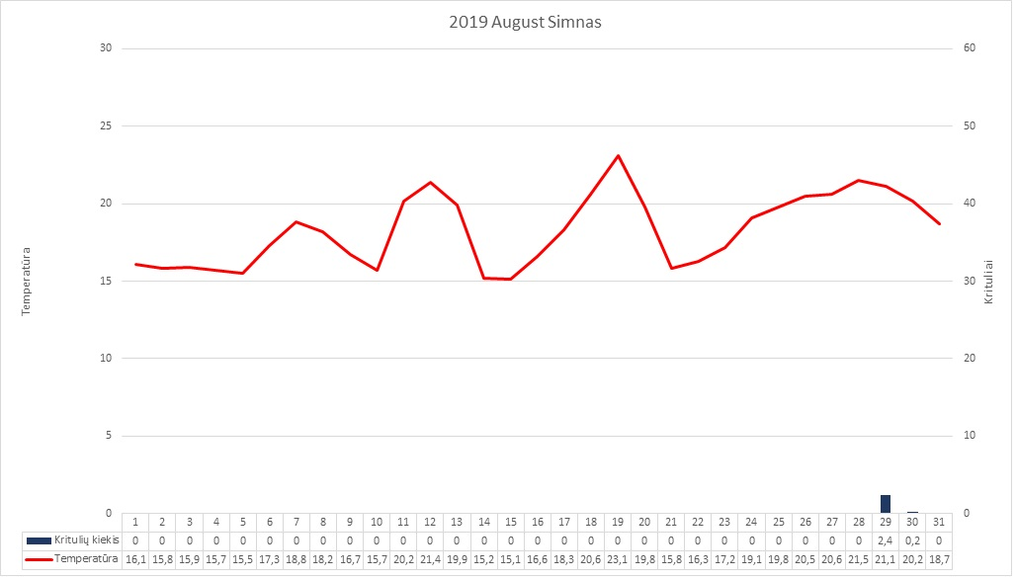

Slide 12
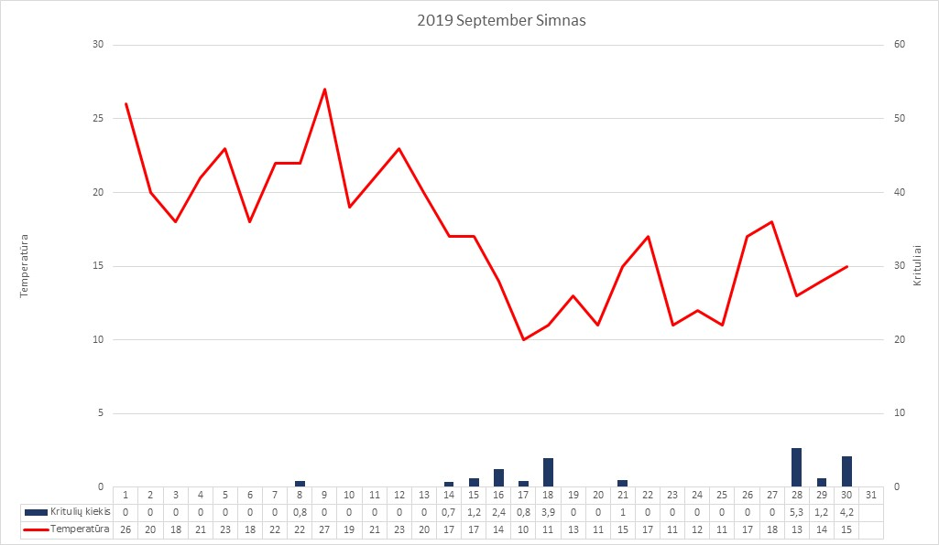

Slide 14
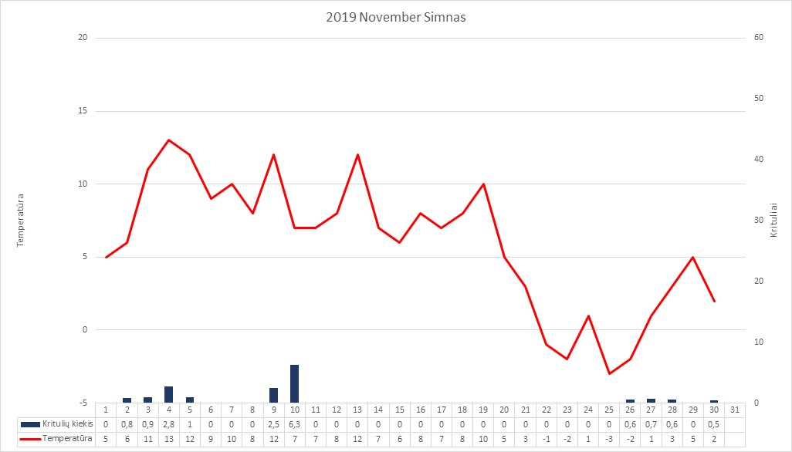

Slide 15
