Slide 1
1ST GYMNASIUM OF CHOLARGOS
EUROPEAN MOBILITY WEEK

Slide 2
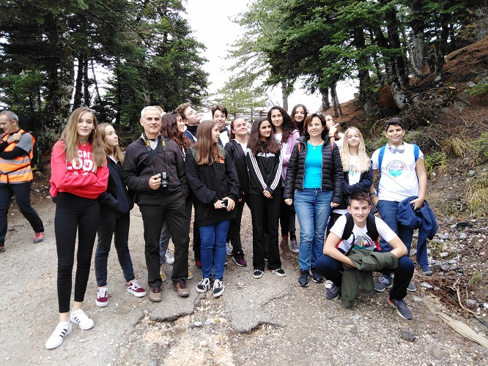
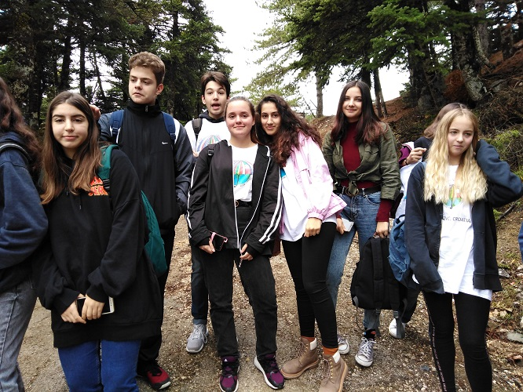
Teachers and students of Erasmus project …

Slide 3
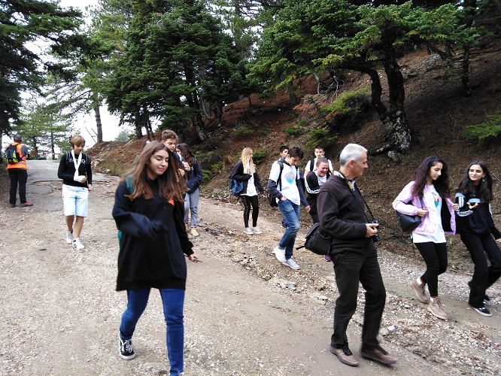
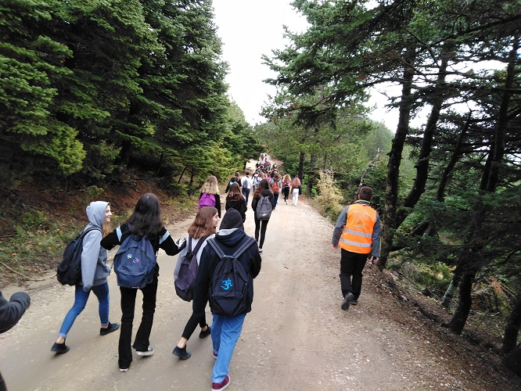
… walking at Parnitha mountain in terms of European Mobility Week

Slide 4
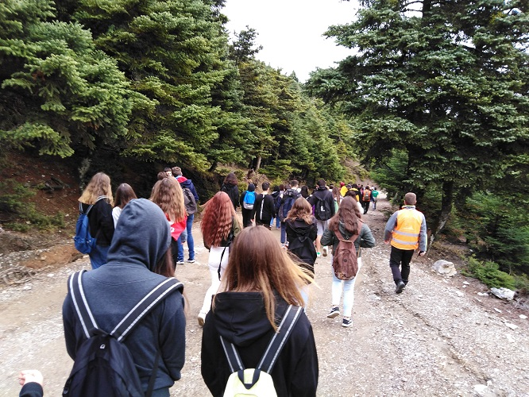
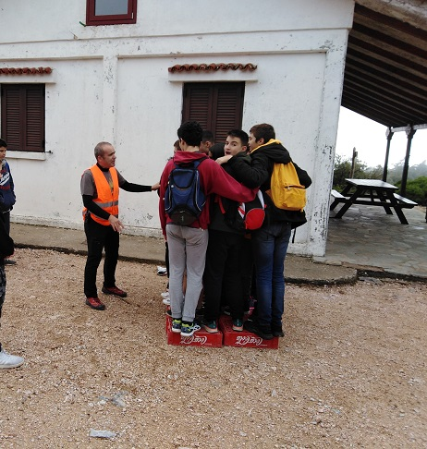
Students learned about advantages of walking and played interactive games

