Slide 1
MOBILITY TO ROERMOND - NETHERLANDS
12/5 – 18/5/2019

Slide 2
ARRIVAL OF TEACHERS AND STUDENTS AT ROERMOND

Slide 3
A HISTORICAL CITY IN THE SOUTHERN PART OF NETHERLANDS …

Slide 4
ON THE BANKS OF RIVERS ROER AND MAAS

Slide 5
1ST DAY (13/5/2019)

Slide 6
VISIT THE CITY HALL – PRESENTATION OF THE CITY

Slide 7
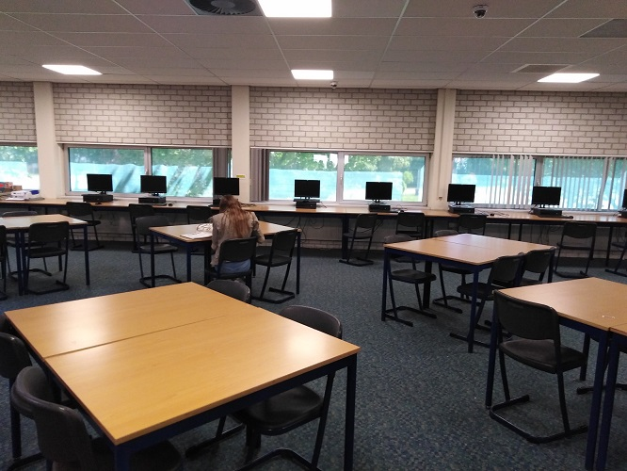
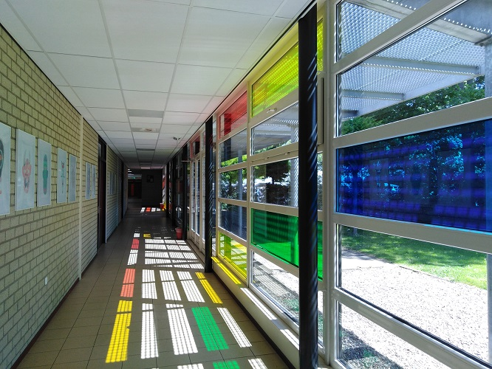
AT SCHOOL “BC BROEKHIN ROERMOND”

Slide 8
STAFF ROOM

Slide 9
WELCOMING ALL GUESTS BY THE HEAD DIRECTOR

Slide 10
CLIMATE BASED LESSONS

Slide 11
THE LESSON CONDUCTED BY THE GREEK TEACHERS N. LEKKA AND S. PANTOS

Slide 12
HAVING FREE TIME FOR SIGHTSEEING ROERMOND

Slide 13
TEACHERS’ DELEGATIONS VISIT MAASTRICHT

Slide 15
2ND DAY (14/5/2019)

Slide 16
COORDINATORS’ MEETING

Slide 17
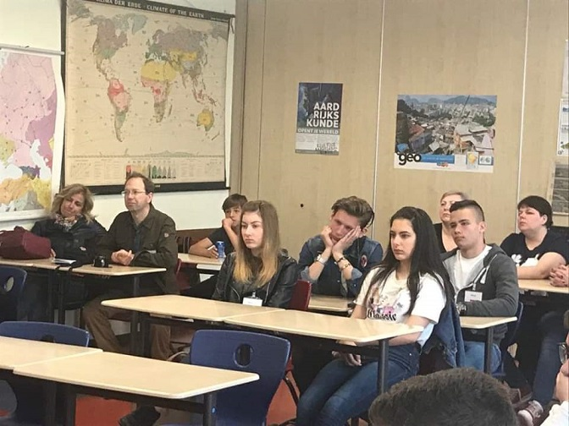
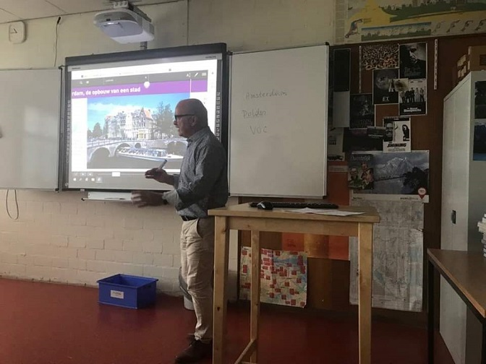
LESSONS FOR STUDENTS ABOUT GLOBAL WARMING AND AMSTERDAM / WATER

Slide 18
“WARTERWALK” THROUGH ROERMOND : the importance of accurate level of the water – dams for protecting the city of Roermond

Slide 20
3RD DAY (15/5/2019)

Slide 21
VISIT TO AMSTERDAM – SIGHTSEEING

Slide 24
4TH DAY (16/5/2019)

Slide 25
WATER TREATMENT PLANT – LEARNING ABOUT THE WATER TREATMENT PROCESS

Slide 26
SMELL WASN’T SO GOOD!!

Slide 27
AT SCHOOL – AN INTERNATIONAL BUFFET FOR TEACHERS, STUDENTS AND PARENTS

Slide 28
THE PERFORMANCE OF PLAY “EVERYBODY’S WATER”

Slide 29
5TH DAY (17/5/2019)

Slide 30
VISIT TO THE DELTA WORKS : facing floods

Slide 32
BOATTRIP OOSTERSCHELDE

Slide 33
THE DEPARTURE

Slide 34
DEPARTURE FROM ROERMOND WITH PLEASANT MEMORIES

