Slide 1


Erasmus+ project 2018-2020
2018-1-HR01-KA229- 047516
Stop Climate Change – Together Europe Achieves More
MEETING IN VINKOVCI
March 2019

Slide 2
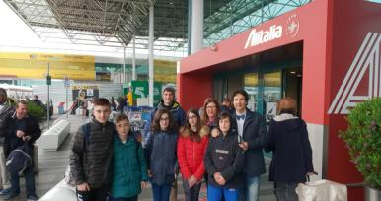
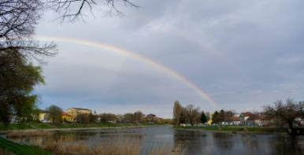
REPORT OF THE MEETING
The second project meeting was held at Osnovna škola Bartola Kašića in Vinkovci, Croatia, from 17 to 23 March 2019. All the partners participated: Greece, Netherlands, Lithuania, Poland and Italy. The Italian team, 3 teachers and 5 students, arrived at the airport of Belgrade “Nikola Tesla” and then in Vinkovci, where we have had lots of activities and cultural moments during the meeting.

Slide 3
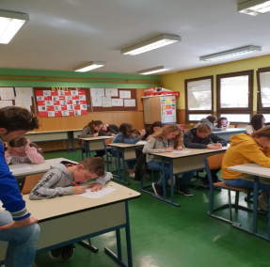
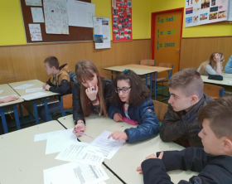
Lessons at school
Pupils attended climate based lessons
conducted by teachers from all the six countries.

Slide 4
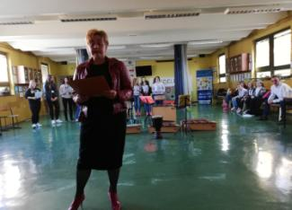
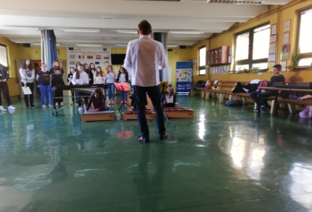
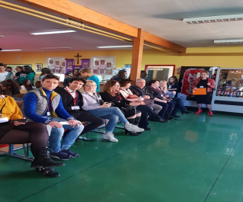
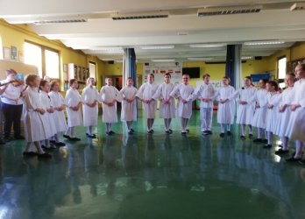
Welcoming ceremony

Slide 5
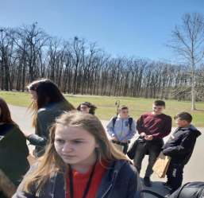
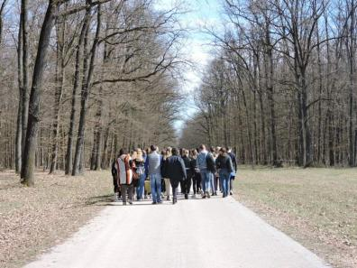
Kunjevci forest
Coordinators had the meeting to discuss project activities and the rest of the group went to Kunjevci forest, where they saw animals and talked about the changes they have noticed and that are caused by climate change.

Slide 6
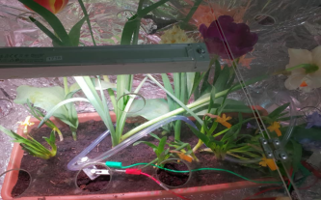
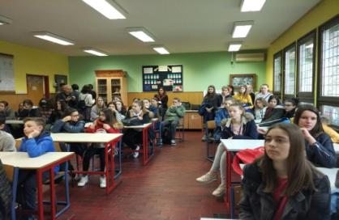
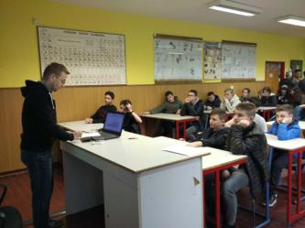
Lecture at school
Mr Vedran Menđušić, a Croatian teacher, demonstrates the possibility of growing plants in controlled conditions, controlled by a computer.

Slide 7
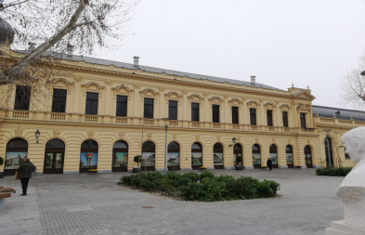
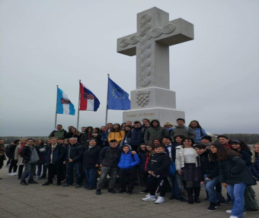
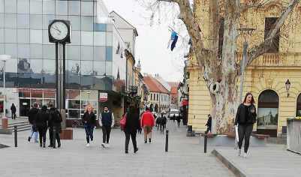
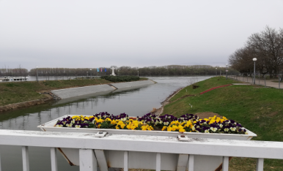
VUKOVAR

Slide 8
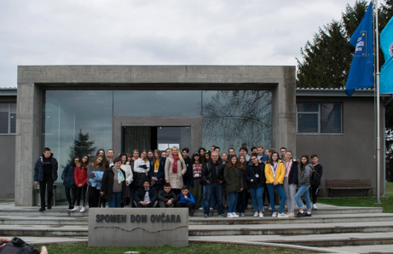
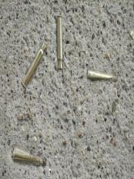
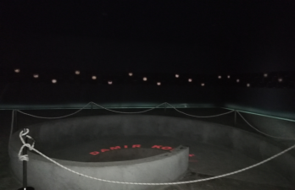
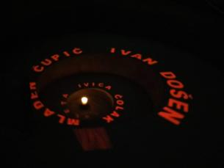
Ovčara - place where more than 200 patients from Vukovar hospital were killed in November 1991

Slide 9
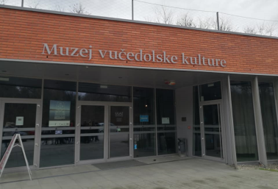
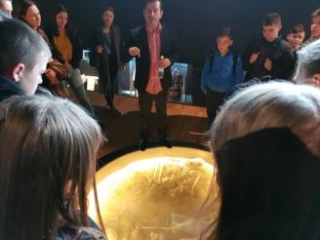
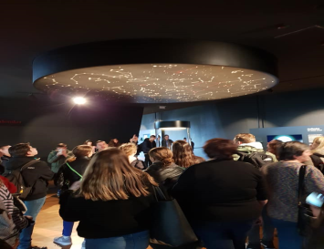
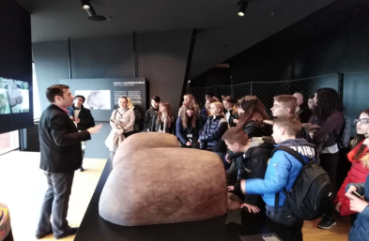
Museum of Vučedol culture

Slide 10
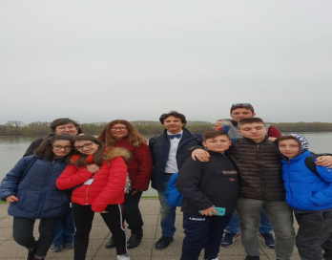
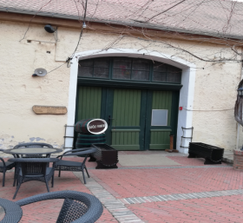
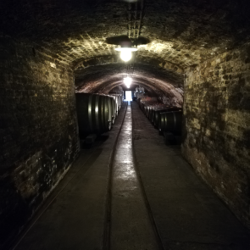
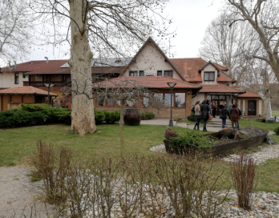
ILOK and wine cellars

Slide 11
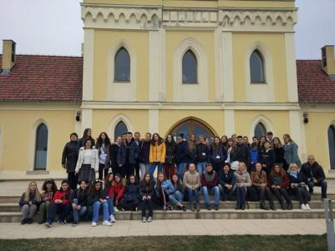
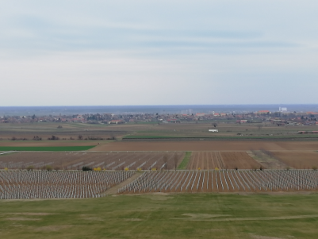
PRINCIPOVAC

Slide 12
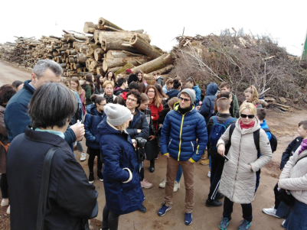
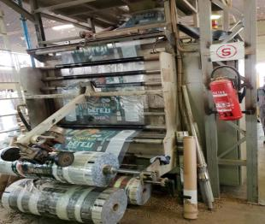
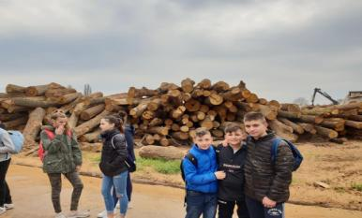
Spačva, a wood processing company

Slide 13
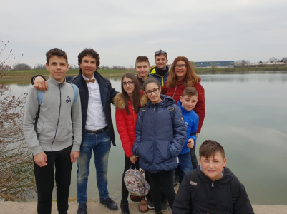
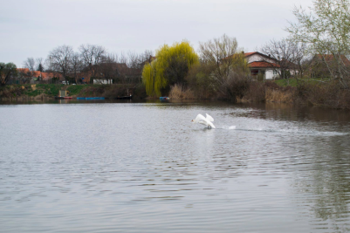
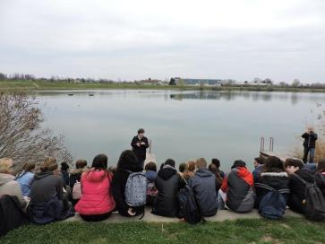
Banja lake

Slide 14
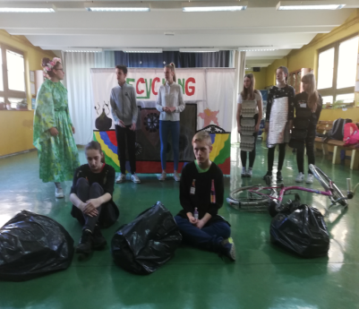
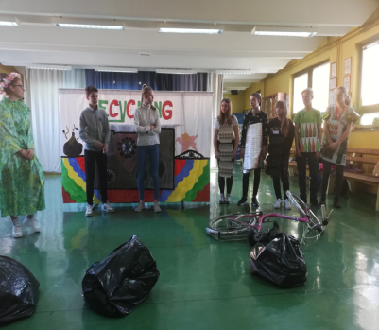
PLAY: “Down in the Dumps” - performance

Slide 15
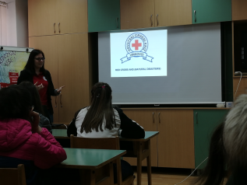
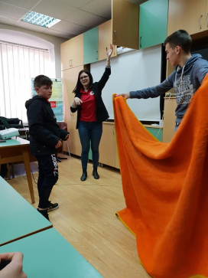
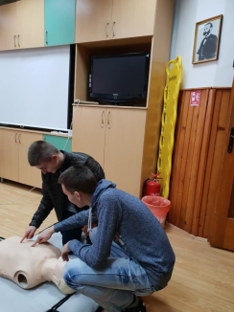
Activities at Red Cross
Students attended a lecture at Red Cross Vinkovci about the role of Red Cross organization and they had a short first-aid course.

Slide 16
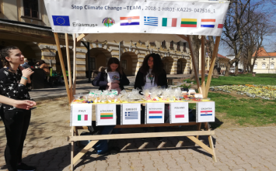
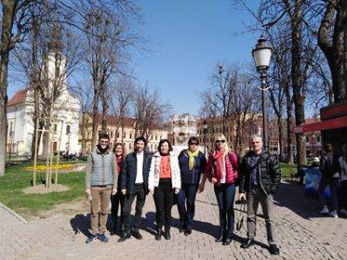
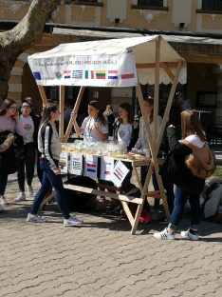
VINKOVCI: City centre
Stall for the sale of products brought by partners

Slide 17
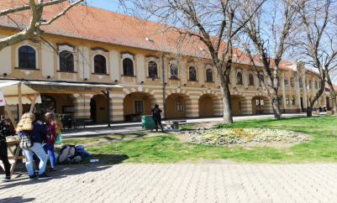
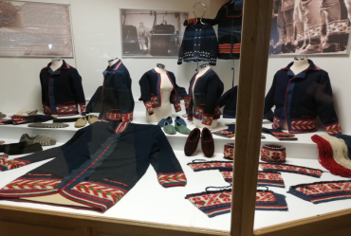
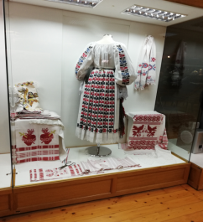
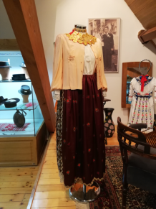
Vinkovci: City Museum

Slide 18
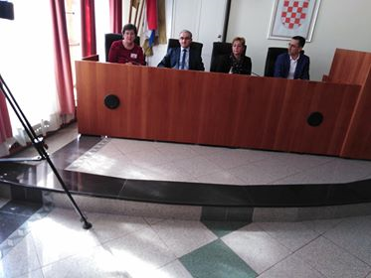

Welcoming by the deputy mayor at city hall

Slide 19



Đakovo: visit to the State Stud Farm and the cathedral

Slide 20




Lectures on climate changes at Zlatna greda and sports activities

Slide 21


Nature park Kopački rit

Slide 22



Osijek

Slide 23





Farewell and back to Italy

Slide 24
See you in The Netherlands:
Roermond

