Slide 1
Logo contest
Alytaus r. Simno gimnazija Erasmus+ project 2018-2020 Stop Climat Change – Together Europe Achieves More
September, October 2018

Slide 2
Logo designs show

Slide 3
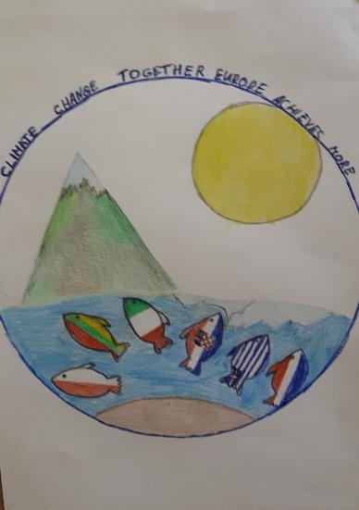

Slide 5
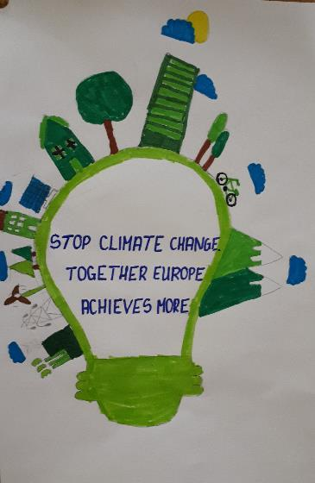

Slide 7
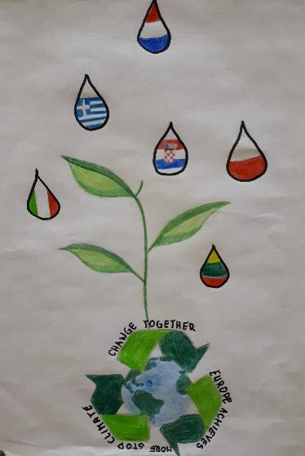

Slide 9
Our best logo designs by Miglė Zailskaitė Mocevičiūtė Kamilė Zmejauskas Deividas

