Slide 1
CLIMATE CHANGE AND CULTURAL HERITAGE

Slide 2
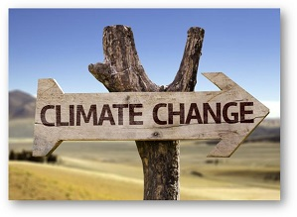
Climate change has a wide impact on our contemporary world.

Slide 3
Heating and storms
Due to these extreme weather phenomena, we have also victims and destructions of houses or trees.

Slide 4
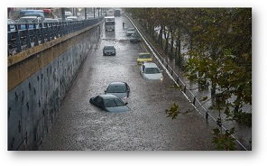
FLOODING
In the last years, this phenomenon is getting more and more frequent…

Slide 5
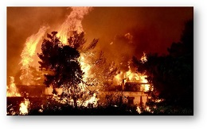
FIRES
Fires are also one of the climate change effects.

Slide 6
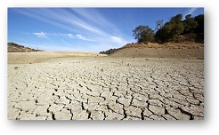
DROUGHTS
Drought is maybe the most dangerous effect, because humans, animals, and plants can’t survive without water and food.

Slide 7
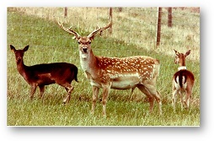
Animals in danger
So, many kinds of animals, birds and fish are in danger.

Slide 8
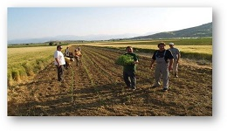
The decrease of rural production
The extreme weather phenomena influence the rural production. Some kinds of Mediterranean products will be in luck.

Slide 9
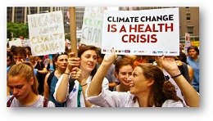
Our health
Changing or extreme weather conditions, water quality, air and food as well as changes in the ecosystem and agriculture lead to increase of existing diseases or furthermore to development of new ones.

Slide 10
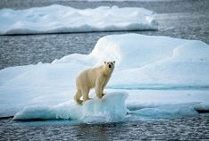
Ice is melting …

Slide 11
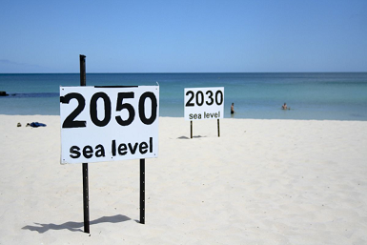
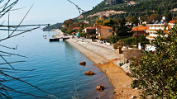
… and the level of the sea has started to be higher and higher destroying many beaches.

Slide 12
Conversations about climate change, tend to focus on the wider impact and global threats to our contemporary world. Global warming, rising seas, flooding and erosion are threatening cultural landmarks across the globe, too.

Slide 13
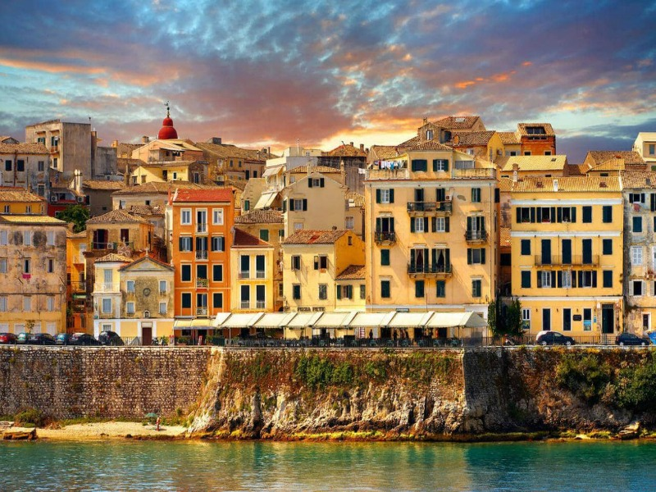
UNESCO World Heritage sites located in coastal areas are increasingly at risk from coastal hazards due to sea-level rise. Especially, in the Mediterranean region, a lot of cities known from their long history and civilization are in danger.

Slide 14
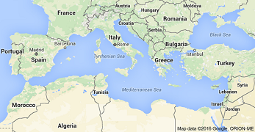
Approximately one third of these sites are located in Italy, followed by Croatia, Greece, and Tunisia. 47 of these 49 sites may be at risk from at least one of these hazards, flooding or erosion, by the end of the century.

Slide 15
ITALY

Slide 16
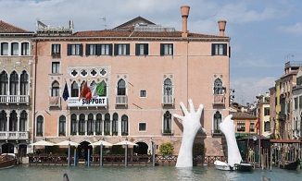
Venice in danger

Slide 17
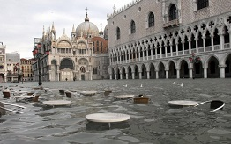
Venice is sinking at a rate of 1-2 millimeters a year. There is the Aqua Alta, a particularly high tide, that occurs in special weather conditions and causes a 9 cm rise in water level. Then, most of the town is flooded. Coastal protections are already being developed to shield Venice from flooding.

Slide 18
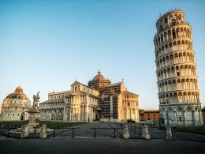
Scientists identified the Piazza del Duomo, home to the famous Leaning Tower, is being at particular risk from flooding in the coming decades unless urgent action is taken.

Slide 19
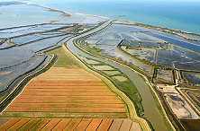
Climate changes and sea-level rise are important issues, especially for deltas such as the Po Delta, Italy. The formation of the Po Delta began about 2000 years ago and has undergone many phases of development.

Slide 20
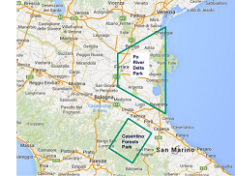
Last decades due to dam and barrier construction and to river bed excavation that caused soil erosion, scientists noticed the reduction of the solid supply of the Po.

Slide 21
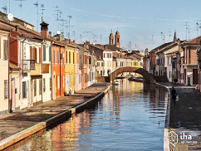
Near delta Po, an important renaissance city, Ferrara, is in danger.

Slide 22
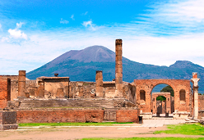
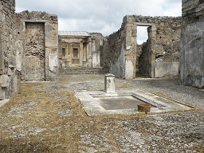
Archaeological site of Pompei. Nearly 2.000 years ago, Pompeii was a bustling city located in the southern part of Italy. But in the summer of A.D. 79, the nearby Mount Vesuvius volcano erupted. Smoke and toxic gas spread to the town. Almost overnight, Pompeii—and many of its 10.000 residents—vanished under a blanket of ash. Sites as Pompei, Herculaneum and Torre Annunziata that were preserved by the eruption of Vesuvius, nowadays are at risk from flooding and erosion.

Slide 23
CROATIA

Slide 24
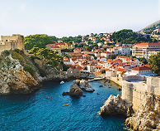
In many places along the Croatian coast, historical towns, residential houses, roads are constructed very close to the coastline. Scenarios of sea-level rise for 2030 - 2100 have been reported of 18 to 65 cm.

Slide 25
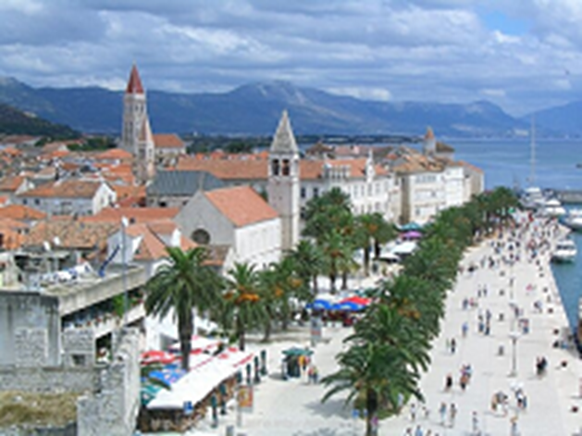
Trogir which is in the list of UNESCO World Heritage is also in danger. The street plan of this town dates back to the Hellenistic period and it was embellished with many fine public and domestic buildings and fortifications. There are beautiful Romanesque churches and the outstanding Renaissance and Baroque buildings from the Venetian period.

Slide 26
GREECE

Slide 27
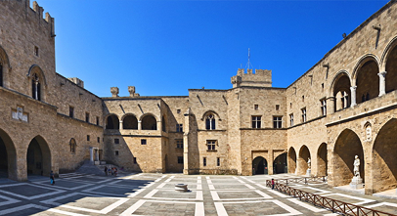
Medieval City of Rhodes, Greece During antiquity, Rhodes was an ancient Greek state. Later, it came under Byzantine rule. In the Middle Ages, it was conquered by the Ioannites knights, who were crusaders. They built the medieval town with the big castles in the city of Rhodes. Now the ancient walls are threatened by gradual erosion from the rising tides.

Slide 28
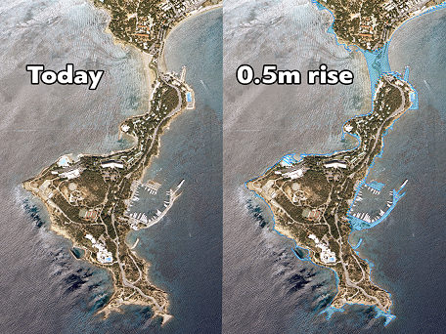
According to predictions, by the end of the century, sea levels are expected to rise by 20 to 59 centimeters. However, some researchers believe that existing models underestimate the threat for the Antarctic glaciers. So, by the end of the century, it is more probable for sea levels to rise between 80 centimeters to 2 meters. These quantities may sound small or negligible, but they are not. We can see the effects on the coasts of Lemos in Vouliagmeni.

Slide 29
There will also be very significant problems in archeological sites located in forest areas or on steep slopes that are vulnerable to erosion. High temperatures and luck of rainfalls make forest areas drier, and therefore more vulnerable to forest fires. Some of these specific destinations protected by UNESCO, are the Temple of Epicurean Apollo and Ancient Olympia that will be in immediate danger.

Slide 30
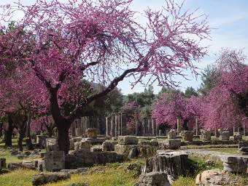
Olympia is one of the most influential ancient Greek sanctuaries, located in western Peloponnese. It is positioned in a serene and rich valley between two rivers. In antiquity it was famous beyond the borders of mainland Greece for hosting the Olympic Games every four years, starting in 776 B.C.

Slide 31
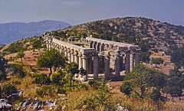
This famous temple to the god of healing and the sun, Apollo Epicurious, was built towards the middle of the 5th century B.C. on the rocky mountains, in Peloponnese. It’s one of the most imposing temples of antiquity, because it combines the Archaic style and the serenity of the Doric style with some daring architectural features.

Slide 32
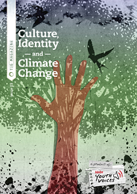
It’s important to protect our cultural heritage, because it is connected with our culture identity, adapting a combination of awareness-raising strategies with protection measures.

