Slide 1
LEARNING ABOUT RED CROSS

Slide 2
In terms of Erasmus Project “Climate Change”, a representative of the Hellenic Red Cross came at 1st Gymnasium of Cholargos …

Slide 3
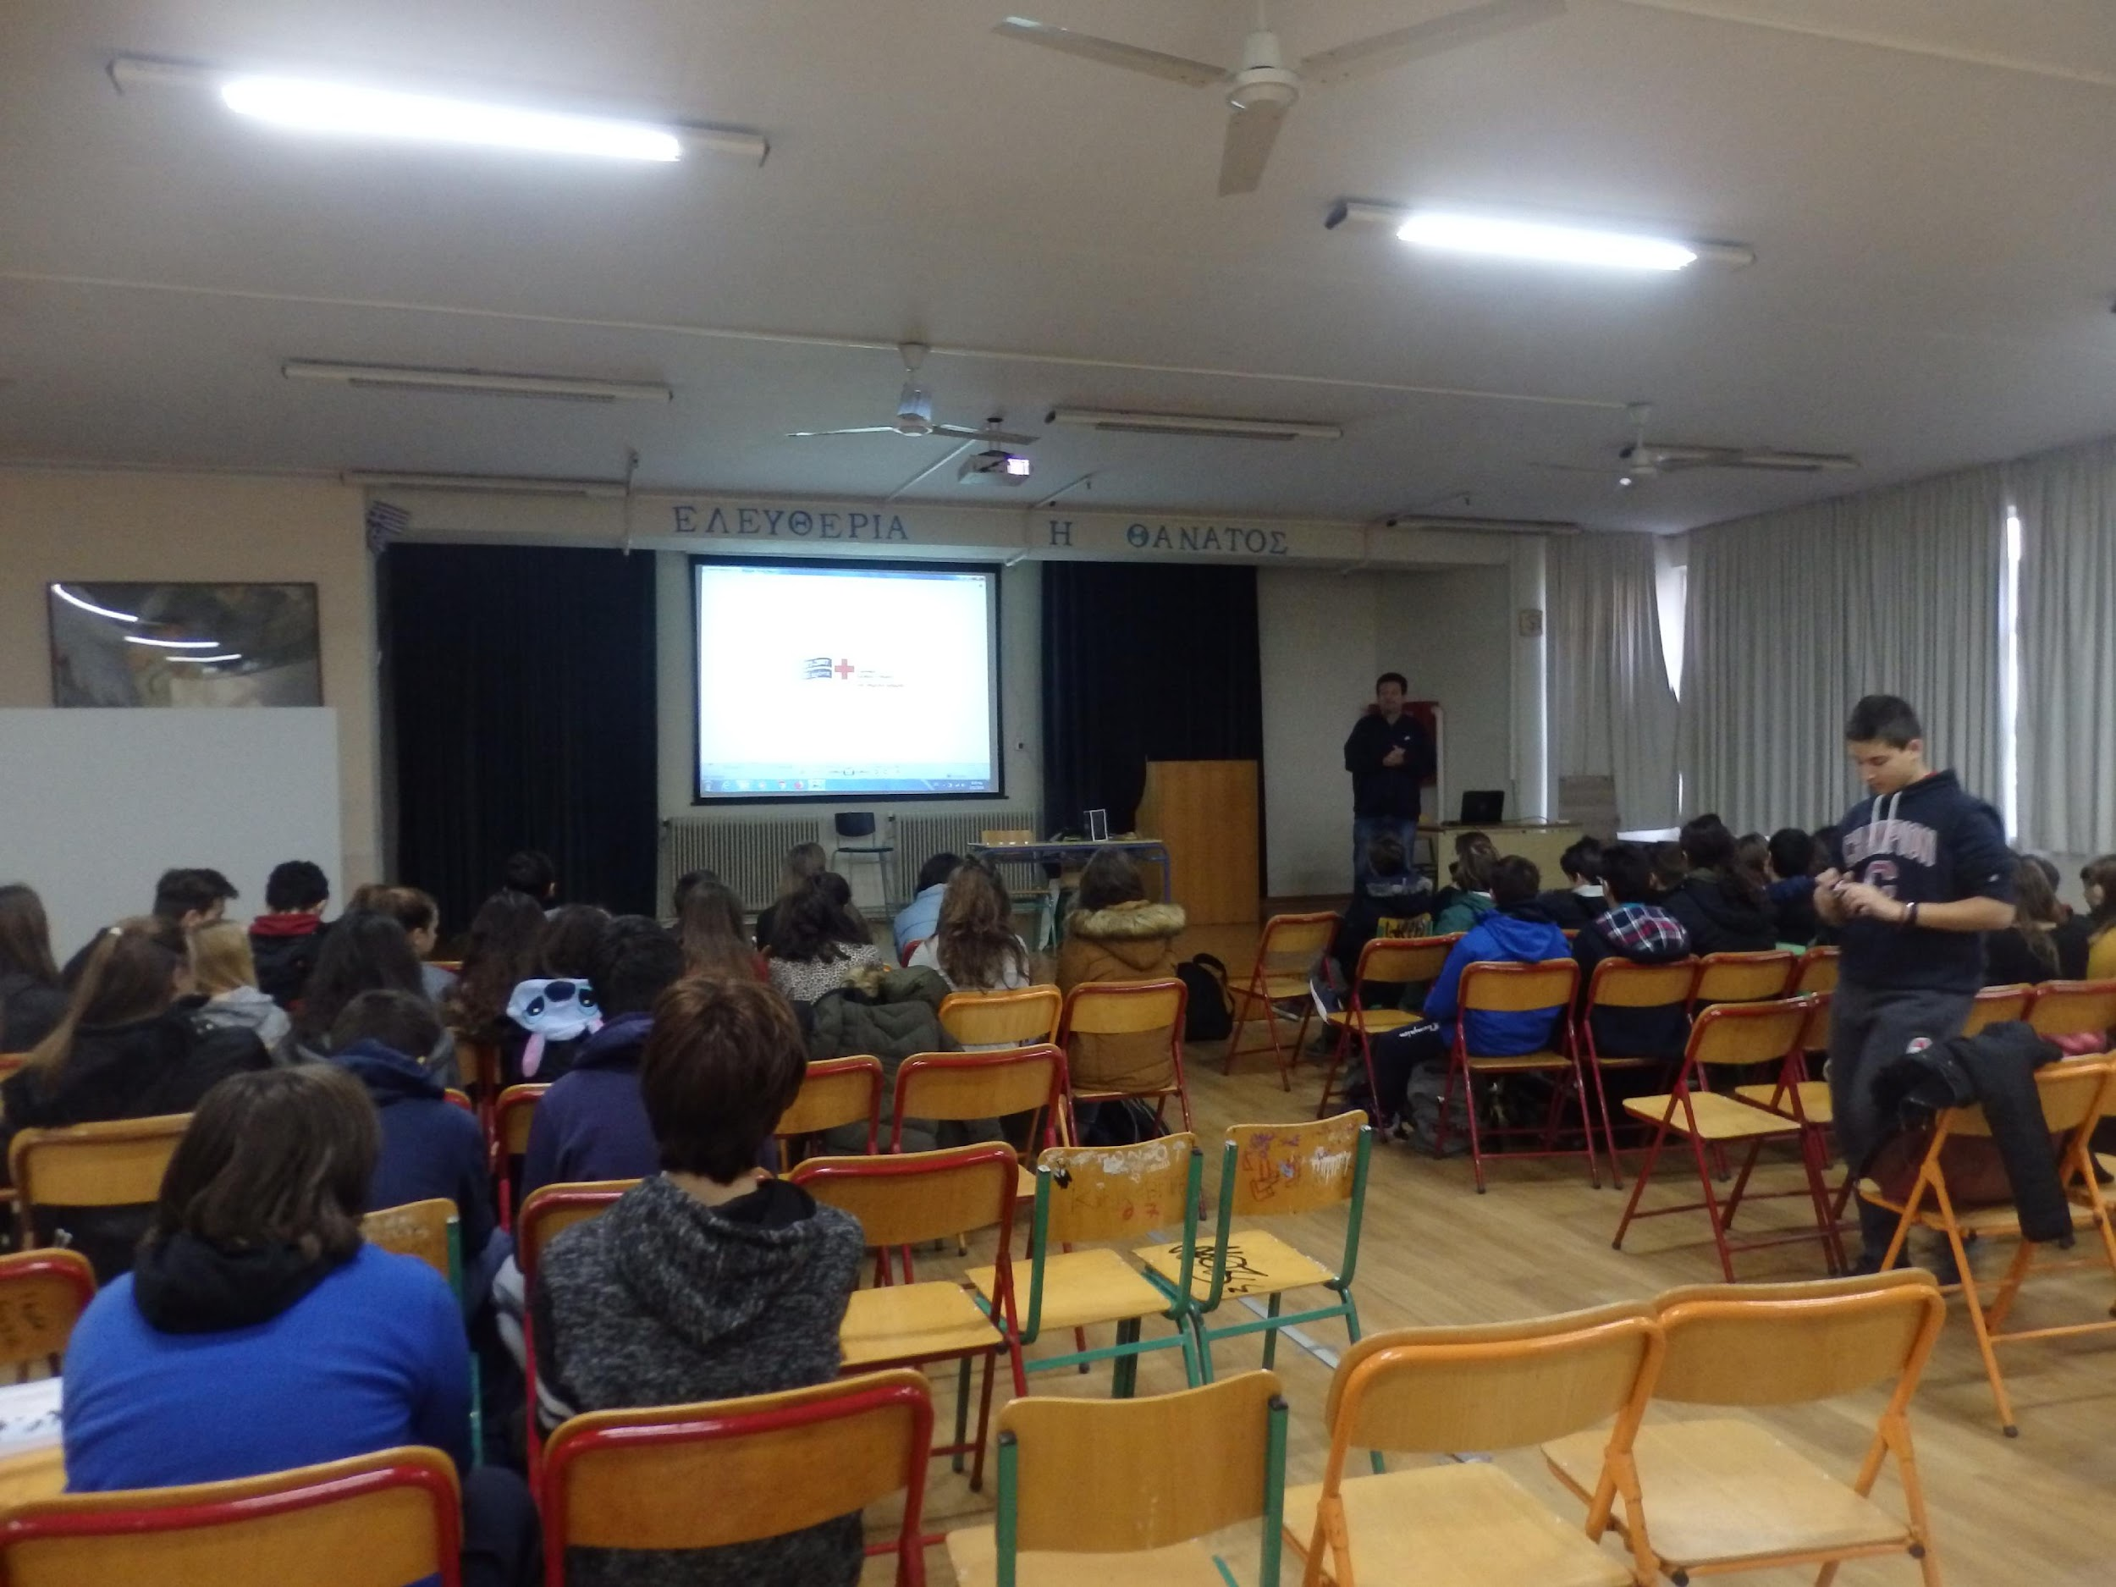
… to inform students about the organization and its aims.

Slide 4
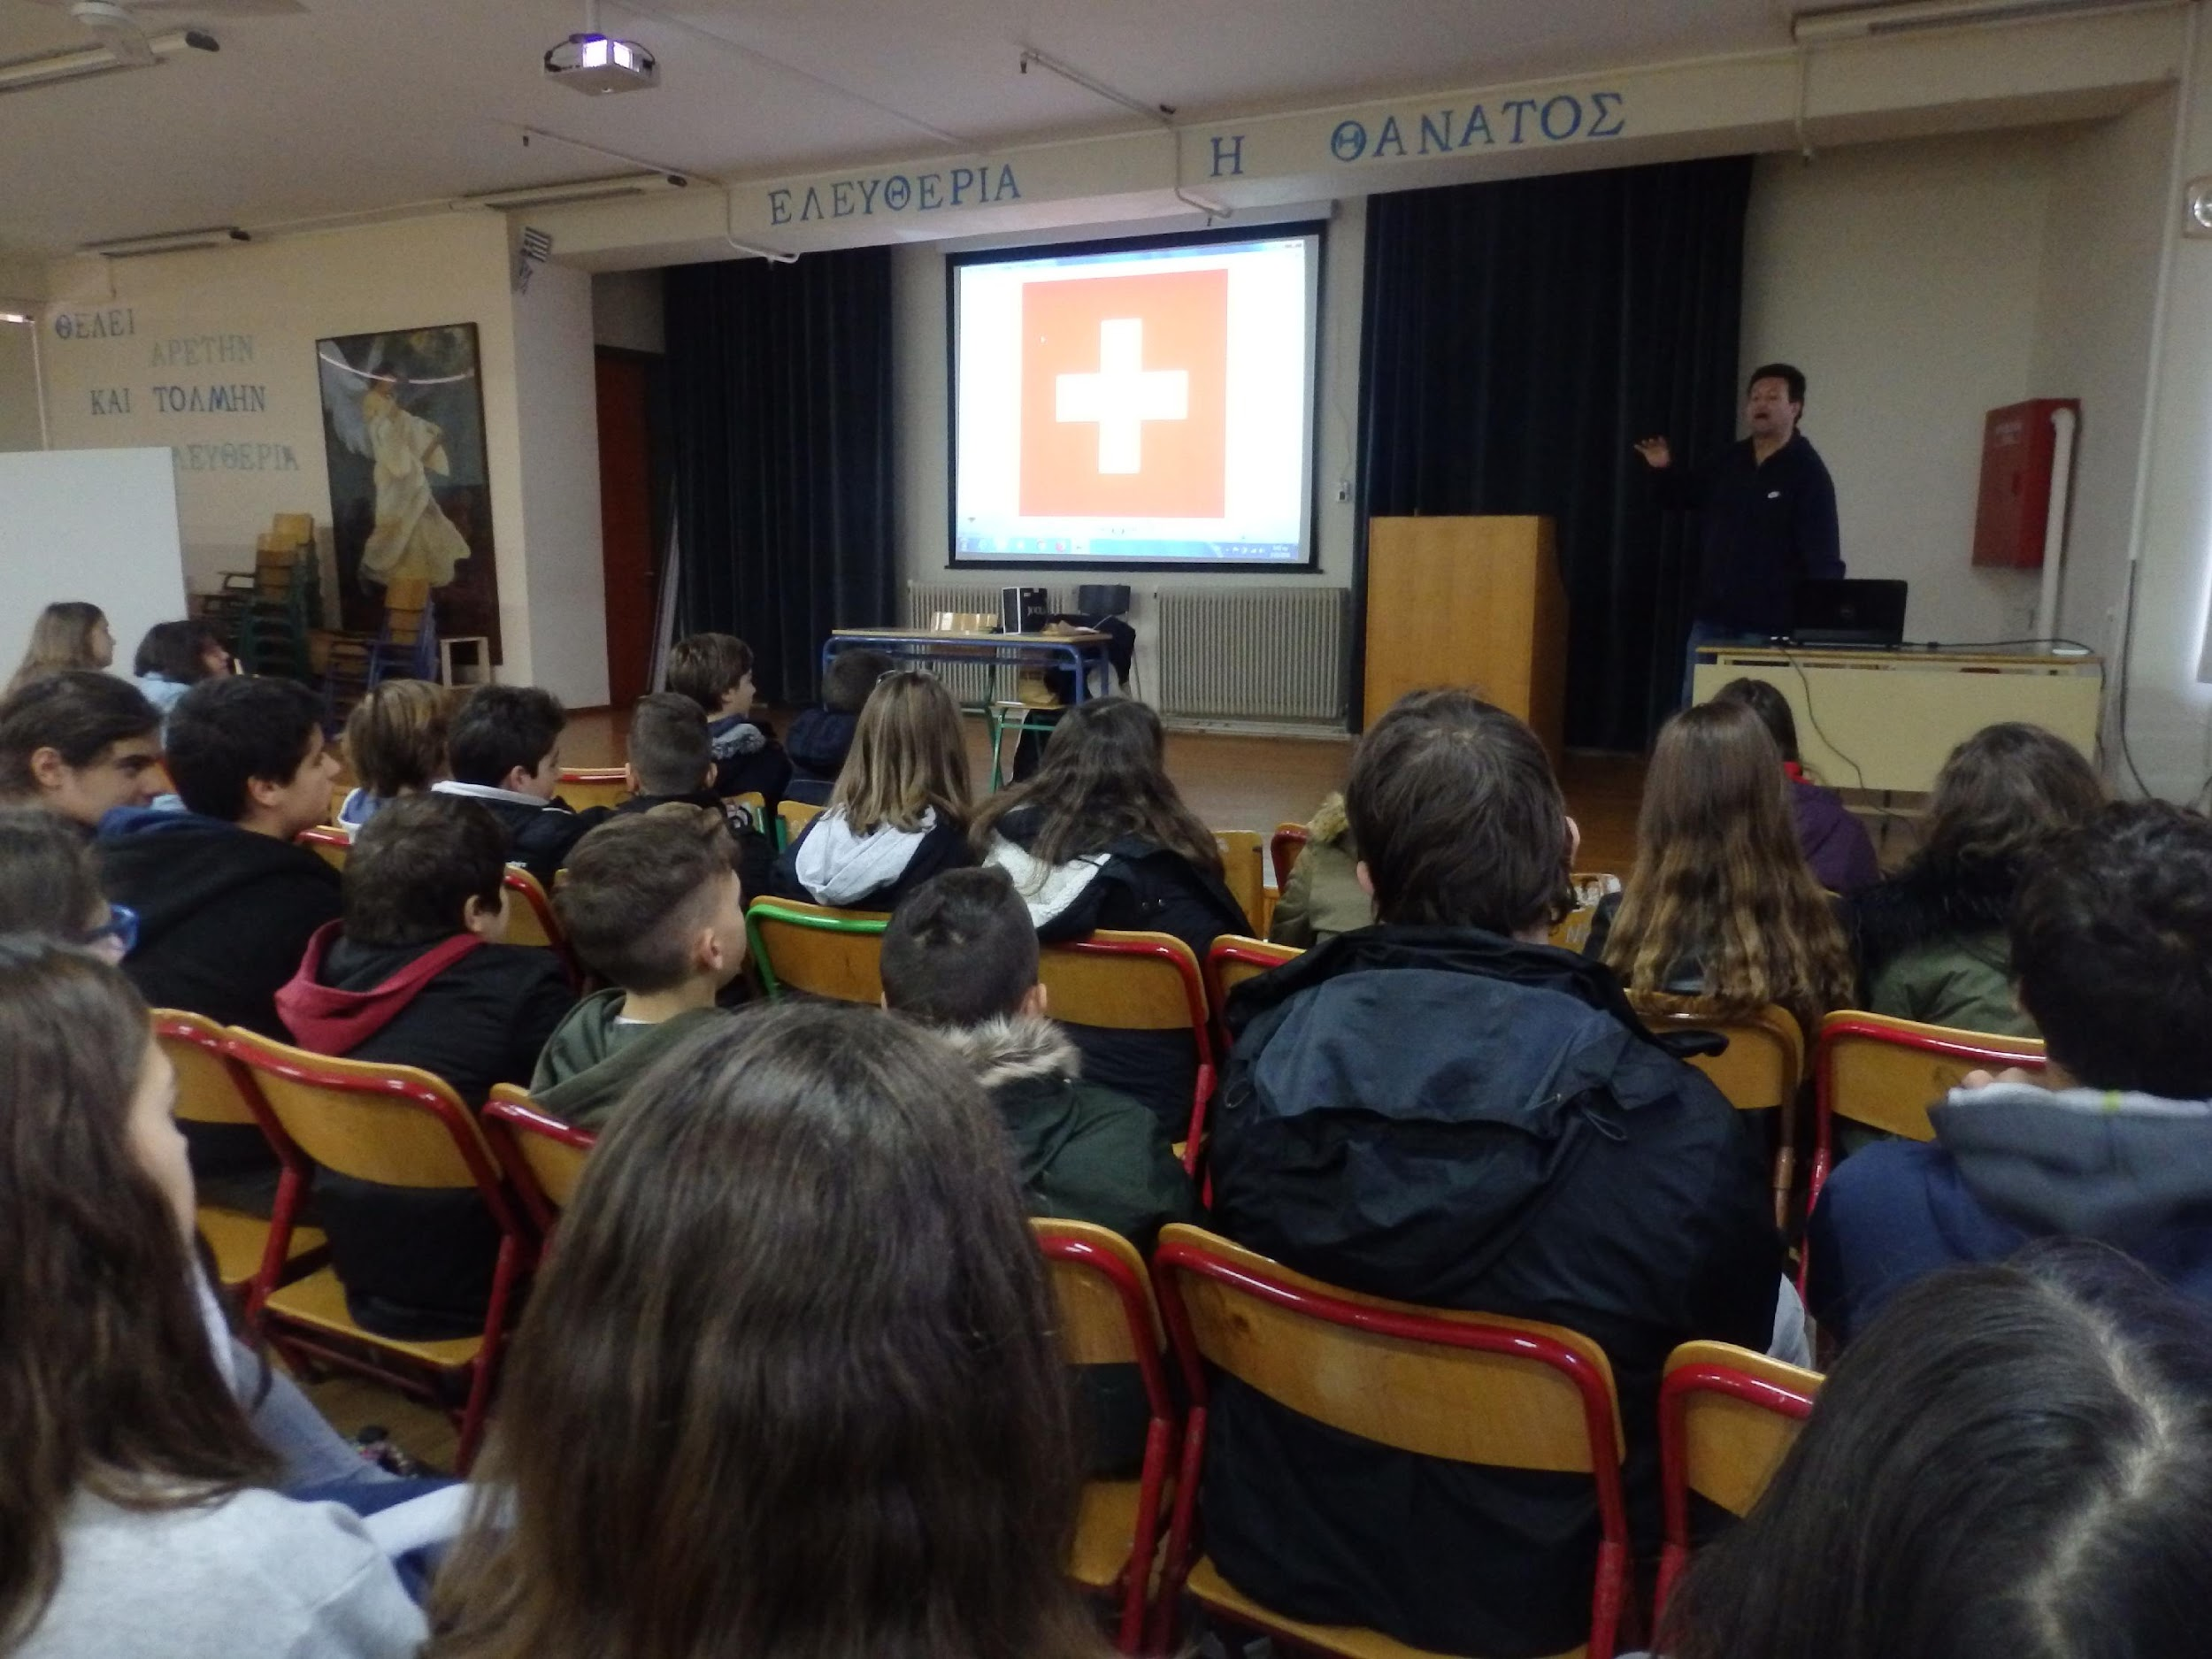
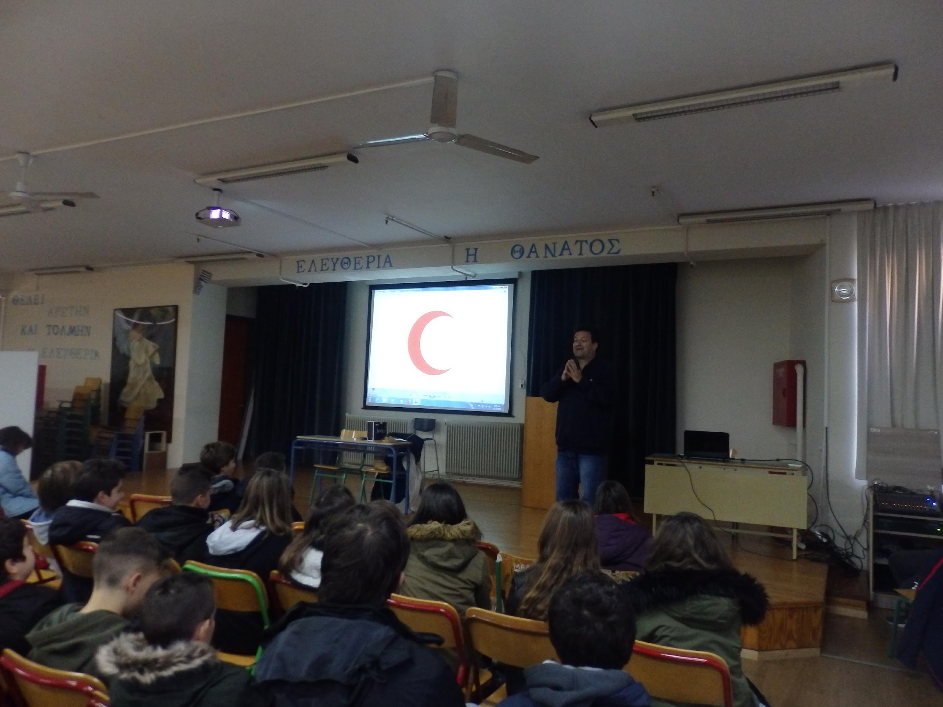
He spoke about the foundation of Red Cross and the story of its emblem …

Slide 5
He presented also the life of Henri Dunant, the man who devoted his life to this organization.

Slide 6
Hellenic Red Cross was activated very early, supporting the civilians under difficult times of poverty and diseases.

Slide 7
Today, Hellenic Red Cross is daily presented assisting people though the sections of …

Slide 8
… Nursing, Rescuers, Lifeguards and social Welfare

Slide 9
One of its activities is supporting student groups on cleaning up beaches.

Slide 10
Teachers and students of Erasmus project are looking forward to doing this activity with Red Cross cooperation!

