Slide 1
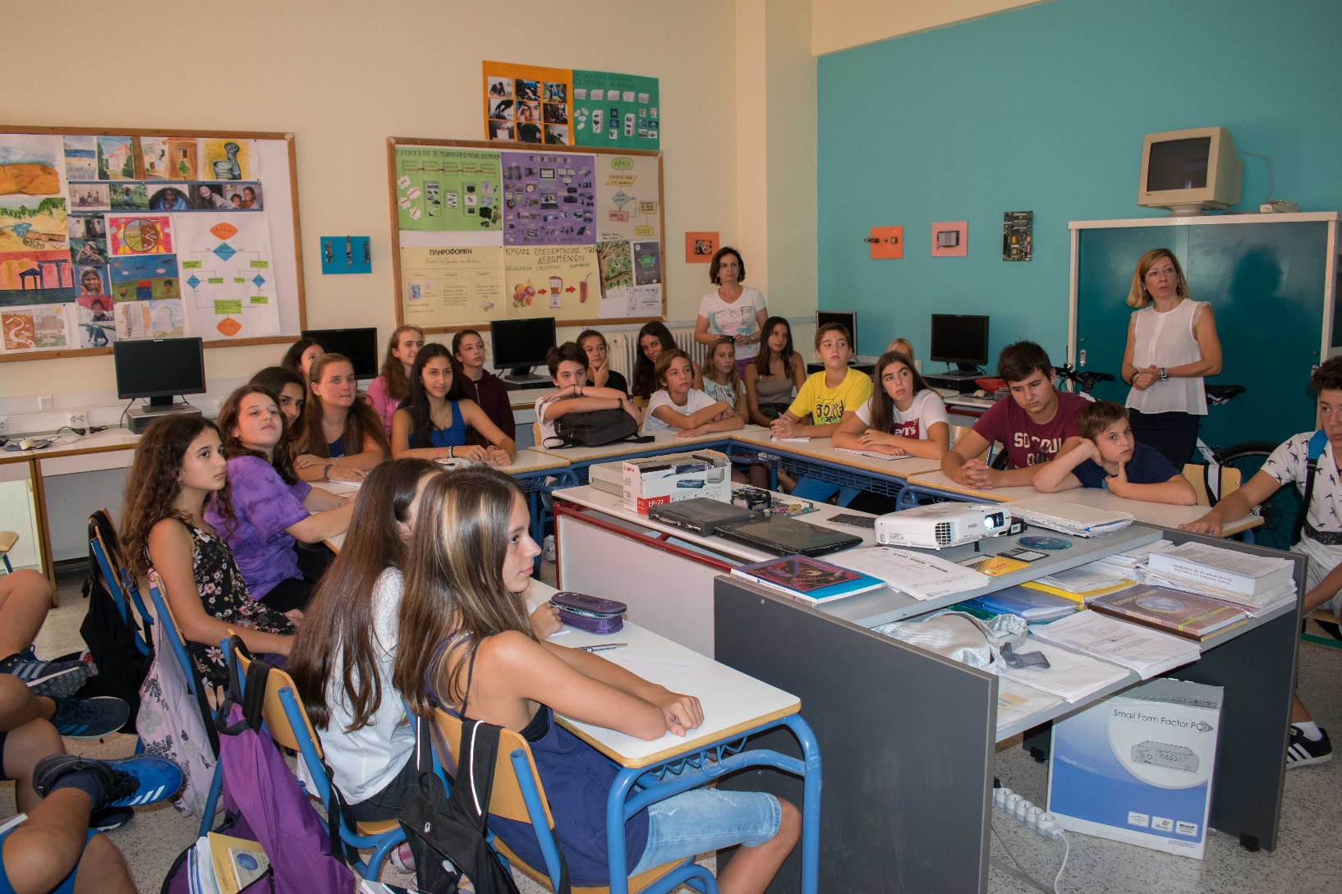
All students interested in participating in the new Erasmus+ project …

Slide 2
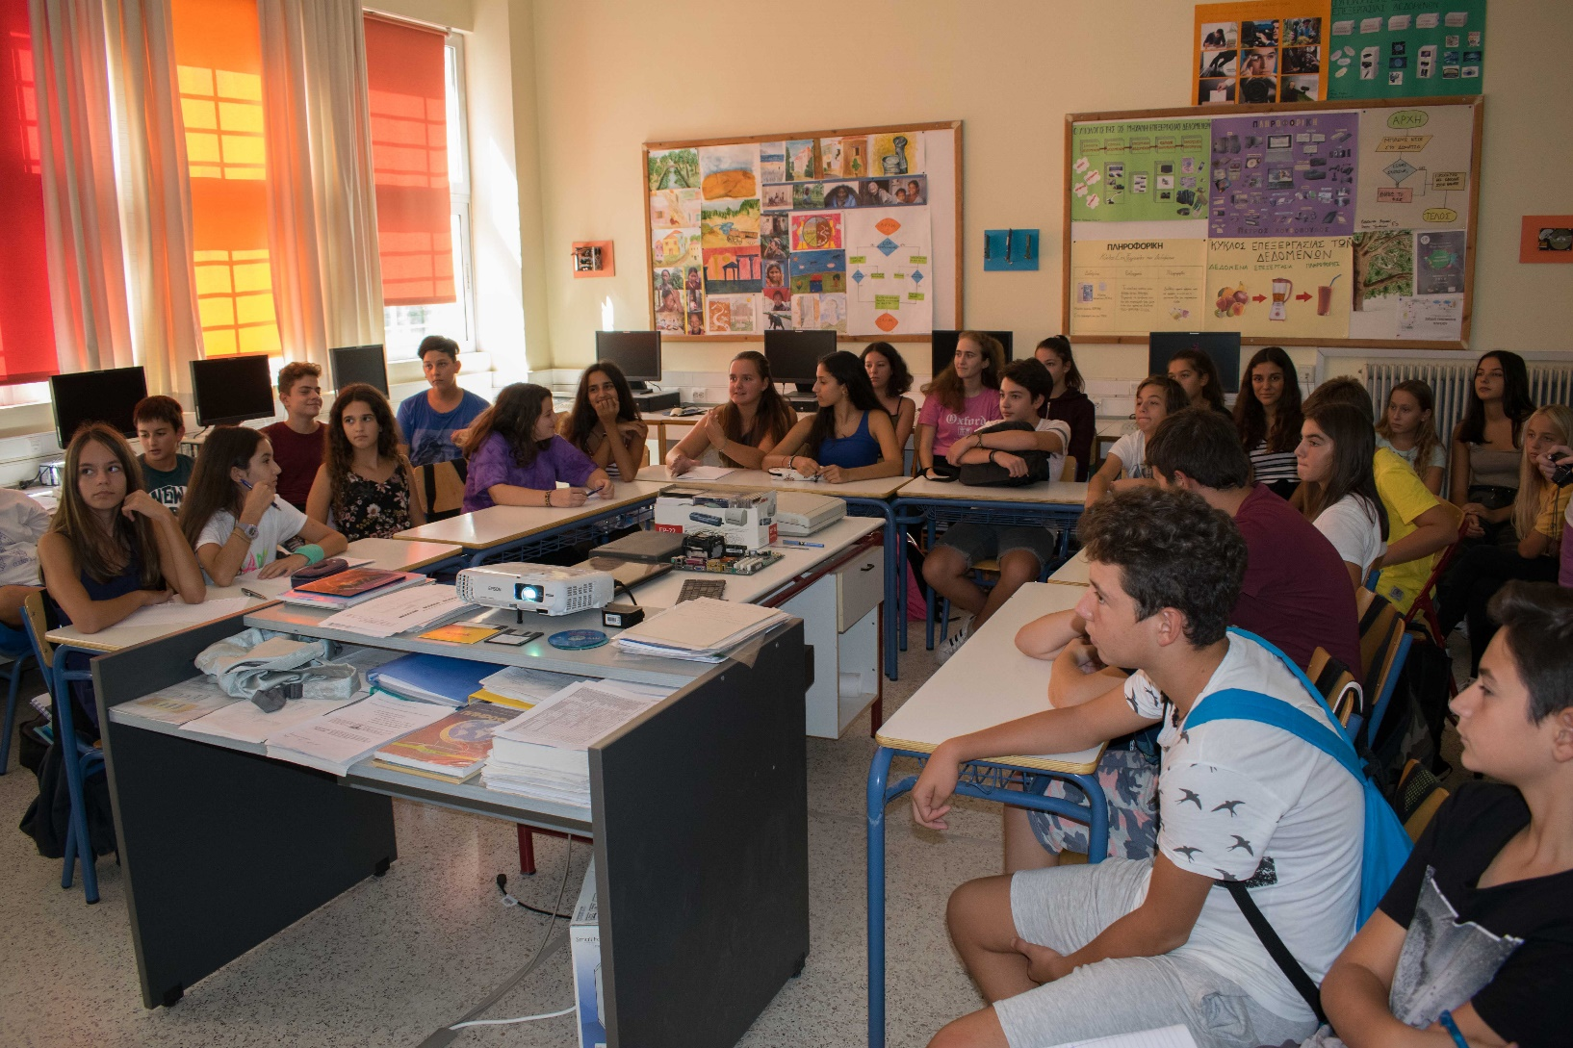
… gathered at computer laboratory of 1st Gymnasium Cholargos

Slide 3
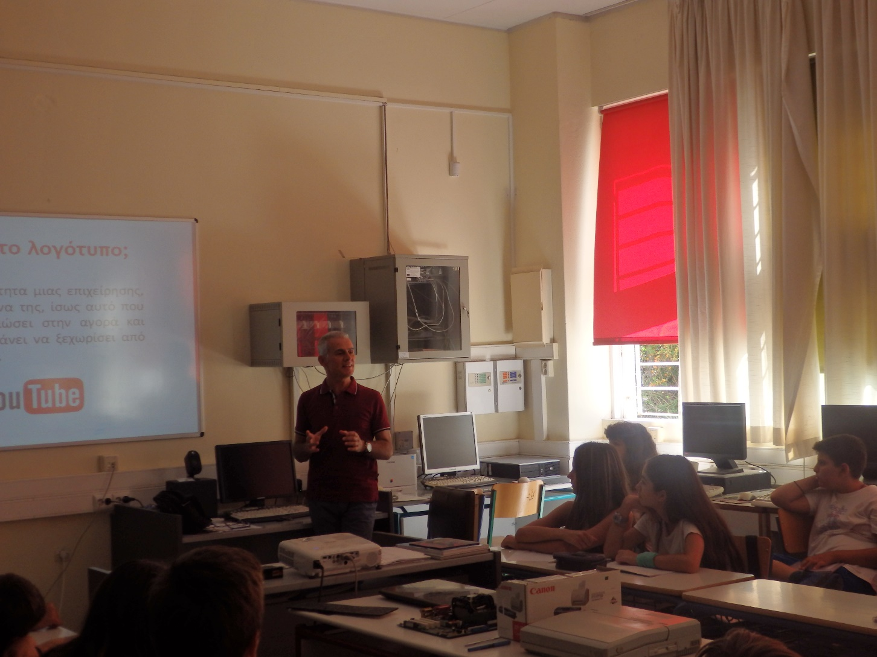
The informatics teacher spoke taught them about logo

Slide 4
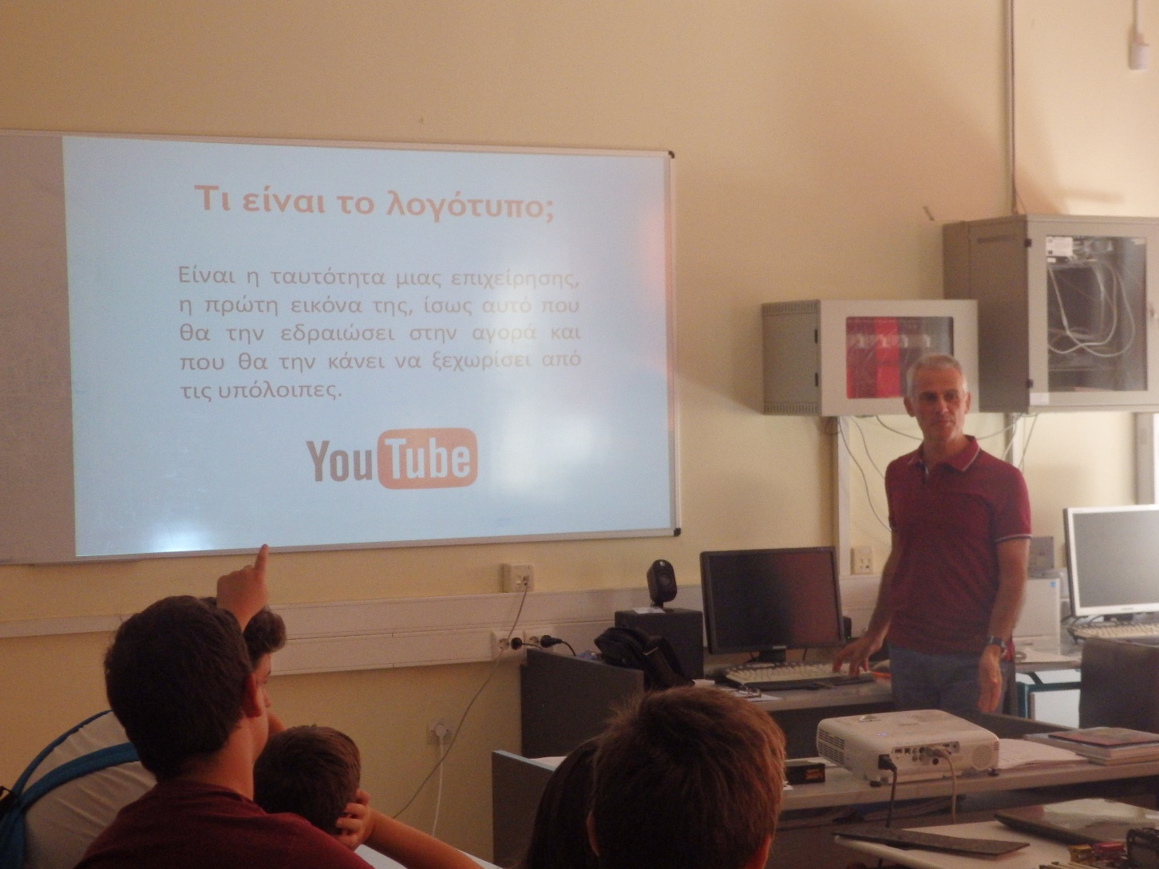
They told them what characteristics should a good logo have

Slide 5
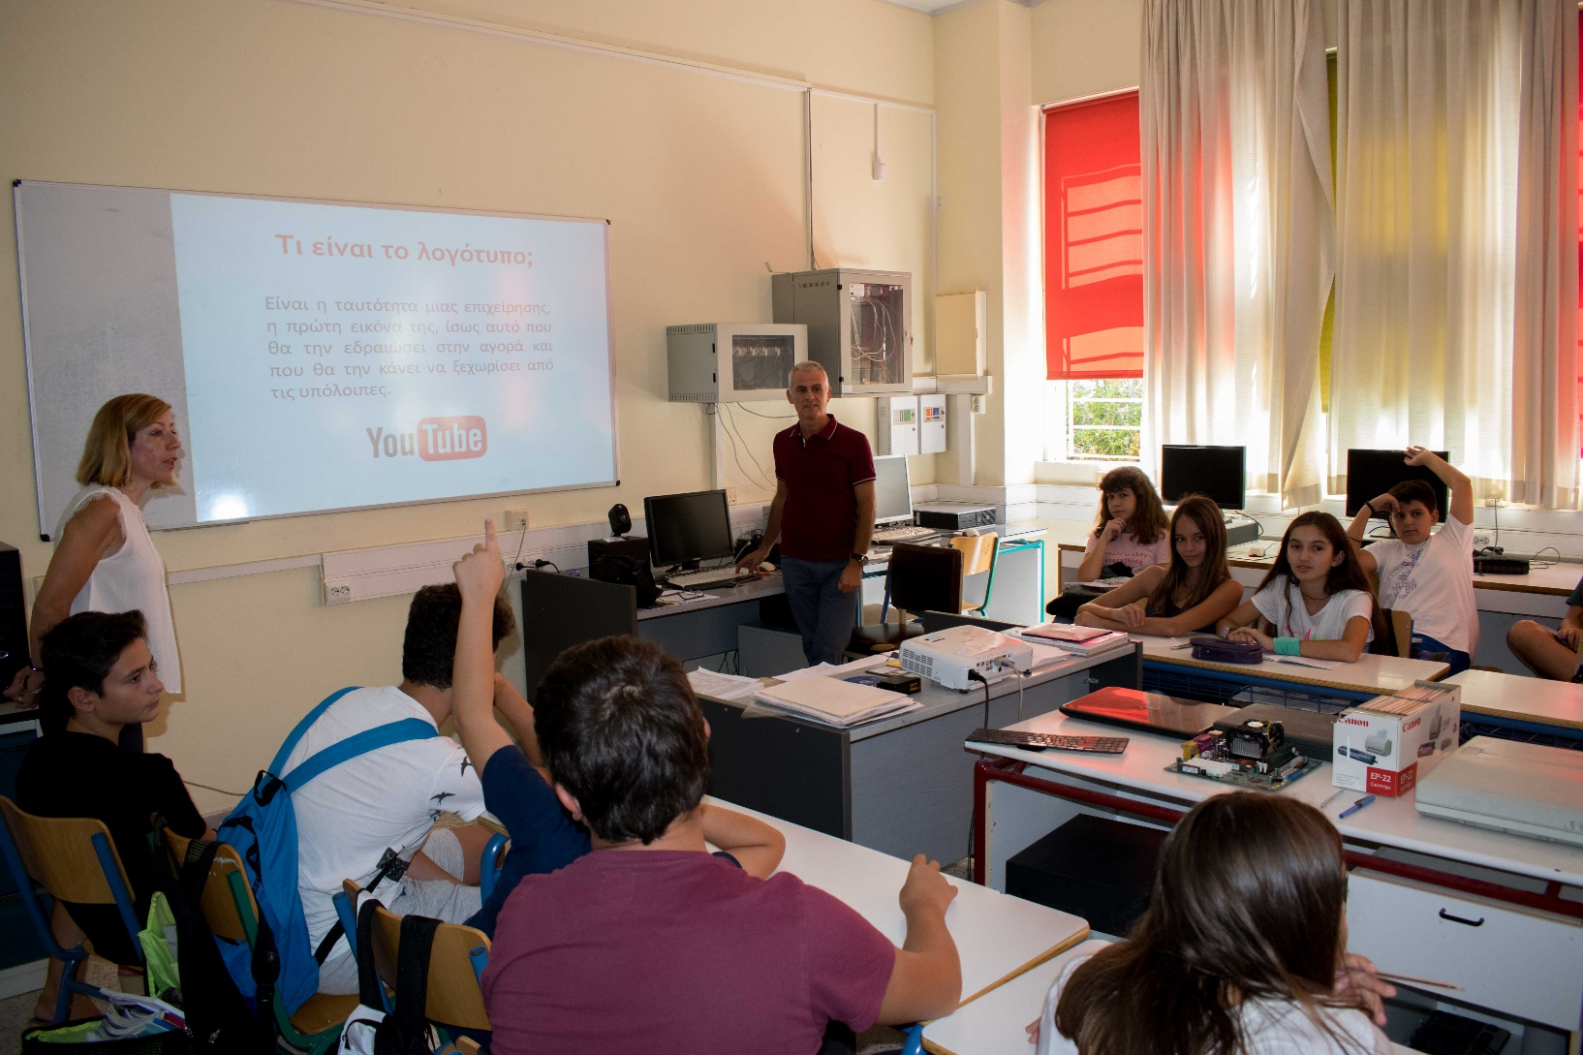
and assigned them to make logo for the new Erasmus+ project “Climate changes”

Slide 6
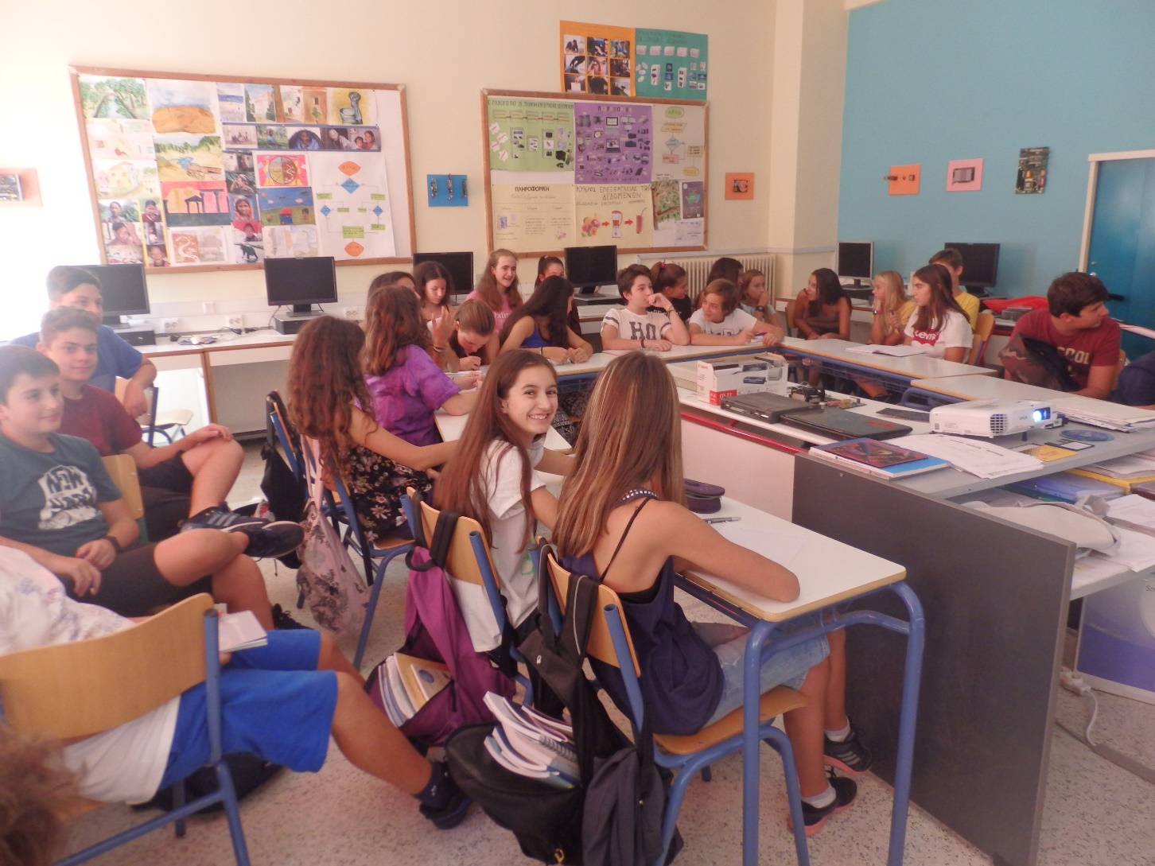
This was the first task students of 1st Gymnasium of Cholargos

Slide 7
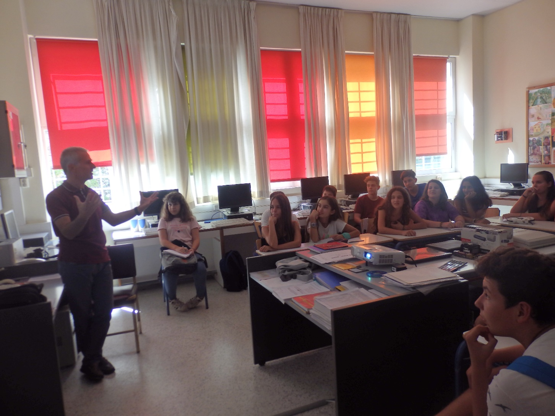
The three best logos of Greek school will be presented to the first short – term exchange of pupils in Greece.

