Slide 1
Invasive alien animals and plants
By Szymon szczechowski

Slide 2
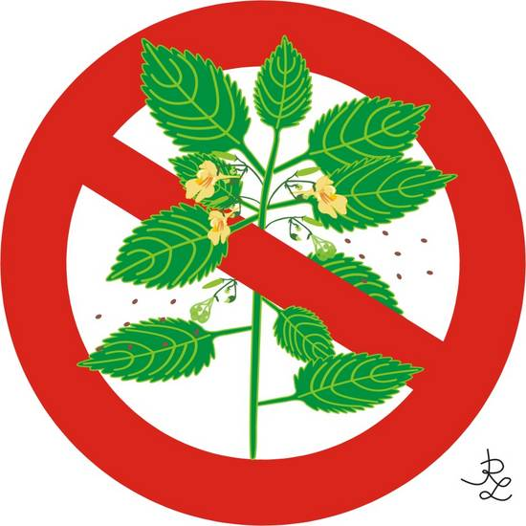
Invasive alien species - definition
Non-native (or alien) to the ecosystem,
Aggressive, grows outside desired territory,
Likely to cause harm to human health, economy and environment,
Chase out native species,
Can be in the form of animals, plants and other organisms

Slide 3
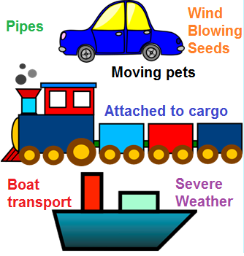
How do invasive species enter?
By accidental transport (large ships, recreational boats, aircrafts)
With imported food,
as goods such as plant products,
Improper disposal of garden plants,
Intentionally as garden ornamentals,
Unintentional dispersal. Without their natural predators and pathogens, invasive plants spread quickly

Slide 4
Climate change and ias
Human-influenced climate change has increased invasion of ORGANISMs.
Global warming is the increase in climate temperature caused by humans. This increase has a cascading effect on the plants and animals of the region. thus causing non native organism of land and sea to migrate to new areas suitable for their lifestyle or die with the once habitable environment.
The non native plants can then invade and take over the ecosystem in which they were introduced

Slide 5
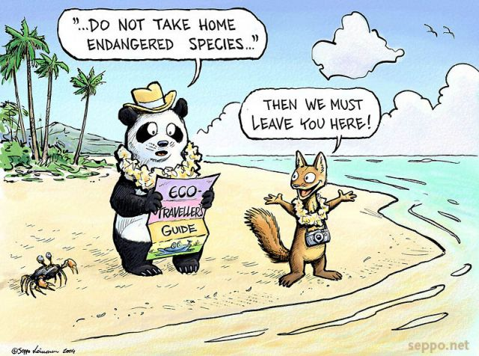

Slide 6
Negative effects of invasive species
environmental
economic
health
extinction of local species
Changes in ecosystem
Changing the ways ecosystem functions
Necessity to Control the spread of invasive species
Necessity to save endangered species
spreading diseases,
Causing allergies
Lowering Food security

Slide 7
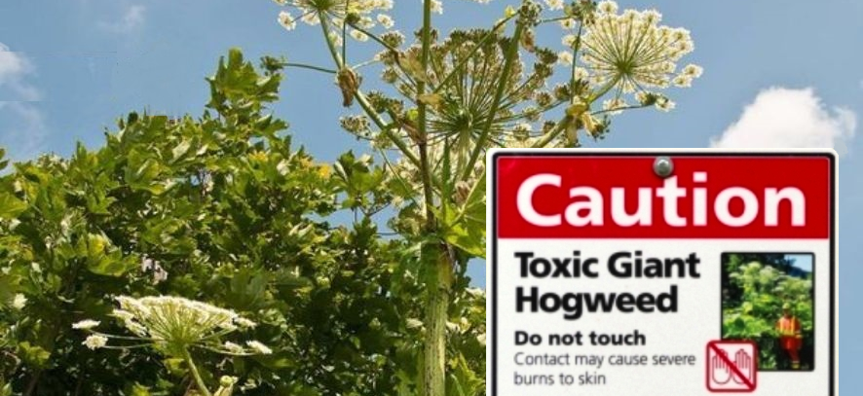
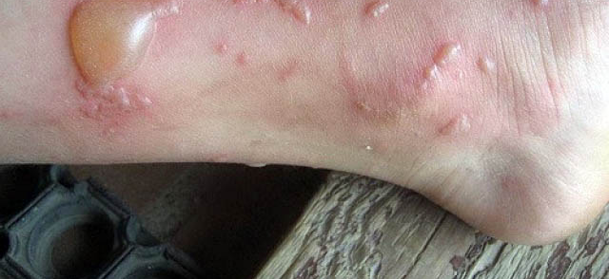
Sosnowsky's hogweed
Oryginally native to caucasus,
All parts of the plant are toxic,

Slide 8
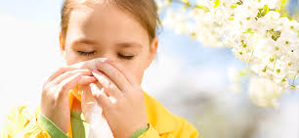
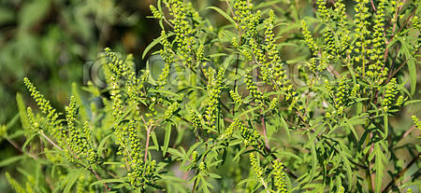
Ambrosia artemisiifolia
Originally native to north America,
Ragweed pollen is notorious for causing allergic reactions in humans, specifically allergic rhinitis,
Ragweed species are expected to continue spreading across Europe in the near future in response to ongoing climate change.

Slide 9
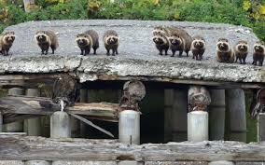
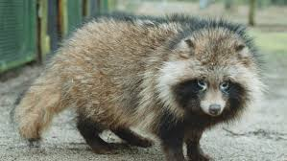
Raccoon dog
Originally native to east asia
Game and crop damage
Demage to breeding colonies of water and wetland birds
Threat to amphibian population

Slide 10
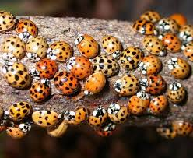
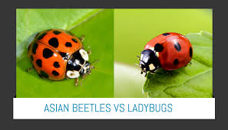
Asian lady beetle
Originally native to south-eastern asia
allergies in some individuals, ranging from eye irritation to asthma
Extermination of local ladybugs
Likely to bite or 'pinch' if in contact with skin
Due to their noxious odor can taint the flavor of wine

Slide 11
What can we do?
Verify that the plants you are buying for your yard or garden are not invasive
WHEN BOATING, CLEAN YOUR BOAT THOROUGHLY BEFORE TRANSPORTING IT TO A DIFFERENT BODY OF WATER.
CLEAN YOUR BOOTS BEFORE YOU HIKE INA NEW AREA TO GET RID OF HITCHHIKING WEED SEEDS AND PATHOGENS.
DON'T "PACK A PEST" WHEN TRAVELlING. FRUITS AND VEGETABLES, PLANTS, INSECTS AND ANIMALS CAN CARRY PESTS OR BECOME INVASIVE THEMSELVES.
DON'T RELEASE AQUARIUM FISH AND PLANTS,LIVE BAIT OR OTHER EXOTIC ANIMALS INTO THE WILD.
VOLUNTEER AT YOUR LOCAL PARK, REFUGE OR OTHER WILDLIFE AREA TO HELP REMOVE INVASIVE SPECIES. HELP EDUCATE OTHERS.

Slide 12
The longer we ignore the problem the harder the battle will become

