Slide 1
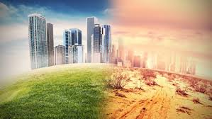
Introduction to Climate Change

Slide 2
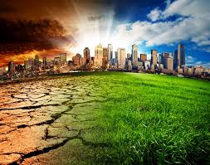
What is Climate Change?
Climate Change means the difference in the Earth's global climate or in regional climates over time.
It describes changes in the state of the atmosphere over time scales ranging from decades to millions of years. These changes can be caused by processes inside the Earth, forces from outside (e.g. variations in sunlight intensity) or, more recently, human activities. Ice ages are prominent examples.
Climate change is any significant long-term change in the expected patterns of average weather of a region (or the whole Earth) over a significant period of time. Climate change is about abnormal variations to the climate, and the effects of these variations on other parts of the Earth. Examples include melting of the ice caps at the South Pole, These changes may take tens, hundreds or perhaps millions of years.

Slide 3
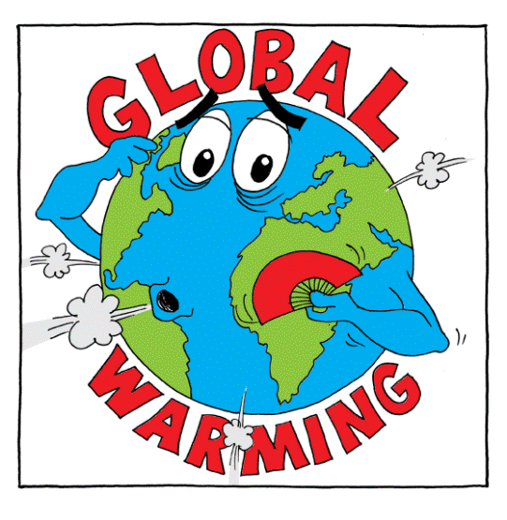
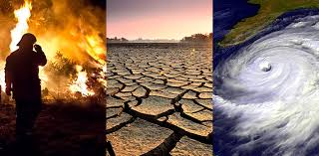
What are the consequences?
extreme maximum temperatures
less extreme low temperatures
extreme height of the sea
higher sea temperatures
higher number of heavy rainfall
melting of snow and ice like ice caps, glaciers and permafrost.

Slide 4
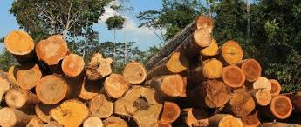
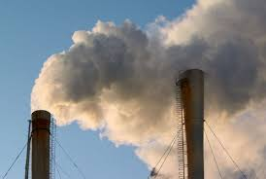
What causes Climate Change?
Burning coal, oil and gas
Cutting down rainforests
Farming Livestock
Greenhouse gases

Slide 5
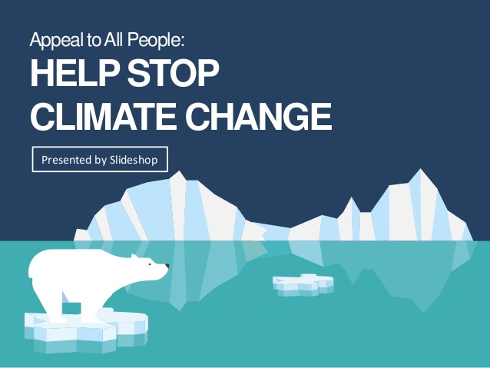
How to stop it
1. Speak up!
2. Power your home with renewable energy.
3. Weatherize, weatherize, weatherize.
4. Invest in energy-efficient appliances.
5. Reduce water waste.
6. Actually eat the food you buy—and make less of it meat.
7. Buy better bulbs.
8. Pull the plug(s).
9. Drive a fuel-efficient vehicle.
10. Maintain your ride.

Slide 6
Climate Change’s impact in our lives
Buildings
Climate change is already affecting foundations of buildings as the soil dries out, according to the Building Research Establishment. The government is also considering new regulations, particularly for tall buildings, so they can withstand higher wind speeds.
Grapes
There are now commercial vineyards as far north as Leeds, while consistently earlier springs and warmer summers mean British vineyards are regularly harvesting grapes at least one or two weeks earlier than they could have 20 years ago. But the industry is wary of the extreme frosts and storms predicted by climate change.
Health
The medical profession has been warned by the Department of Health to expect fewer cold-related winter deaths but more heat-related summer deaths and skin cancers.

Slide 7
Farming
Warming temperatures in the past decade have already turned more farmers to growing maize and sunflower, according to the National Farmers Union, and this summer's heat wave has led to a higher than usual death rate in poultry farms. Drought stress in crops has increased sharply in the past 20 years. Farmers are now saving irrigation water for higher value vegetables and salad crops.
Floods
Sea-level rise and flooding are likely to have the greatest effect on Britain under global warming. A decade of sudden downpours, ferocious storms, flash floods and prolonged cloudbursts all consistent with global warming have provoked the government to increase spending on defending towns from river flooding by hundreds of millions of pounds. It is also raising the standard height of sea defenses.

