Slide 1
How Tsunamis Work

Slide 2
Climate Change causes
Floods
Tornados
Tsunamis
Droughts
Earthquakes
Hurricanes

Slide 3
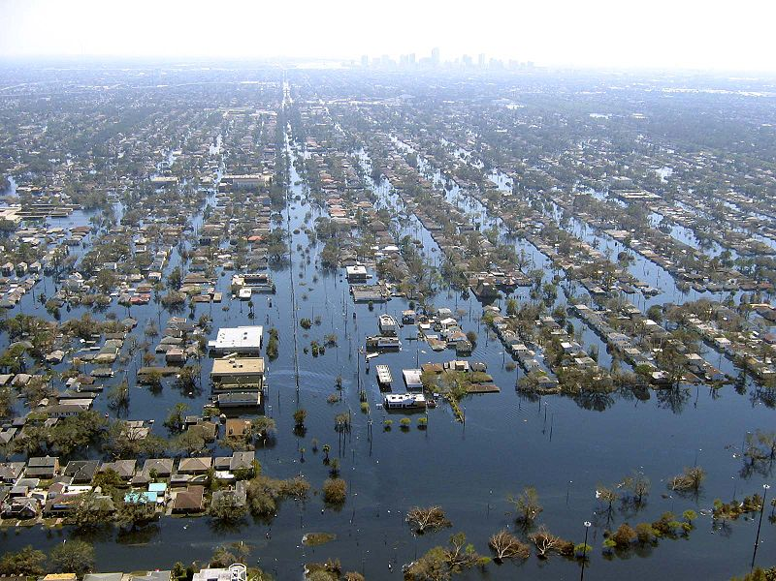

Slide 4
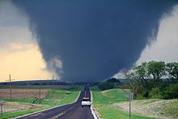

Slide 5
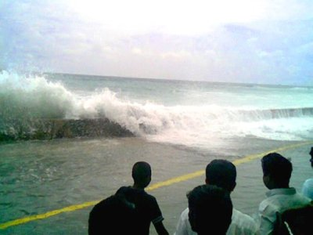

Slide 6
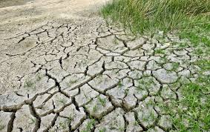

Slide 7
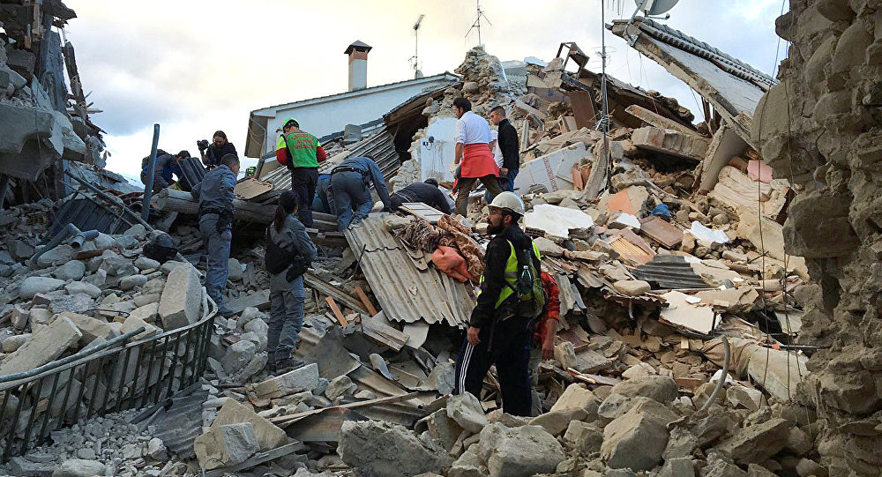

Slide 8
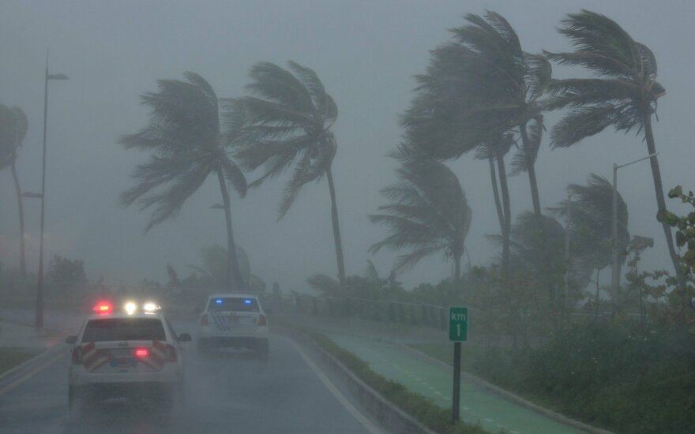

Slide 9
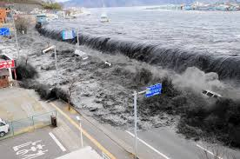
A tsunami is a large wave that travels at great speed towards land.

Slide 10
Tsunamis usually happen due to three causes after:
an underwater earthquake
a large undersea landslide
an underwater volcanic eruption

Slide 11
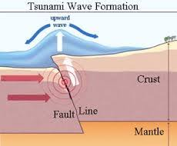
When an undersea earthquake happens, the Earth tectonic plates move suddenly downwards or upwards.

Slide 12
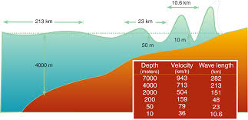
The waves ripples outwards until it reaches land.

Slide 13
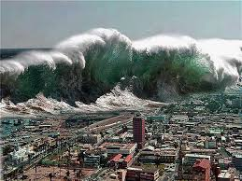
Waves come inland as a strong and fast tide and destroy everything in their path.

