Slide 1
Global warming green house effect & renewable sources of energy
MELINA TAYLOR B’4

Slide 2
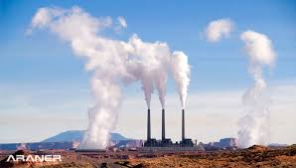
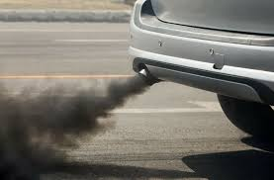
CARBON FOOTPRINT
BASIC CAUSES:
Fossil Fuels by burning coal, natural gas, oil petrol and diesel increase carbon dioxide.
Extend production of carbon dioxide by industries.
Large consumption of energy for electricity and heat by residential and commercial users.
Consumption of processed foods or foods that are not locally produced.
Air Travel because the emission of carbon dioxide from an aircraft is about 90 kg CO2 per hour.

Slide 3
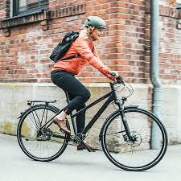
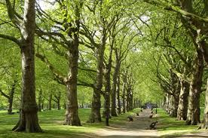
WAYS TO REDUCE CARBON FOOTPRINT
Use your bike instead of your car.
Buy second hand goods such as clothes, appliances etc.
Turn down your thermostat at your heating system.
Turn off the lights when you leave a room an unplug the appliances you don’t use.
Consume less processed foods and prefer foods from your own country.
Use more renewable sources of energy.
Plant trees.

Slide 4
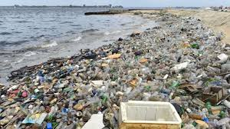
WATER FOOTPRINT
Water pollution by industrial waste.
Water pollution by extend use of chemicals by residential and commercial users.
Overuse of water by meat production industry.
Everyday waste of use by residential users.
Waste of enormous amount of plastic and shop waste in the oceans.

Slide 5
WAYS TO REDUCE WATER CONSUMPTION
Strict regulation for industrial waste.
Turn off the water while you brush your teeth.
Wash your car with bucket and sponge and not with fossil.
Eat less meat and processed foods.
Use less plastic things and recycle plastic.
Use less chemicals or eco friendly products for cleaning.
Do not throw waste in the ocean.

Slide 6
NON NATIVE PLANTS AND ANIMALS
Non-native species have various effects on the local ecosystem.

Slide 7
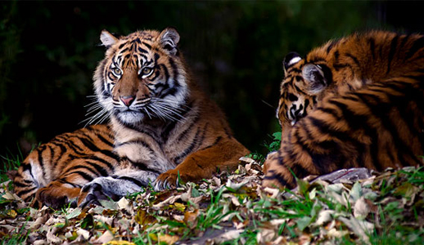
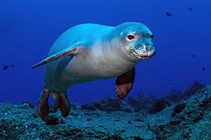
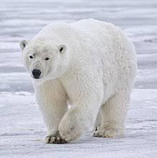
ENDANGERED ANIMALS
Giant Panda
Gorillas
Tigers
Polar bears
Sea turtles and in Greece caretta caretta
The monk seal monachus monachus

Slide 8
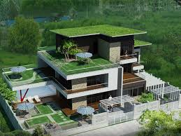
URBAN HEAT – ISLAND EFFECT WAYS OF LOWRING TEMPERATURE
Plant more trees and plants.
Create more green spaces and parks.
Create green roofs on buildings.
Paint the buildings white.
Reduce reflective surfaces.

