Slide 1
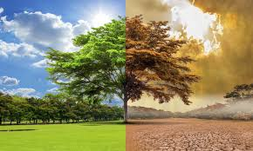
GLOBAL WARMING AND GREENHOUSE EFFECT
Mirosław Wrzos kl. III A Gim

Slide 2
Weather, global warming and climate change
„Climate change” and „global warming” are often used interchangeably but have different meanings. Similarly, the terms „weather” and „climate” are sometimes confused.

Slide 3
Weather
“If you don’t like the weather in New England, just wait a few minutes.”
- Mark Twain
Weather refers to atmospheric conditions that occur locally over short periods of time—from minutes to hours or days. Familiar examples include rain, snow, clouds, winds, floods or thunderstorms.
Climate refers to the long-term regional or even global average temperature, humidity and rainfall patterns over seasons, years or decades.

Slide 4
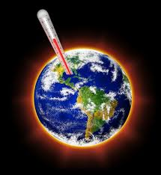
Global warming
Global warming refers to the long-term warming of the planet since the early 20th century, and most notably since the late 1970s, due to the increase in fossil fuel emissions since the Industrial Revolution.
Worldwide since 1880, the average surface temperature has gone up by about 1 °C (about 2 °F), relatively to the mid-20th-century baseline (of 1951-1980).

Slide 5
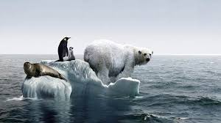
Climate change
Climate change refers to a broad range of global phenomena created predominantly by burning fossil fuels, which add heat-trapping gases to Earth’s atmosphere. These phenomena include the increased temperature trends described by global warming, but also changes such as sea level rise; ice mass loss in Greenland, Antarctica, the Arctic and mountain glaciers worldwide; shifts in flower/plant blooming; and extreme weather events.

Slide 6
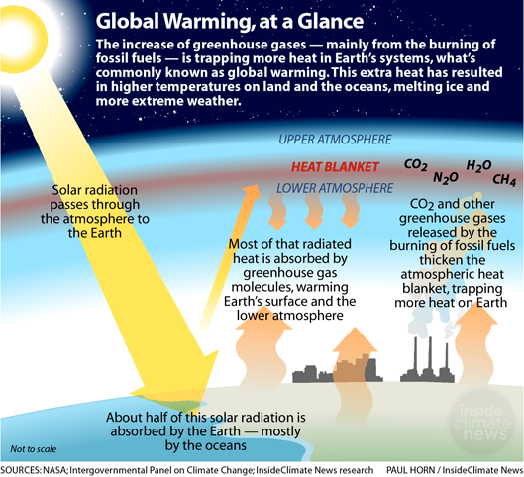
Greenhouse effect

Slide 7
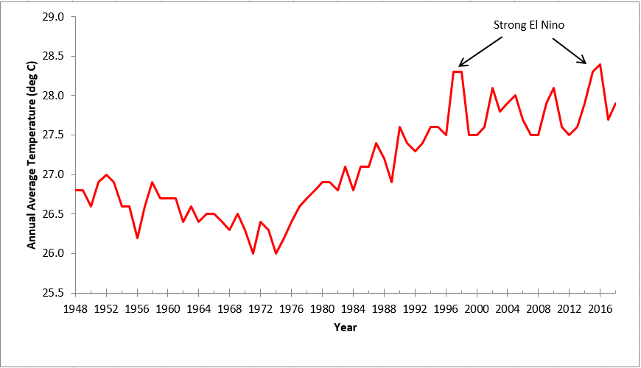

Slide 8
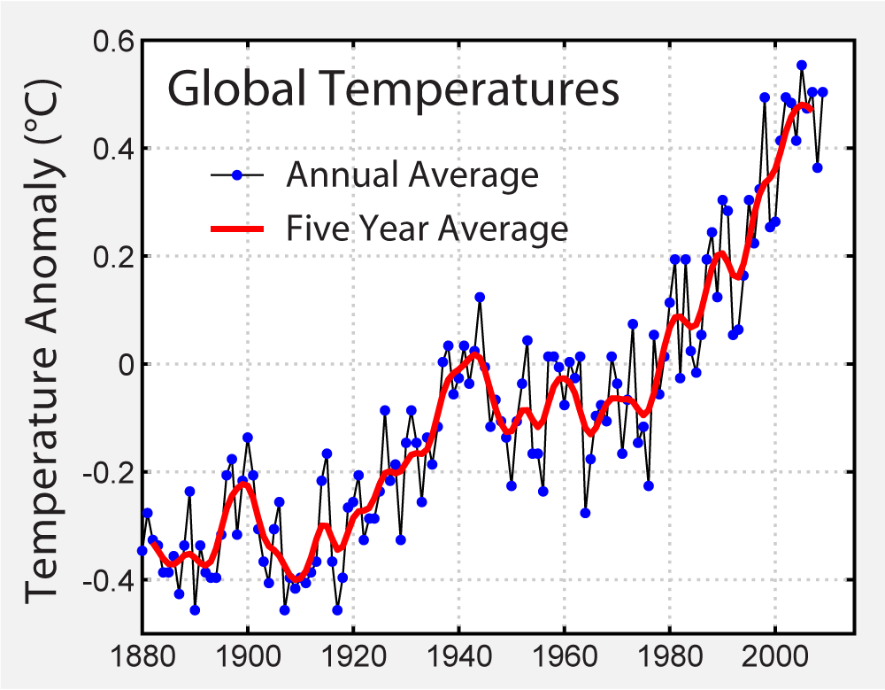

Slide 9
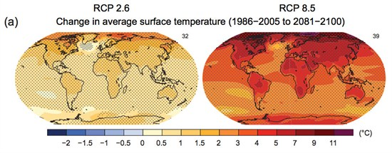

Slide 10
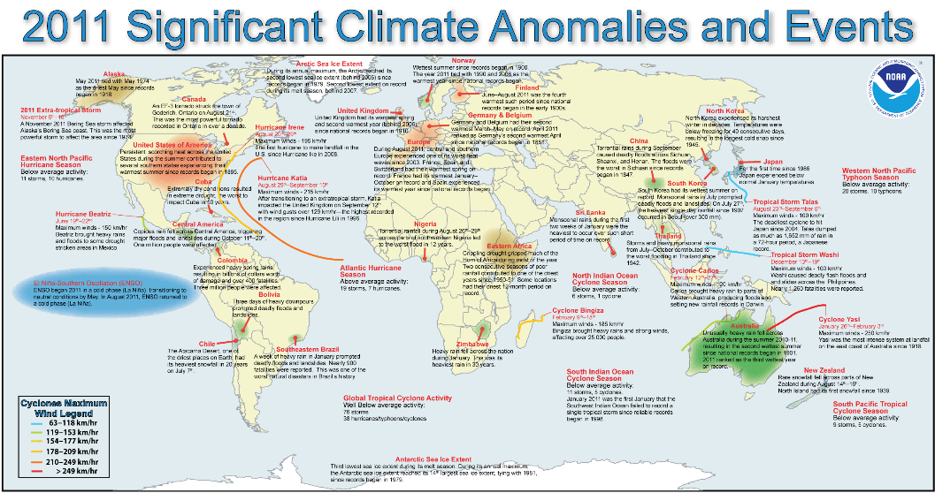

Slide 11
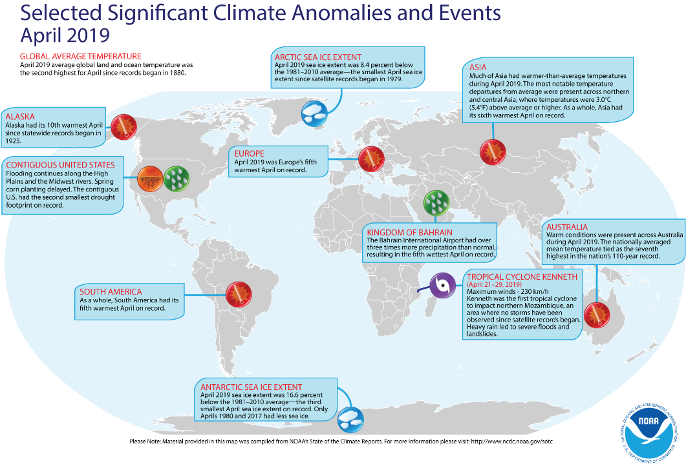

Slide 12
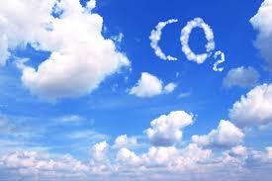
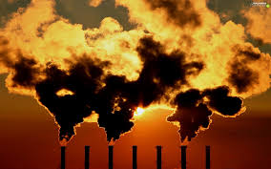
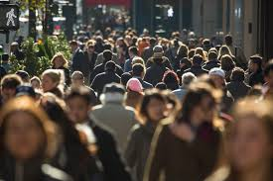
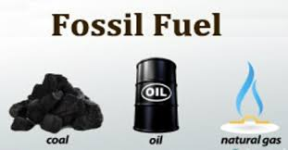
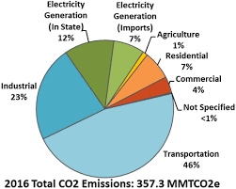
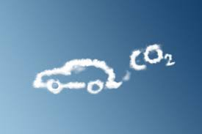
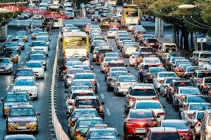
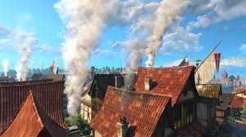
Who and what is a culprit?

Slide 13
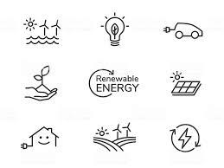
What can we do?
The answer is; use the power of nature and renowable energy sources

Slide 14
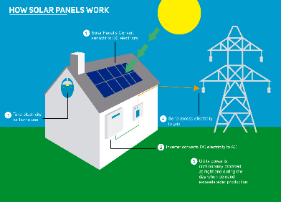
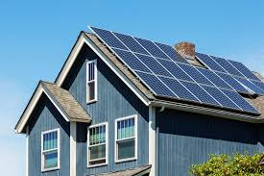
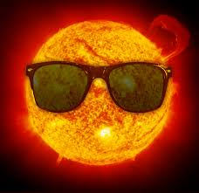
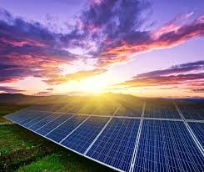
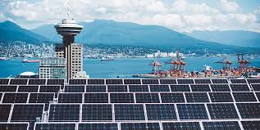
The power of the sun

Slide 15
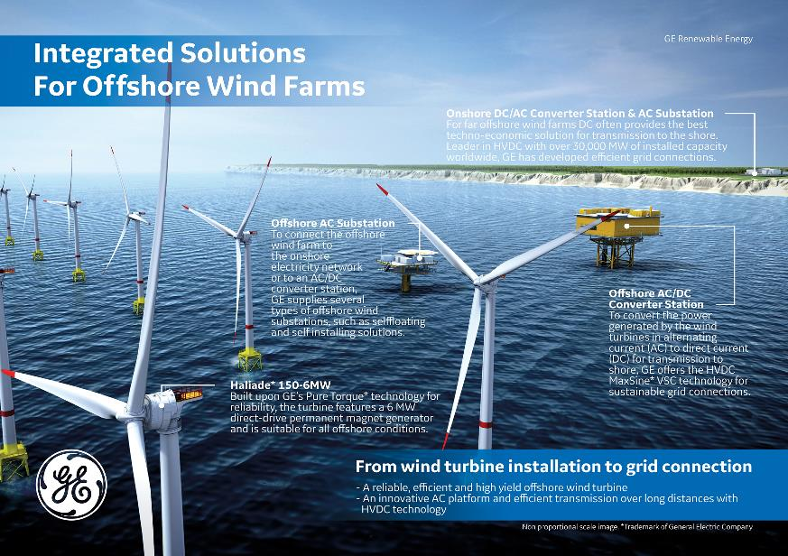
The wind energy

Slide 16
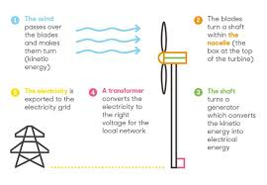
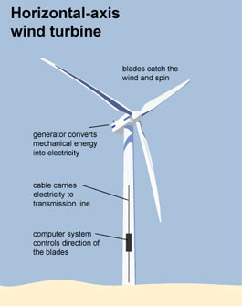
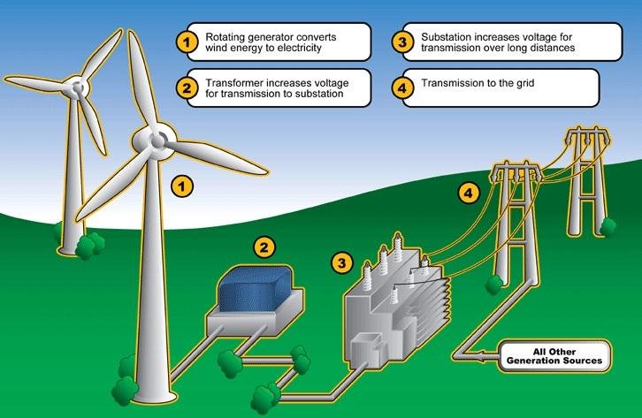

Slide 17
The water energy

Slide 18
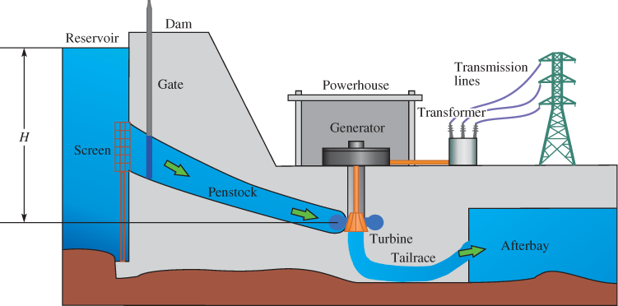

Slide 19
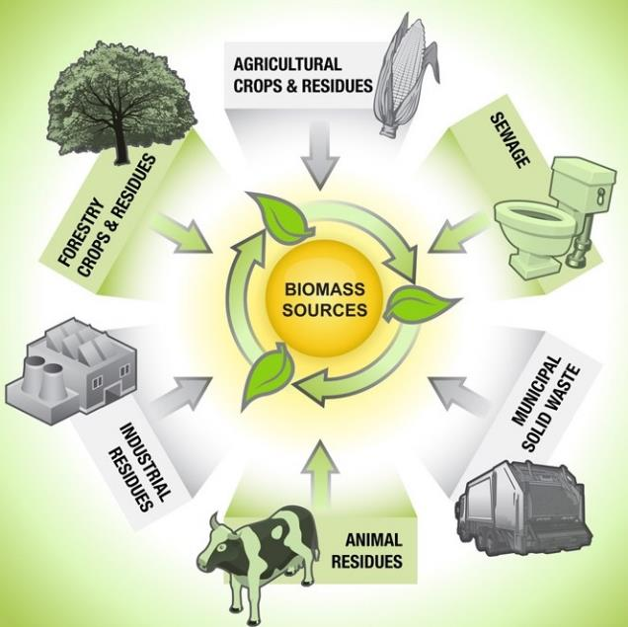
Biomass

Slide 20
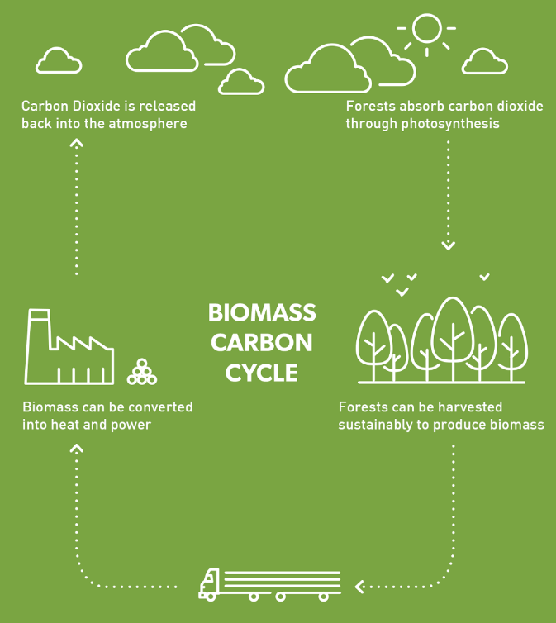

Slide 21
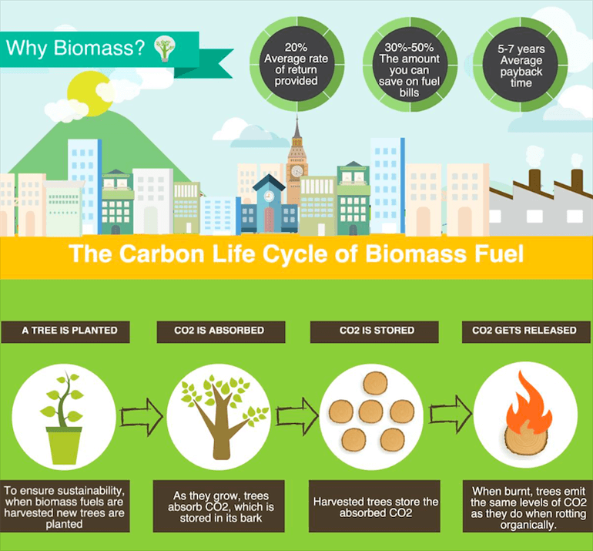

Slide 22
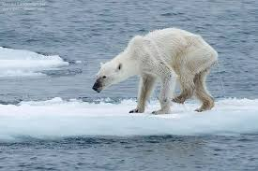
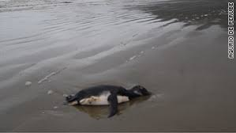
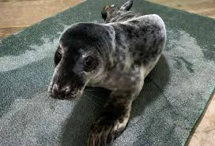
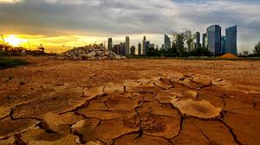
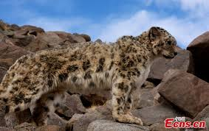
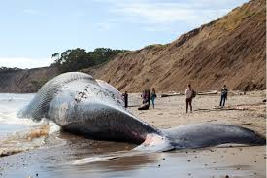
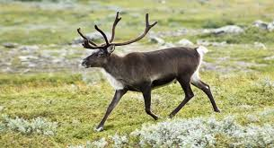
If we do nothing….

Slide 23
Sources:
Internet
„Zero carbon city” – British Council Project 2005 (own materials).

