Slide 1
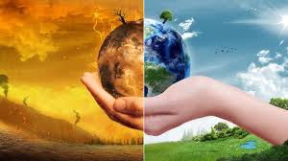
GLOBAL WARMING, GREENHOUSE EFFECT AND RENEWABLE SOURCES OF ENERGY
ΧΑΡΗΣ ΑΝΤΩΝΑΚΟΣ
ΤΜΗΜΑ: Β’3
ΣΧΟΛΙΚΟ ΕΤΟΣ: 2018-2019

Slide 2
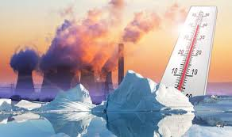
GLOBAL WARMING
Global warming is a long-term rise in the average temperature of Earth, caused mainly by emissions of greenhouse gasses in the modern industrial economy.

Slide 3
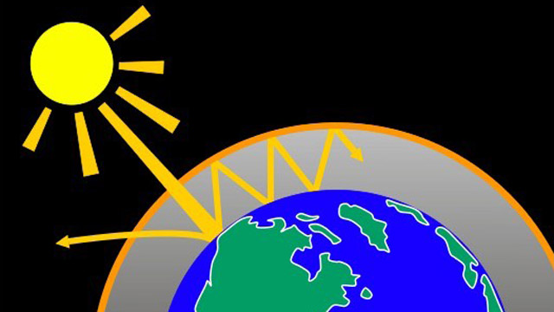
GREENHOUSE EFFECT
The greenhouse effect is a process that occurs when gasses in Earth's atmosphere trap the Sun's heat. This process makes Earth much warmer than it would be without atmosphere.

Slide 4
RENEWABLE SOURCES OF ENERGY
Renewable Energy Sources (RES) are energy sources which are continually renewed by the cycle of nature and are considered to be practically inexhaustible.

Slide 5
HYDROELECTRICITY
Hydroelectricity is electricity produced from hydropower. Τhe cost of hydroelectricity is relatively low, making it a competitive source of renewable electricity. The hydro station consumes no water, unlike coal or gas plants.

Slide 6
SOLAR POWER
Solar power is the conversion of energy from sunlight into electricity, directly using photovoltaics (PV) or indirectly using concentrated solar power. or a combination of the two.
Concentrated solar power systems use lenses or mirrors and tracking systems to focus a large area of sunlight into a small beam. Photovoltaic cells convert light into an electric current using the photovoltaic effect.

Slide 7
WIND POWER
Wind power is the use of air flow through wind turbines to provide the mechanical power to turn electric generators. Wind power, as an alternative to burning fossil fuels, is plentiful, renewable, widely distributed, clean, produces no greenhouse gas emissions during operation, consumes no water, and uses little land. The net effects on the environment are far less problematic than those of fossil fuel sources.

Slide 8
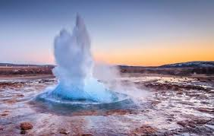
GEOTHERMAL ENERGY
Geothermal energy is thermal energy generated and stored in the Earth. Thermal energy is the energy that determines the temperature of matter. The geothermal energy of the Earth's crust originates from the original formation of the planet.

Slide 9
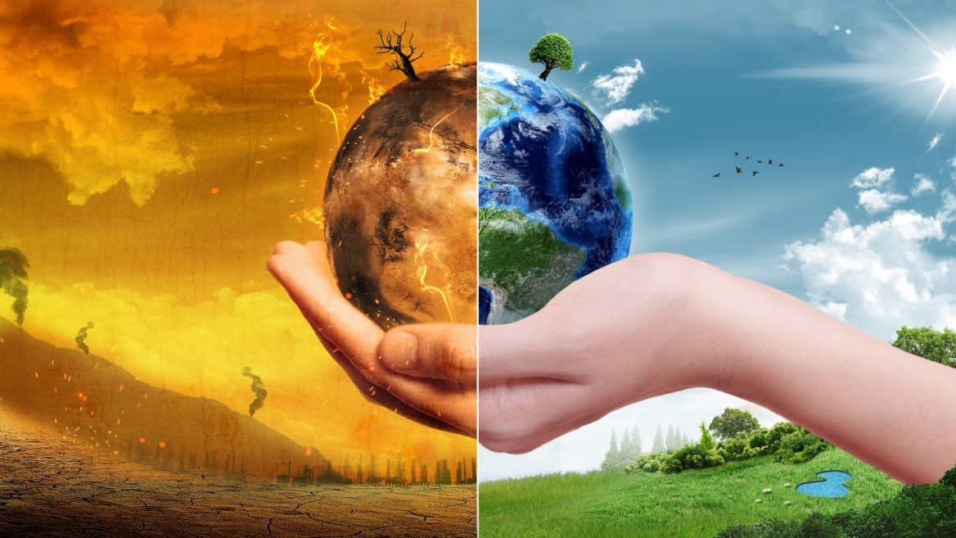
THANK YOU

