Slide 1
GLOBAL WARMING AND GREENHOUSE EFFECT
Alytaus r. Simno gimnazija Erasmus+ project 2018-2020 Stop Climat Change – Together Europe Achieves More
Greta Tamulynaitė IIIag

Slide 2
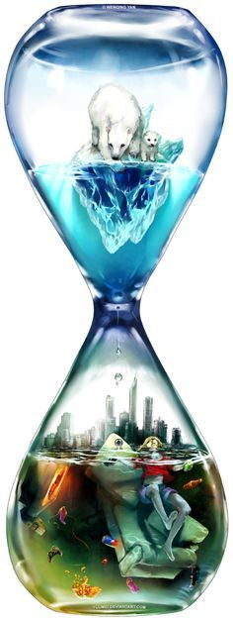
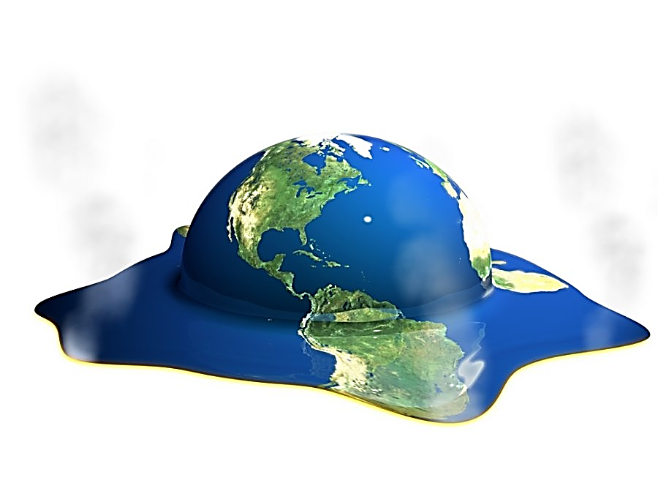
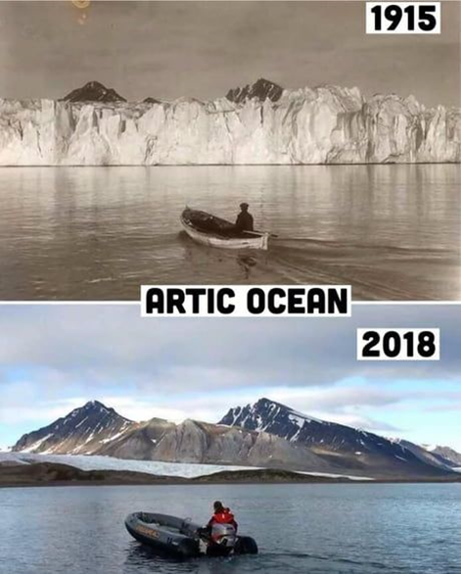
Global warming is a long-term rise in the average temperature of the Earth's climate system, an aspect of climate change shown by temperature measurements and by multiple effects of the warming.

Slide 3
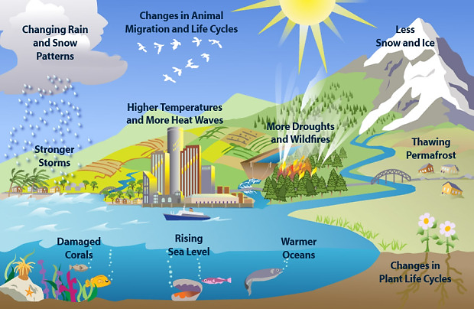
Consequences

Slide 4
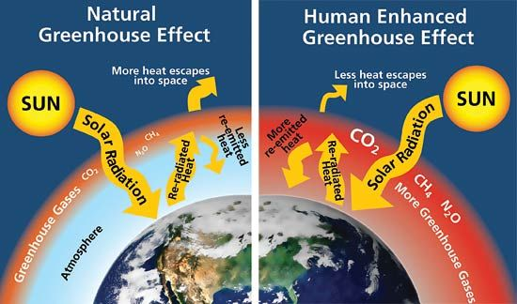

Slide 5
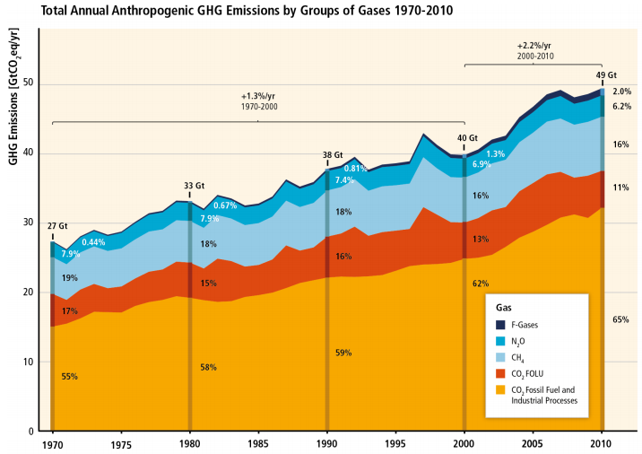

Slide 6
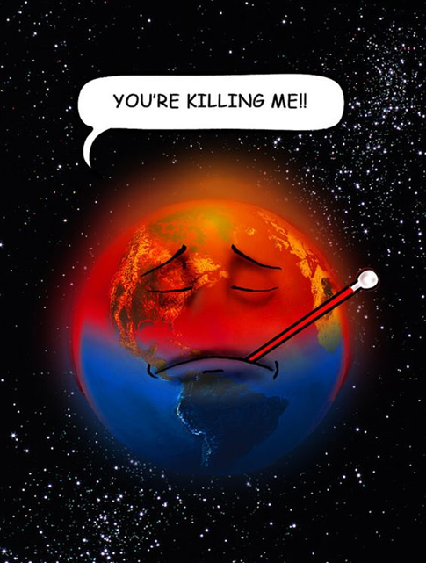
Result
People will be forced to hide from solar ultraviolet radiance
Ice will be completely dissolved, ocean levels will rise by 68-70 m.
Cities like London or New York will be underwater
Countries such as Denmark, Netherlands and Bangladesh will disappear
The Mediterranean sea will be a disastrous drought
There will be increased acidity precipitation zone in europe

Slide 7
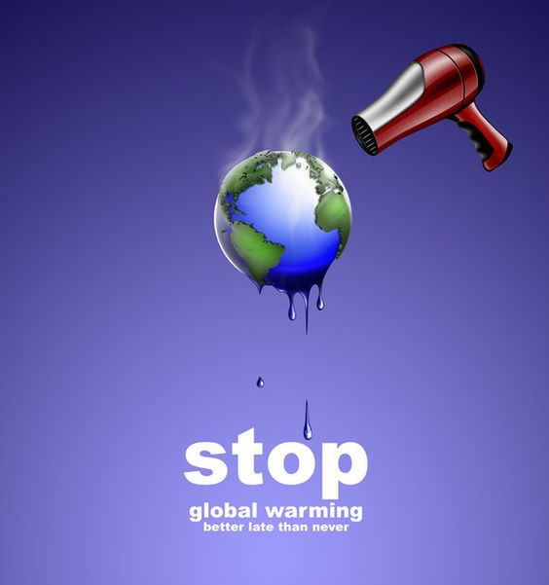
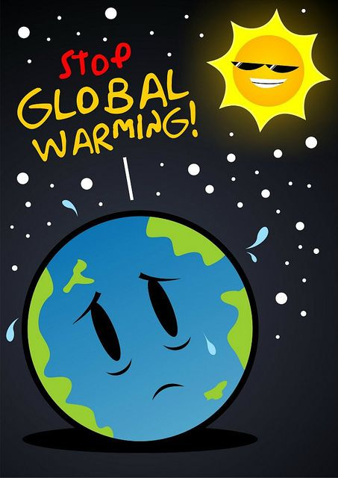
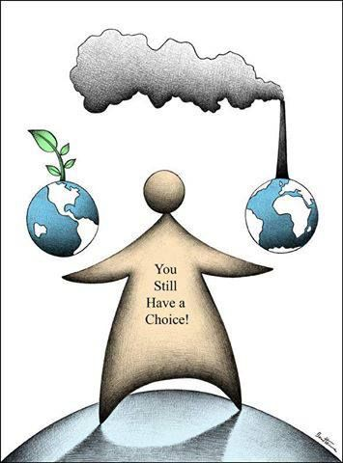
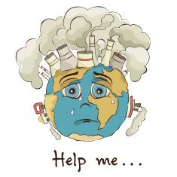

Slide 8
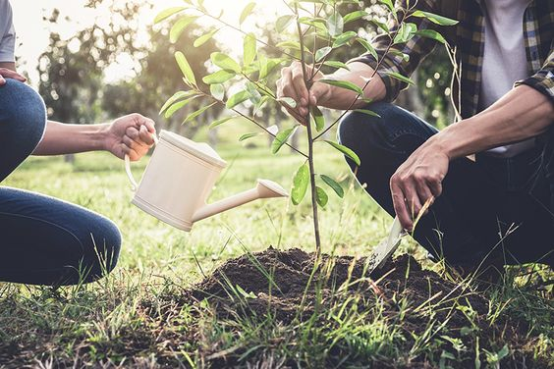
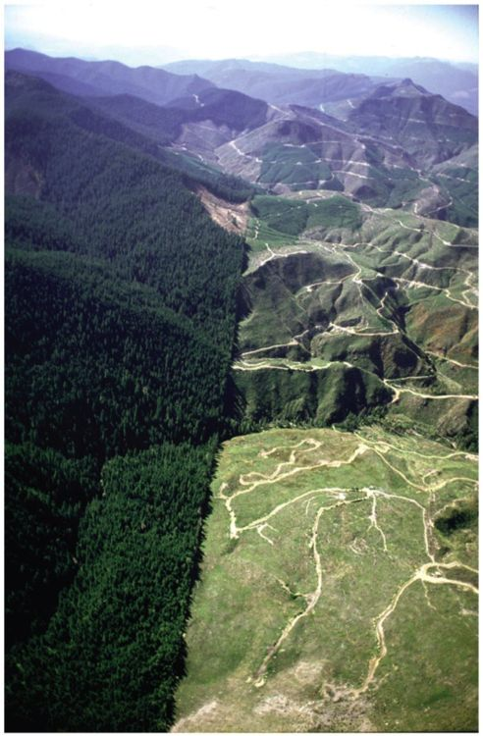
Plant a tree
Recycle your organic waste
Buy organic foods as much as possible
Protect and conserve forest worldwide
Reuse your shopping bag

Slide 9
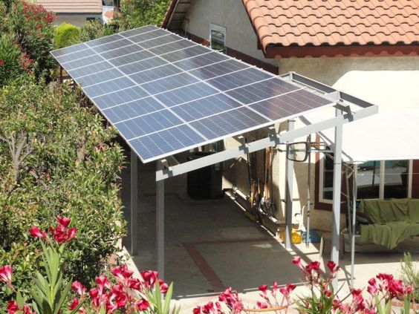
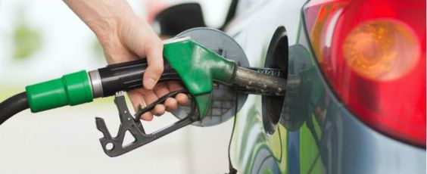
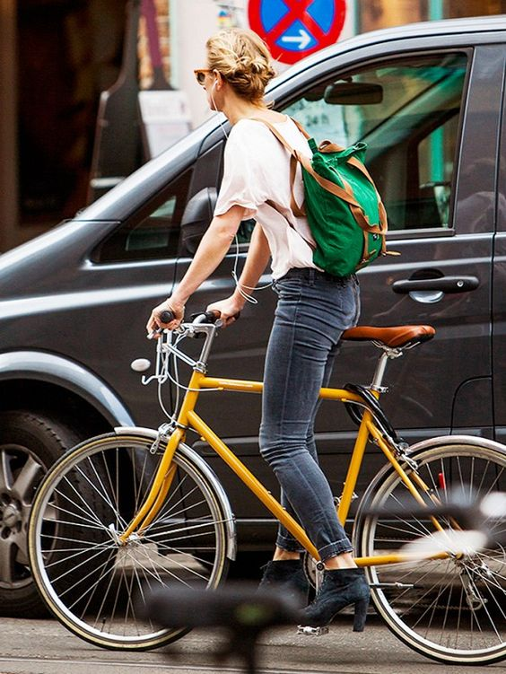
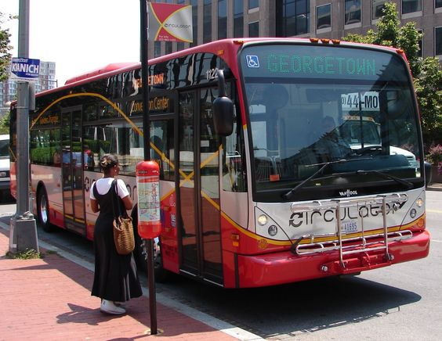
Suggest your parents to buy a fuel-smart car
Choose energy efficient appliances when making new purchases
Consider public transportation alternatives
Ride a bike
Use both sides of paper
Clean or replace filters on your furnace and air conditioner

