Slide 1
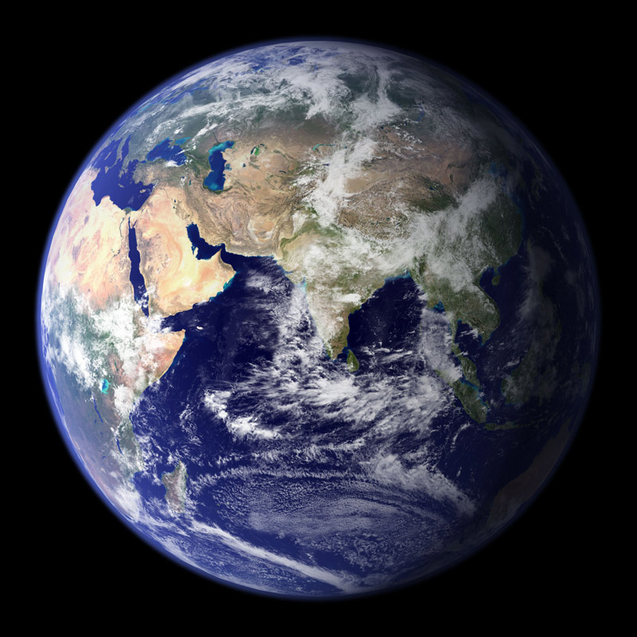
GLOBAL WARMING-GREENHOUSE EFFECT-RENEWABLE SOURCES OF ENERGY
SEREMETAKI OLGA

Slide 2
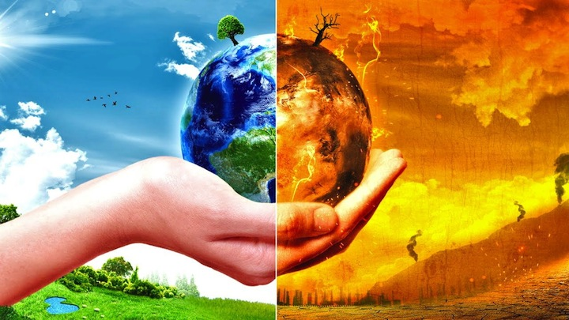
GLOBAL WARMING
Global warming is the unusual increase of temperature in the Earth’s surface. Global warming is when the Sun's energy enters the atmosphere and heats the Earth by light waves. The energy warms the Earth, and then re-radiates infrared waves back into space. Some of the infrared radiation going into space is naturally trapped by the atmosphere, which keeps the temperatures on Earth moderate. The thin layer of Earth's atmosphere is now being thickened by large amounts of human-caused greenhouse gases, like carbon dioxide.

Slide 3
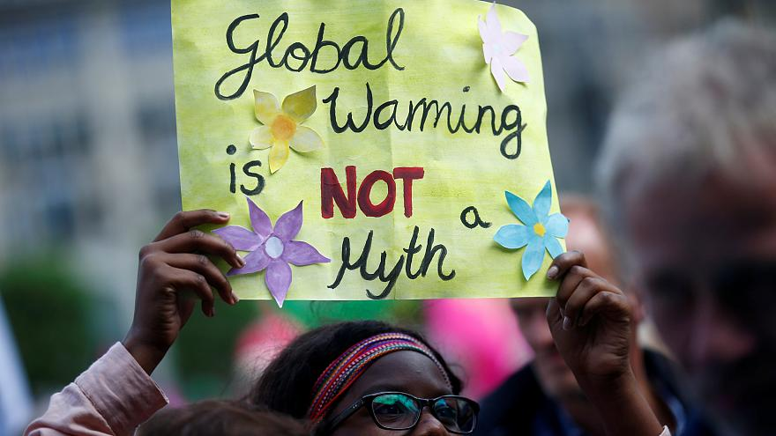
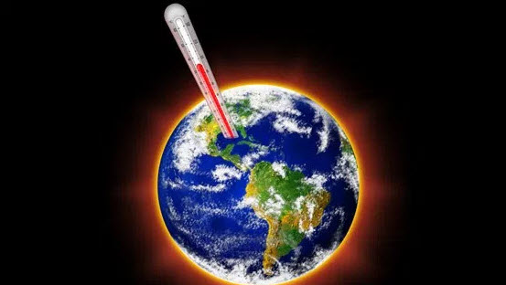
The thickening of Earth's atmosphere traps the infrared radiation, which then warms the temperature of Earth's atmosphere and oceans. Over the past century the temperature has been rapidly increasing because of greenhouse gases caused by burning fossil fuels.

Slide 4
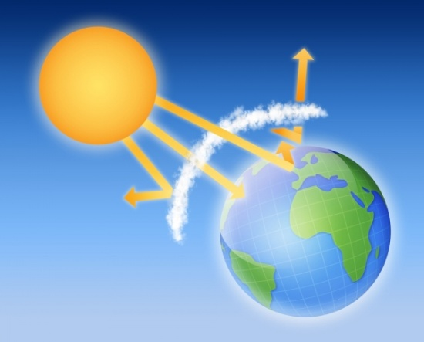
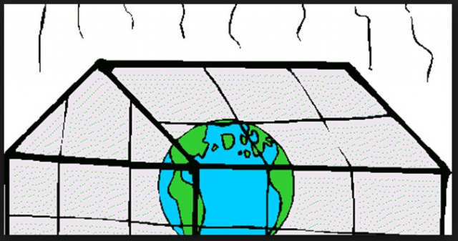
THE GREENHOUSE EFFECT
The greenhouse effect is a process that occurs when gases in Earth's atmosphere trap the Sun's heat. This process makes Earth much warmer than it would be without an atmosphere. The greenhouse effect is one of the things that makes Earth a comfortable place to live.

Slide 5
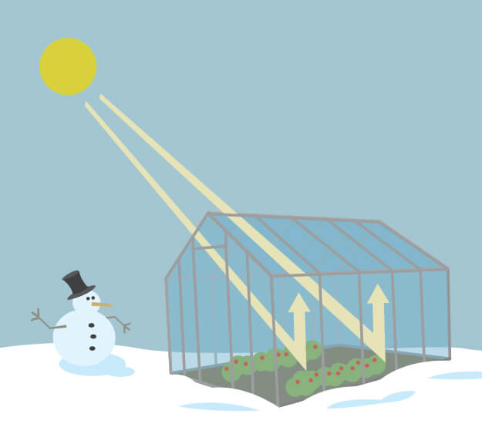
How does the greenhouse effect work?
As you might expect from the name, the greenhouse effect works … like a greenhouse! A greenhouse is a building with glass walls and a glass roof. Greenhouses are used to grow plants, such as tomatoes and tropical flowers.
A greenhouse stays warm inside, even during the winter. In the daytime, sunlight shines into the greenhouse and warms the plants and air inside. At nighttime, it's colder outside, but the greenhouse stays pretty warm inside. That's because the glass walls of the greenhouse trap the Sun's heat.

Slide 6
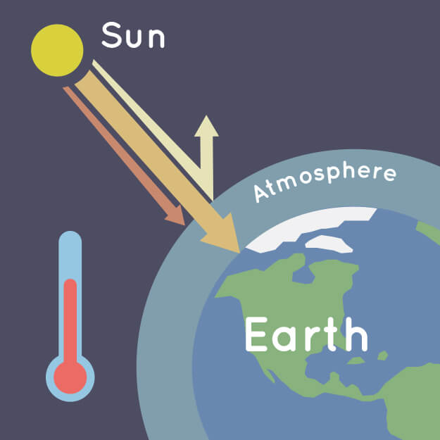
The greenhouse effect works much the same way on Earth. Gases in the atmosphere, such as carbon dioxide, trap heat just like the glass roof of a greenhouse. These heat-trapping gases are called greenhouse gases.
During the day, the Sun shines through the atmosphere. Earth's surface warms up in the sunlight. At night, Earth's surface cools, releasing heat back into the air. But some of the heat is trapped by the greenhouse gases in the atmosphere.

Slide 7
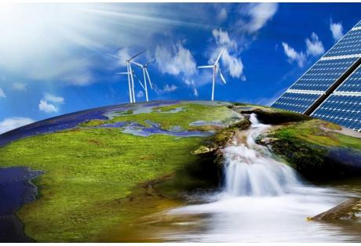
RENEWABLE SOURCES OF ENERGY
What is renewable energy?
Renewable energy is energy from sources that are naturally replenishing but flow-limited. They are virtually inexhaustible in duration but limited in the amount of energy that is available per unit of time.
Some sources of energy are:
Wind energy
Hydroelectric power
Biomass
Solar energy e.t.c

Slide 8
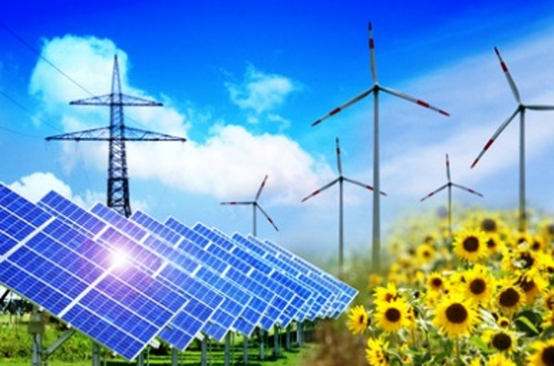
Advantages of renewable energy:
1.Renewable energy won’t run out.
2. Maintenance requirements are lower.
3. Renewables save money.
4. Renewable energy has numerous health and environmental benefits.
5. Renewables lower reliance on foreign energy sources.

